Slide 1
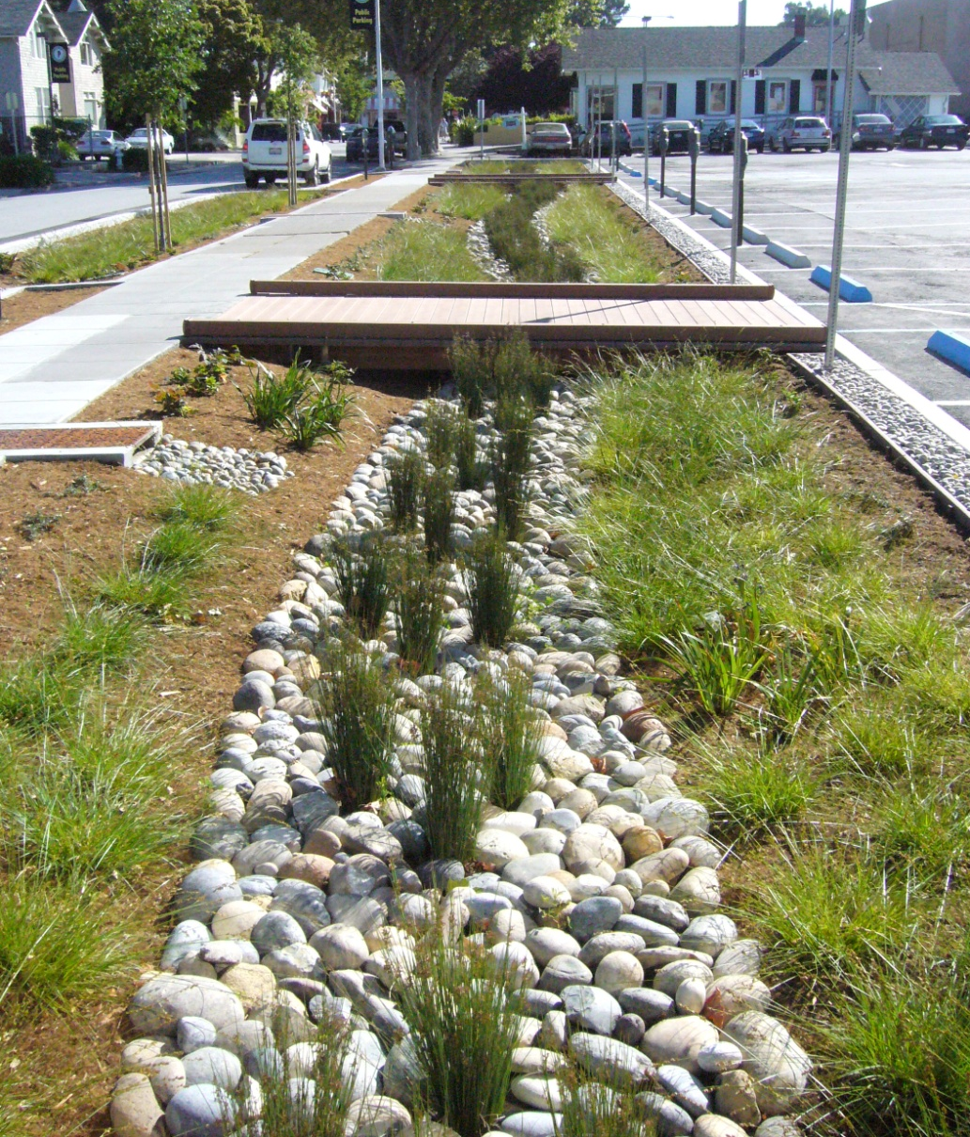

City of Burlingame
Rain Garden

Slide 2
Agenda
Location
Project History and Design
Rain Garden – parking lot
Drainage – storm runoff
Curb Extension – street runoff
Landscaping – California natives
Construction – changes in field
Financing - grant
Interpretive Sign
Lessons Learned

Slide 3
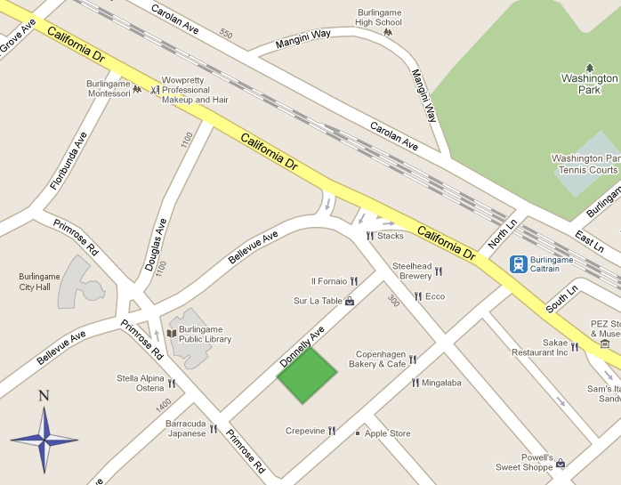
Location – Downtown Burlingame
Project Location

Slide 4
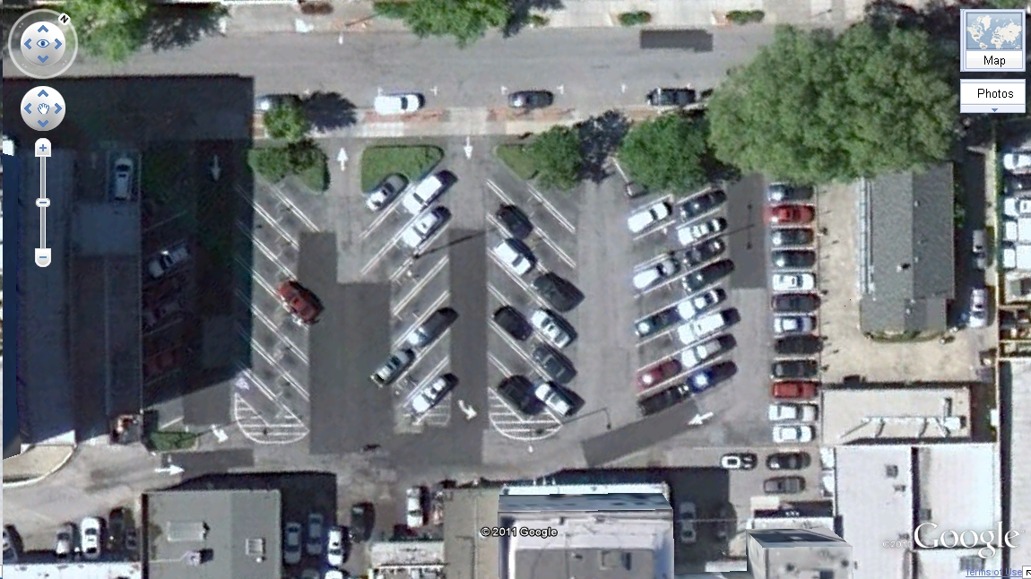
Project History and Design
Existing parking lot with on-street parking behind shopping district

Slide 5
Public Parking Lot C

Slide 6
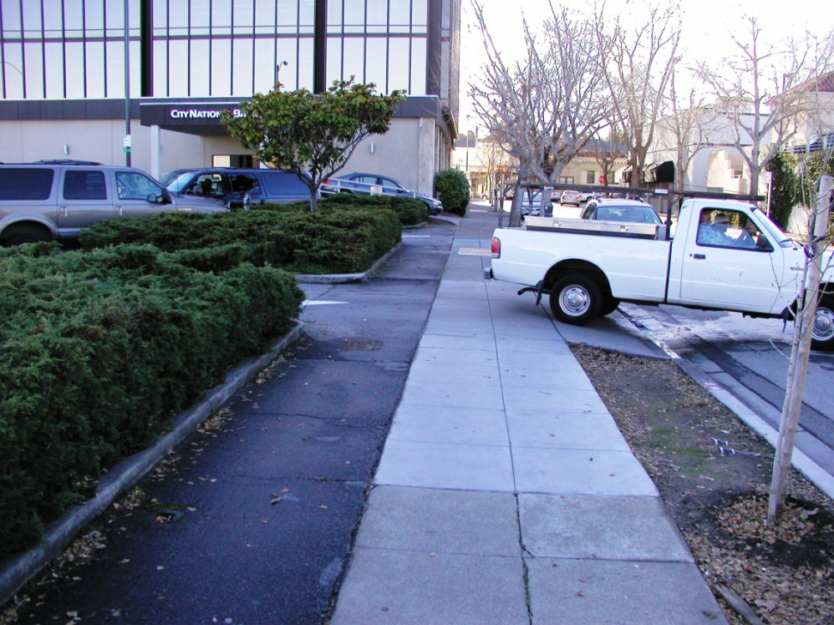
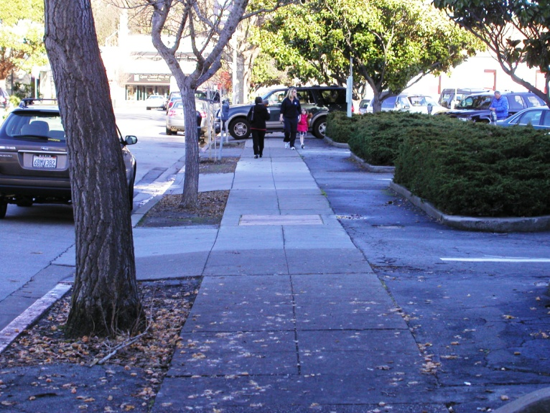
Existing Conditions
Multiple driveways
Original landscaping

Slide 7
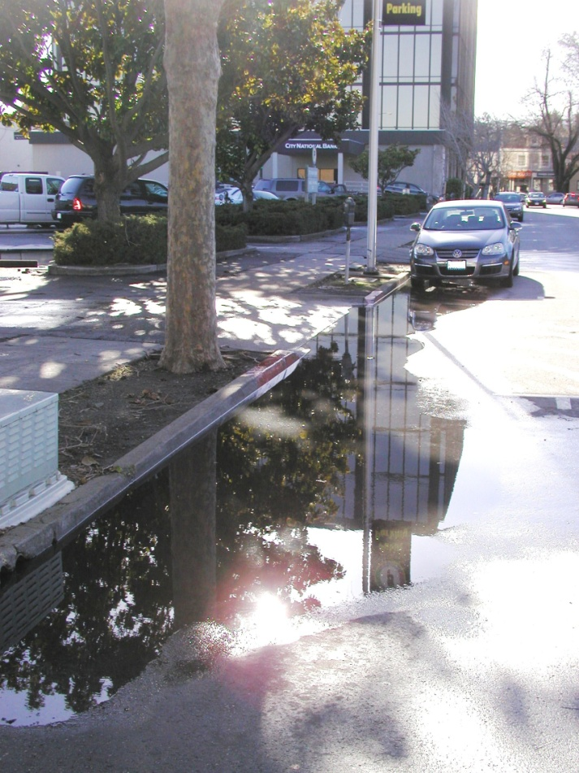
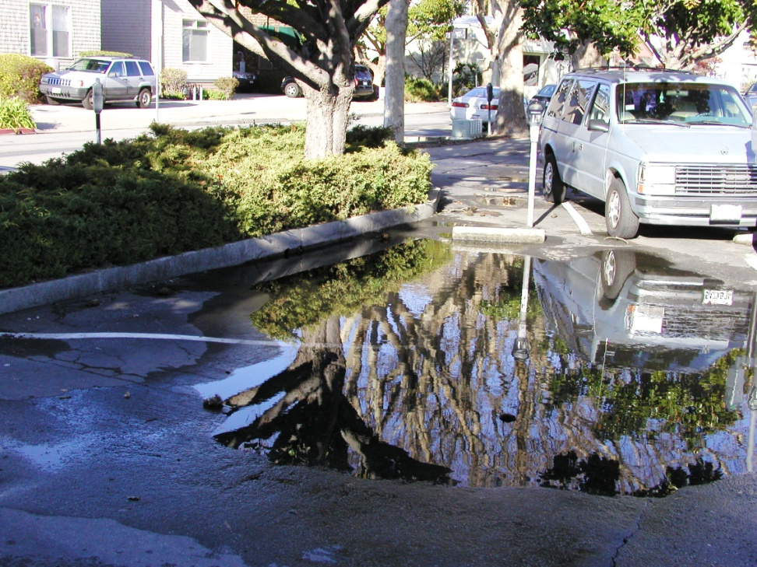
Poor Drainage
Street runoff collects in gutter
Parking lot drainage ponds

Slide 8
RAIN GARDEN
Reconfigure parking lot with two entrances and 90 degree stalls
Capture 16’ x 160’ area for bioswale
Design for 4’ wide channel at 5”-6” deep
California native landscaping
Irrigation for first few years only, by contractor choice
Two boardwalks for pedestrian access to parking lot

Slide 9
Layout of Redesigned Parking Lot

Slide 10
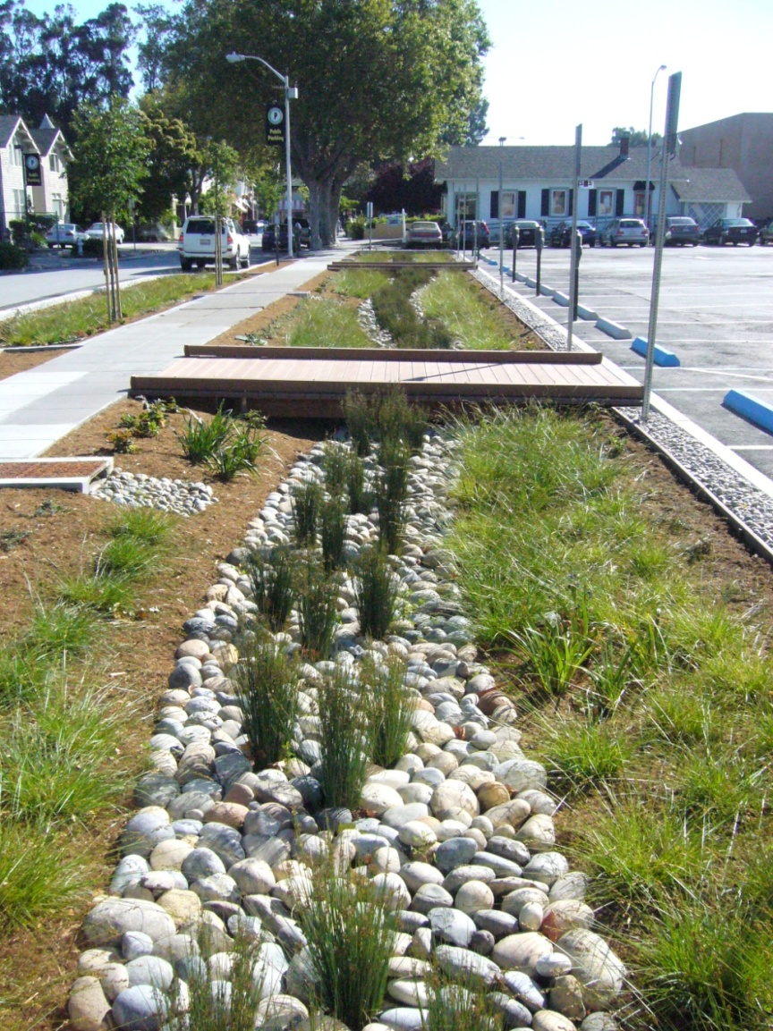
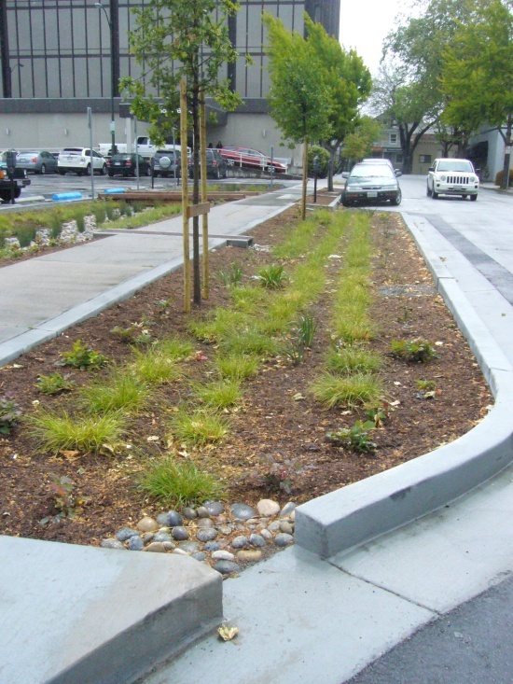
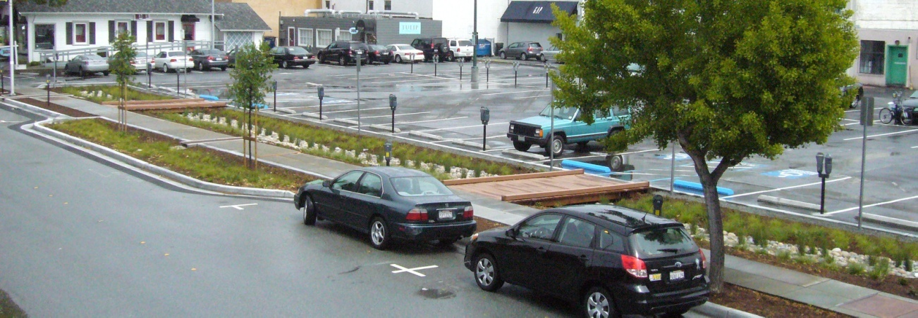
Rain Garden
Photos

Slide 11
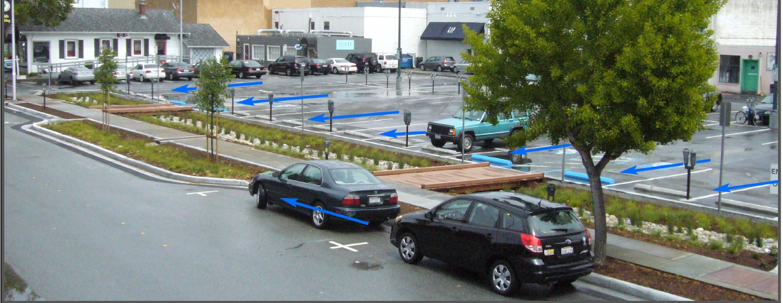
STORM DRAINAGE
Captures runoff from commercial buildings and parking lot
1.32 acres of runoff equals 0.25 cfs for a 30 year event
Designed for 0.43 cfs – almost twice the required C3 guidelines
Overflow to curb for 50 to 100 year storm event

Slide 12
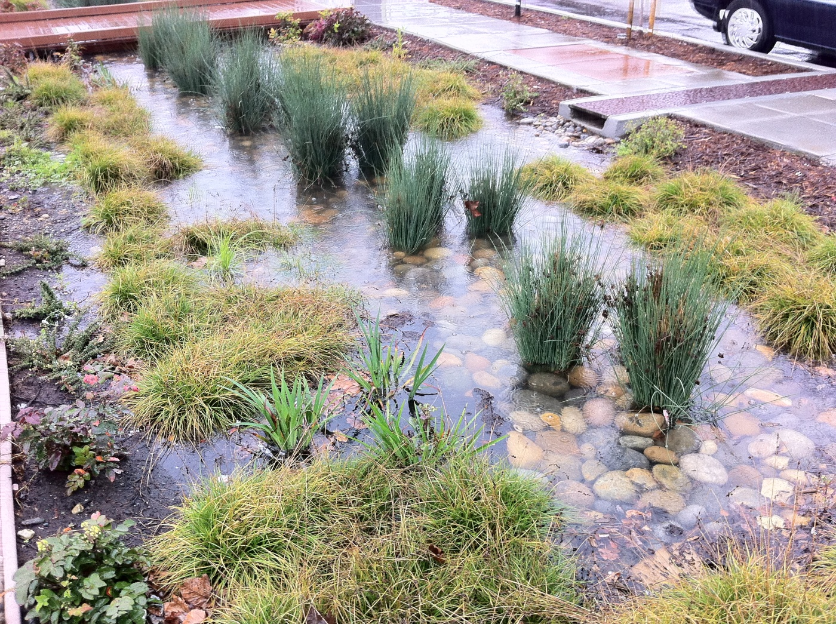
Rain Garden - runoff

Slide 13
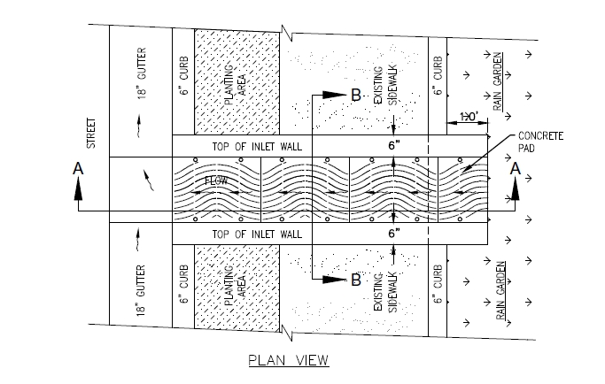
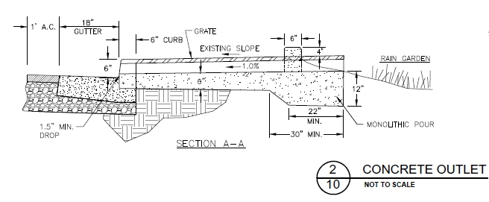
Overflow to street

Slide 14
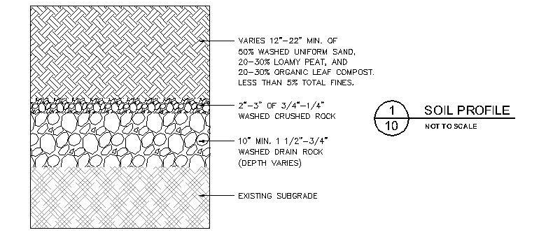
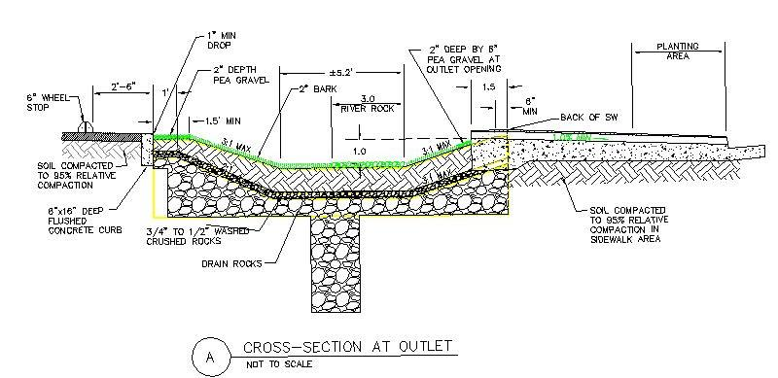
Cross Sections

Slide 15
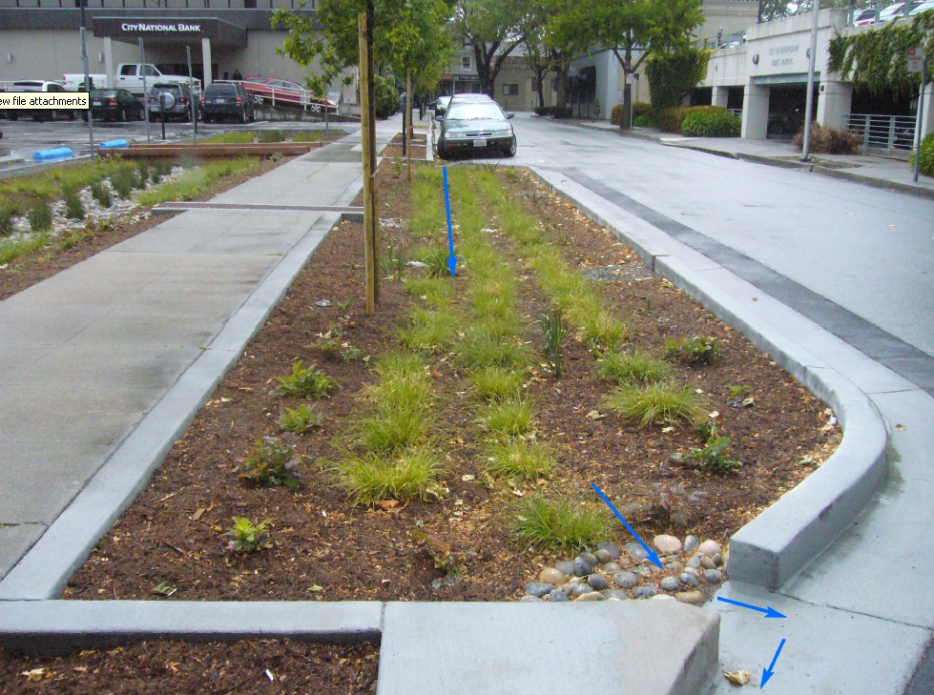
CURB EXTENSION
Captures Runoff from Street and Parking Stalls
0.11 acres of runoff at 0.285 cfs – design for 0.33 cfs exceeding C3 guidelines.
Treats overflows from center cell of garden as well

Slide 16
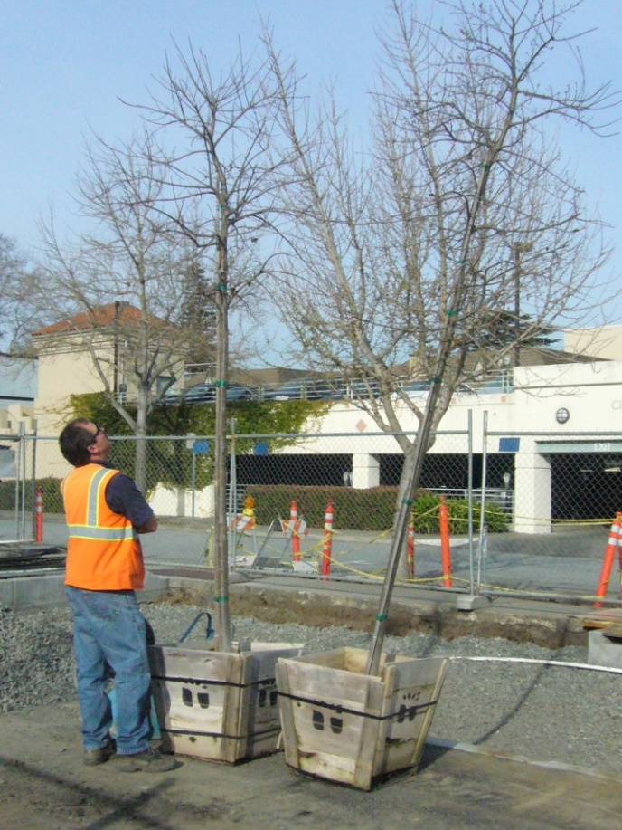
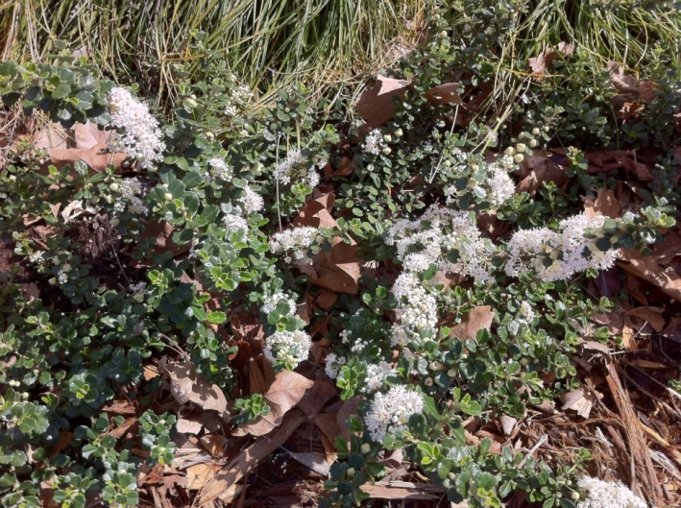
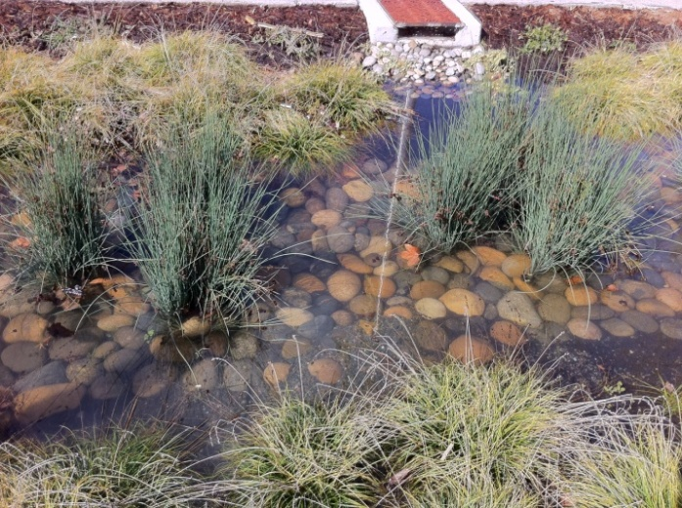
LANDSCAPING
All plants are California Natives
Includes Rush, Sedges, Carmel Creeper or Ceanothus, Iris, Barberry and Buckwheat
Tree specified was native Hackberrys - could not find and used Valley Oaks
Irrigation for first few years only -contractor installed as part of 6 month maintenance period
Use mulch that knits together not bark that floats
Valley Oak Trees
White flowering Ceanothus
Rushes and Sedges

Slide 17
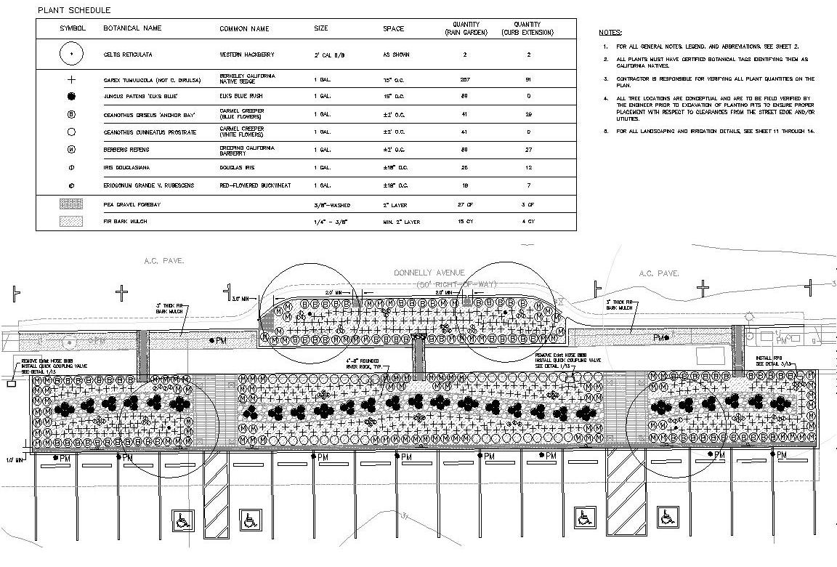
Landscape Plan

Slide 18
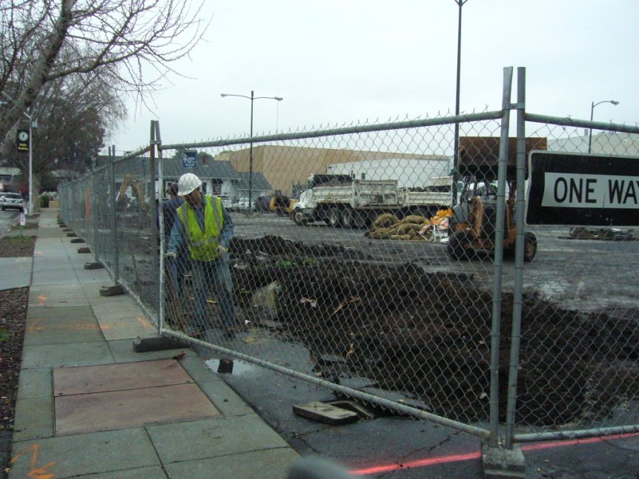
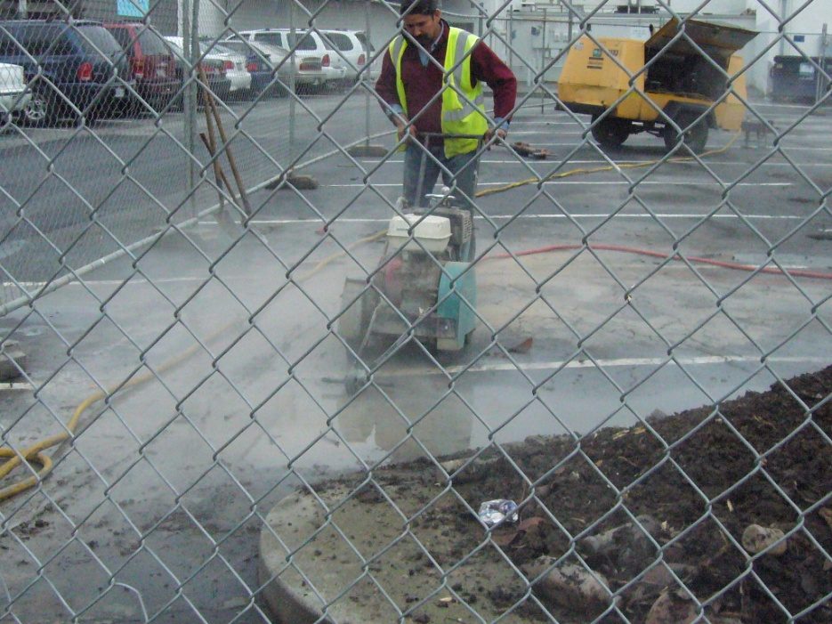
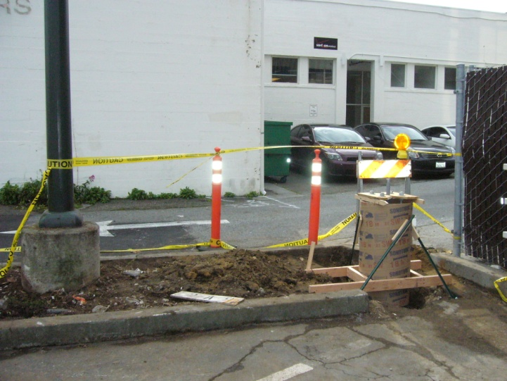
CONSTRUCTION
• Demolition of parking lot
• Relocation of lights
• Restriping of parking

Slide 19
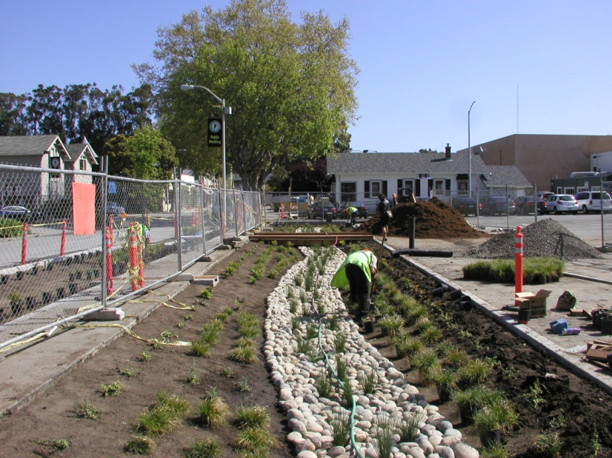
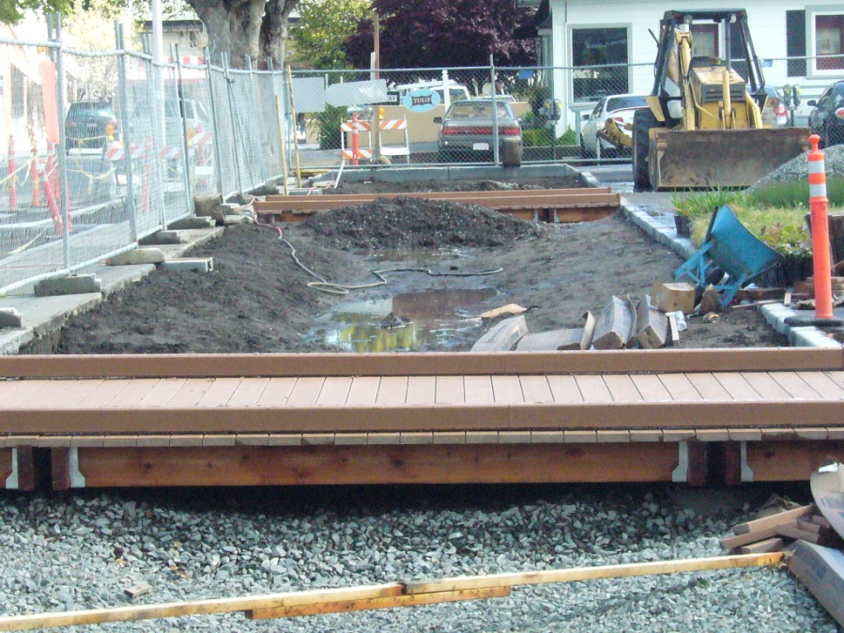
Construction - continued
• Excavation
• Installation of rock
• Boardwalks
• Topsoil
• Landscaping
• Irrigation

Slide 20

Financing
Grant from San Mateo County Storm Water Pollution Prevention
Cost – about $270,000 for design, engineering, and construction
Sustainable, Green Streets and Parking Lots program
Vehicle License Fees
Managed thru C/CAG

Slide 21
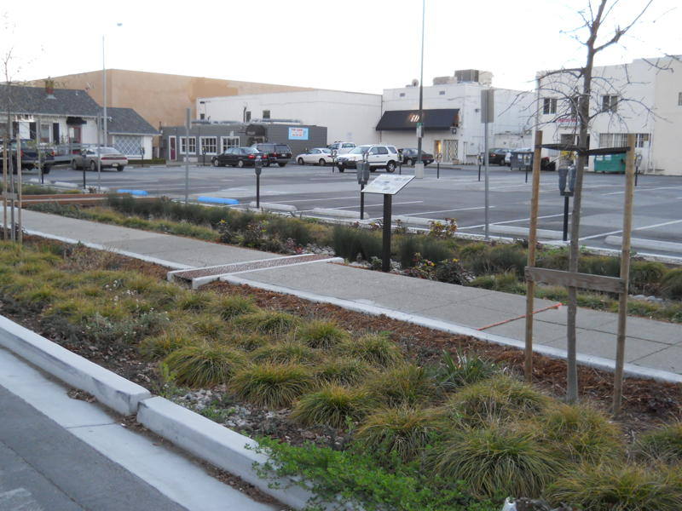
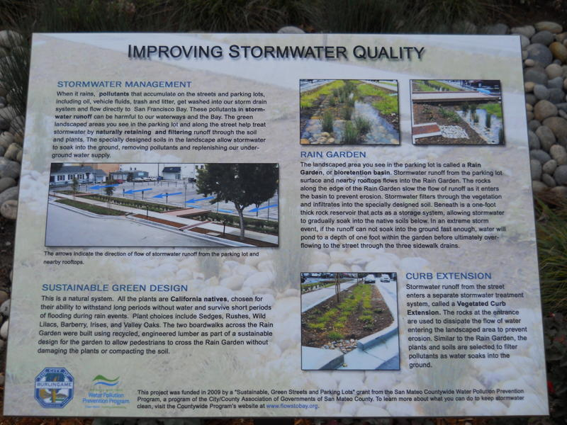
Interpretive Sign
• Educating the public
• Staff designed sign
• Ordered from the Web

Slide 22
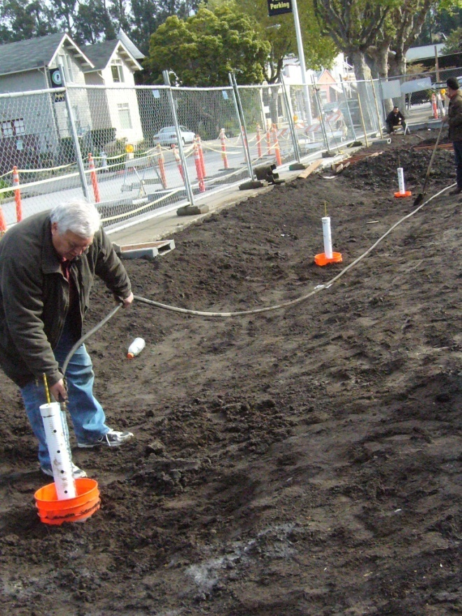
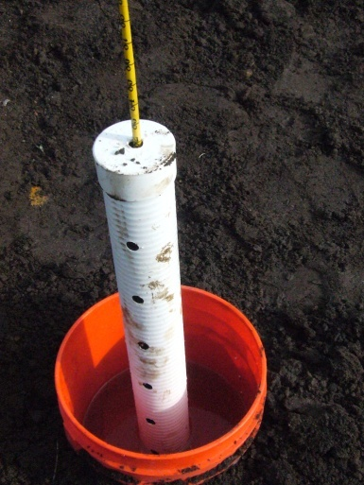
Lesson Learned: Infiltration Test
Percolation test did not work
Infiltration test did
Works like toilet float
Three tests through
out the site

Slide 23
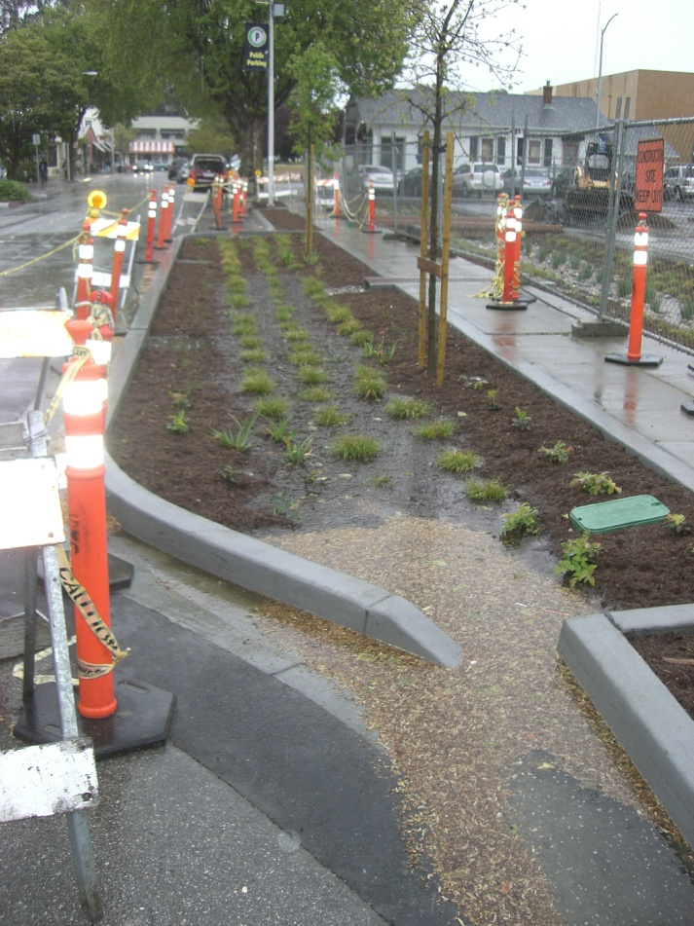
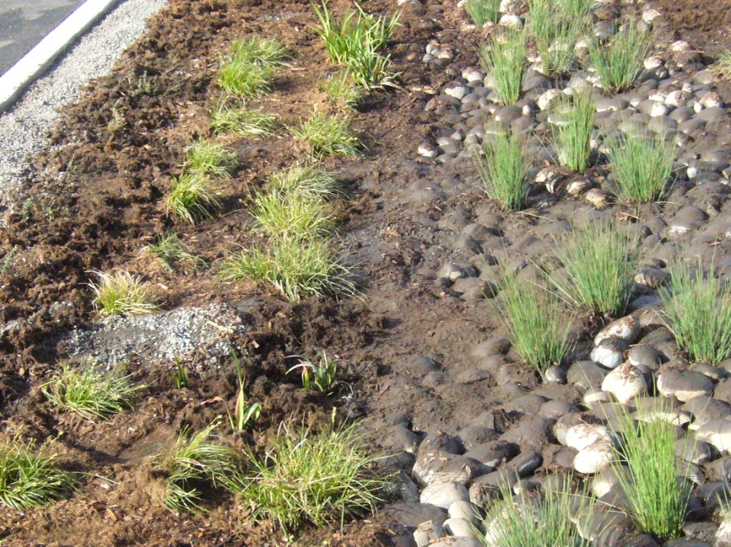
Lesson Learned continued
Erosion along edge
Gutter debris into curb extension – use rock not pea gravel

Slide 24
LESSONS LEARNED
Infiltration test for soil drainage
Added one foot rock strip to deter erosion
Enlarged rock storage area in swale
Include maintenance period and simple irrigation system
Check on plant availability
Contractor qualifications in specifications important

Slide 25
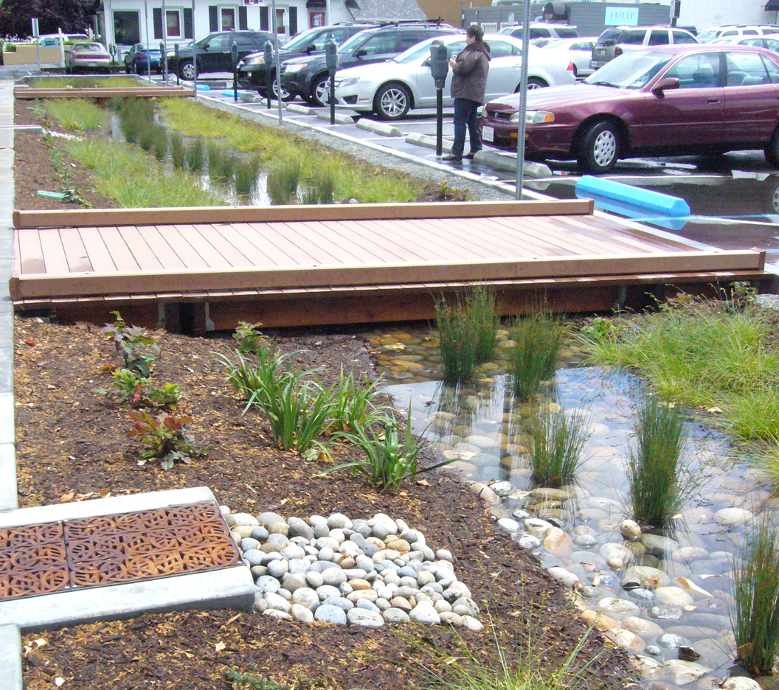
Questions and Comments
Thank you

