Slide 1
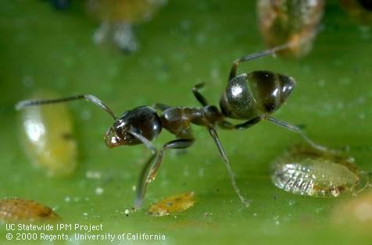
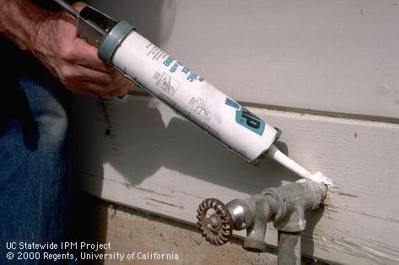
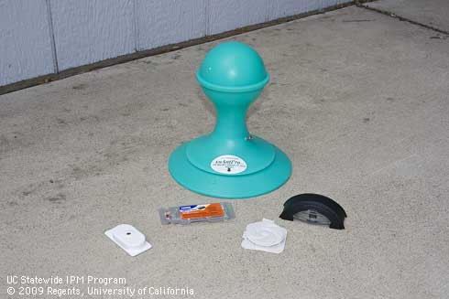
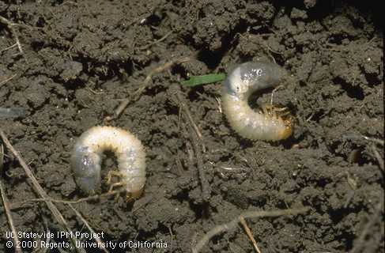
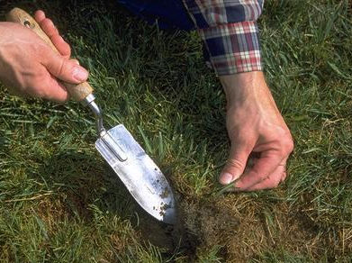
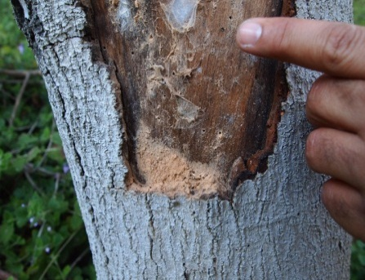
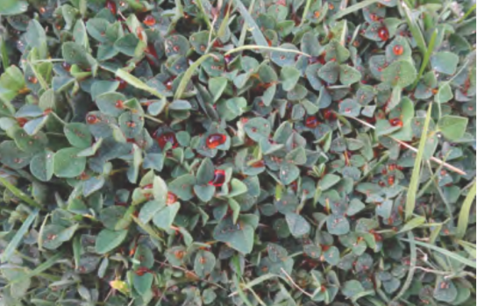

Adapting and applying the central tenets of IPM to urban ecosystems
Andrew Sutherland
Bay Area Urban IPM Advisor
UCCE and UC IPM
Statewide Integrated Pest Management Program

Slide 2

A new Advisor?!
Andrew Sutherland: Bay Area Urban IPM Advisor
  Alameda, Contra Costa, San Francisco, San Mateo, Santa Clara counties
  Professional / commercial landscape IPM
  Structural / industrial IPM
amsutherland@ucanr.edu
http://ucanr.edu/sites/urbanIPM/

Slide 3
Outline of presentation
The what, why, where and who of IPM
Central tenets of IPM
Urban case studies
  Invasive species
  IPM for urban ants
  IPM for white grubs
  Iron-based herbicides
UCCE and UC IPM resources

Slide 4
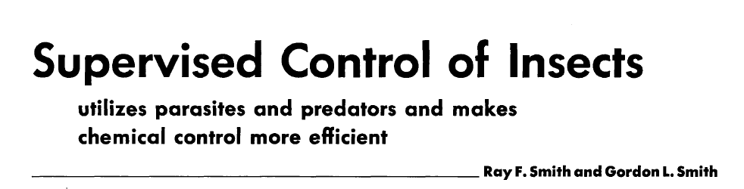
History of IPM
‘Supervised control’ 1949
  California agriculture / cotton belt producers
    Alfalfa, cotton
  Control ‘supervised’ by entomologists
  Applications made based on monitoring
  New alternative to calendar-based programs

Slide 5
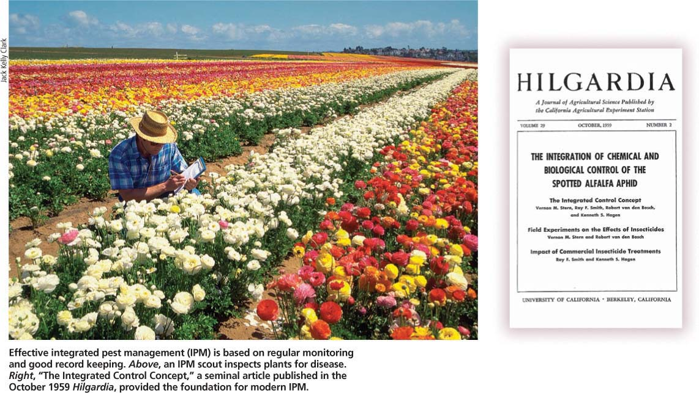
History of IPM
‘Integrated Control’ 1959
UC Berkeley, UC Riverside
‘Applied pest control which combines and integrates biological and chemical control. Chemical control is used as necessary and in a manner which is least disruptive to biological control. Integrated control may make use of naturally occurring biological control as well as biological control effected by manipulated or induced biotic agents’

Slide 6
Significant events in IPM history
1888: Hatch Act establishes land grant universities
1889: 1st highly successful classical biological control program
1892: Canada: law protecting bees from pesticide applications
1925: UK bans fruit imports from US due to lead arsenate res.
1939: DDT introduced
1947: 1st documented pesticide resistance (house fly / DDT)
1962: Silent Spring published by Rachel Carson
1970: US EPA founded by President Nixon

Slide 7
What exactly is integrated pest management (IPM)?
‘a decision-based process involving coordinated use of multiple tactics for optimizing the control of all classes of pests (insects, pathogens, weeds, vertebrates) in an ecologically and economically sound manner’
R.J. Prokopy, 2003

Slide 8
OK……so…
simultaneous management of multiple pests;
regular monitoring of pests, and their natural enemies and antagonists as well;
use of economic or treatment thresholds when applying pesticides;
integrated use of multiple, suppressive tactics.
L. E. Ehler, 2006

Slide 9
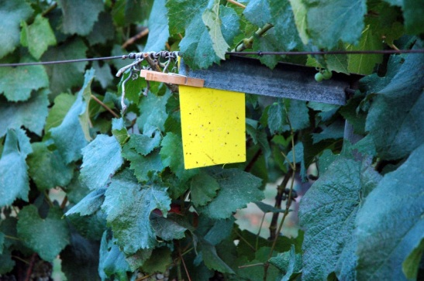
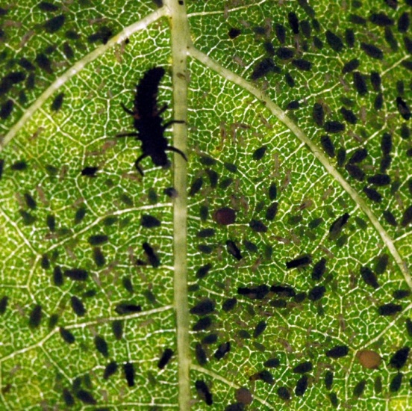
Central tenets of IPM
Education
Prevention
Monitoring
Treatment Thresholds
Multiple Tactics
Integration
Evaluation

Slide 10
Central tenets of IPM
Education
Prevention
Monitoring
Treatment Thresholds
Multiple Tactics
Integration
Evaluation

Slide 11
Why Urban IPM?
Urban surface water contamination levels (w / pesticides) 2 – 3 X higher than that of surface water in production ag areas
  Diazinon and chlorpyrifos (Bailey et al 2000)
  Pyrethroids (Weston et al 2005; Amweg et al 2006)
  Fipronil (Lin et al 2009)

Slide 12
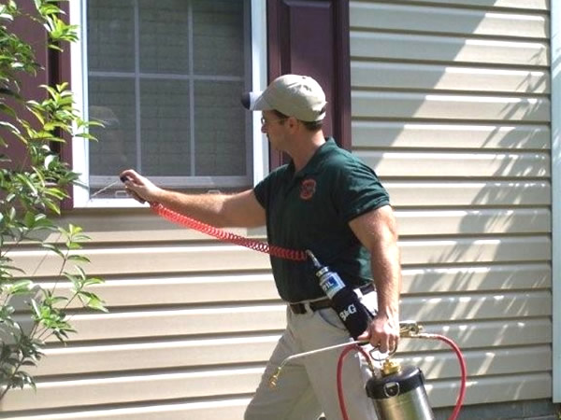
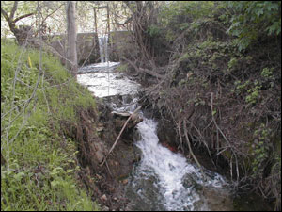
Problems with pesticide use in urban areas
Problems with pesticide use in urban areas
Surface water, soil, groundwater contamination
Human health concerns
Disruption of ecosystem
Economic costs
Public perception

Slide 13
Major users of pesticides in urban areas
General (residential) public
  Homeowners / tenants
  Property owners / managers
Pest management professionals (PMPs)
Government agencies
Agriculture
  Non-crop systems: ornamental nurseries
  Urban ag systems

Slide 14
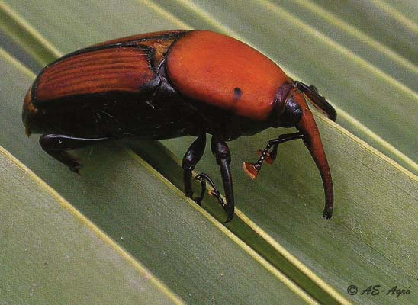
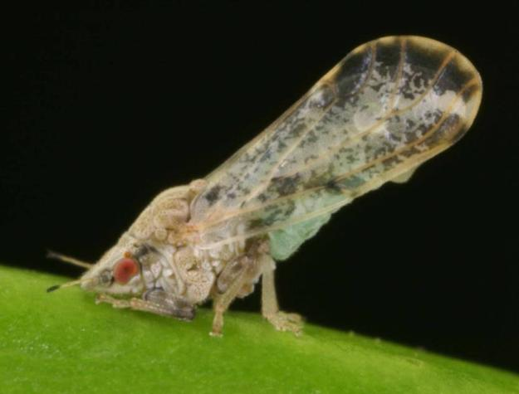
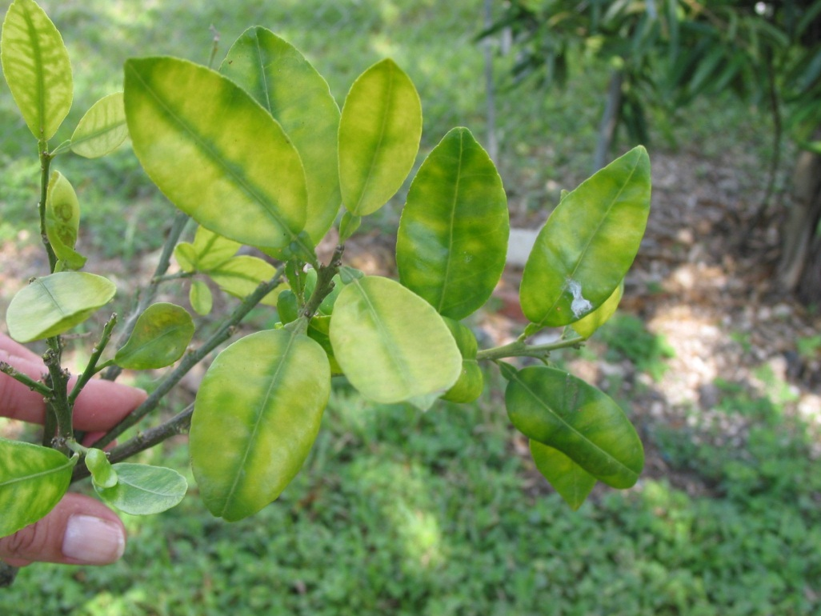
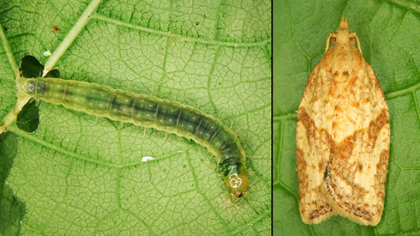
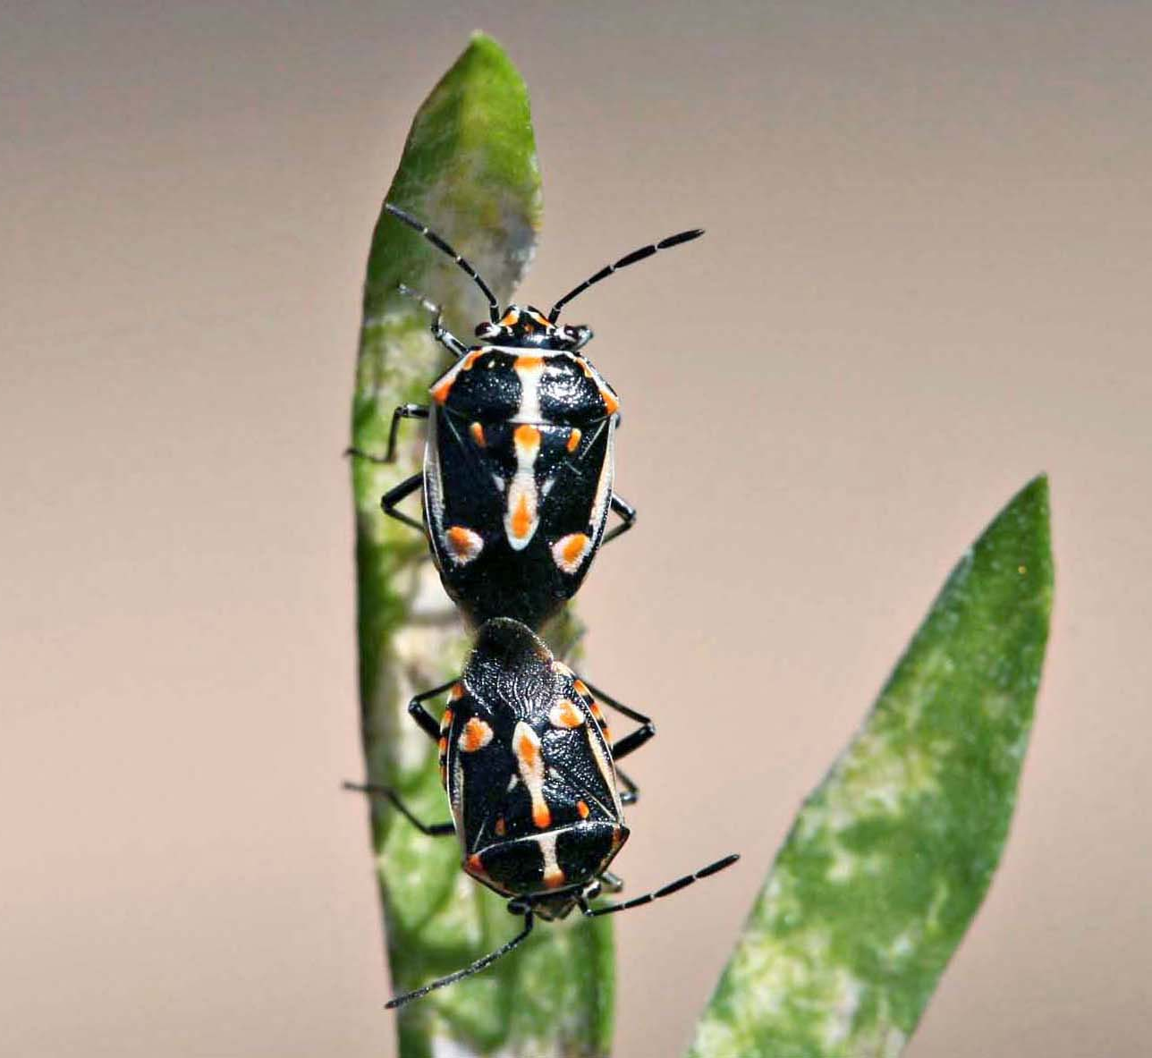
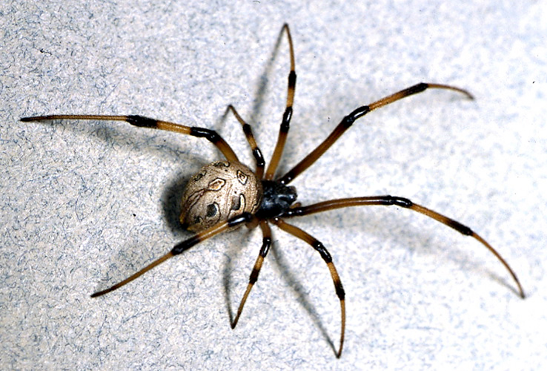
2008
2010
2007
2012
2008
2000

Slide 15
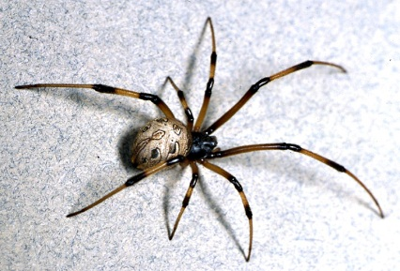
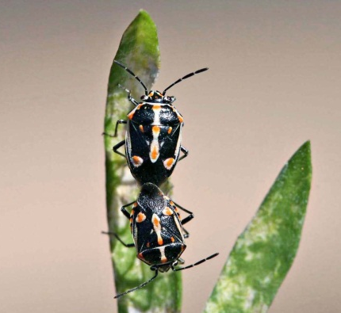

Urban IPM for invasive species
Education
Prevention
Monitoring
Treatment Thresholds
Multiple Tactics
Integration
Evaluation

Slide 16
Urban areas and invasion
High population density
International community
High rates of (global) travel
Urban ‘reservoir’ phenomenon
Urban public perception

Slide 17
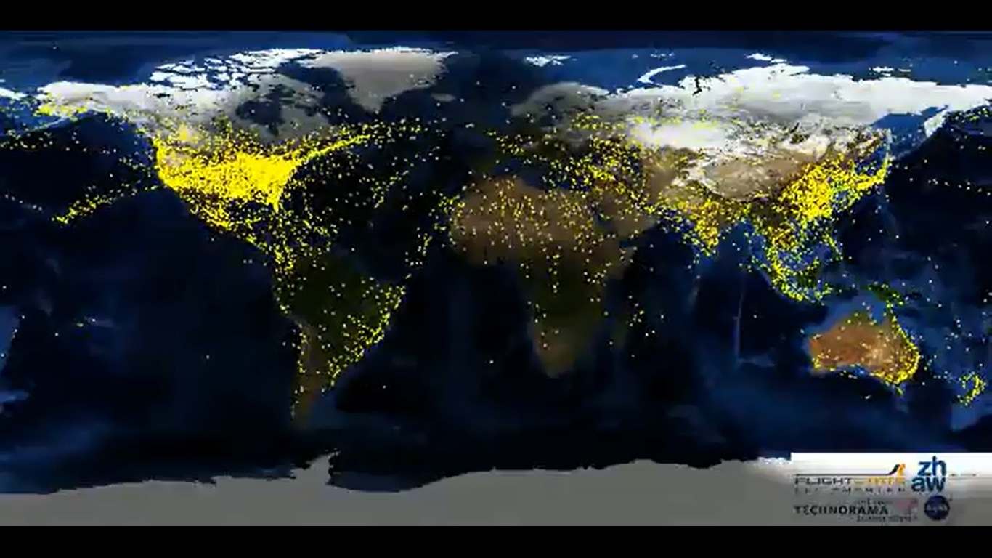

Slide 18
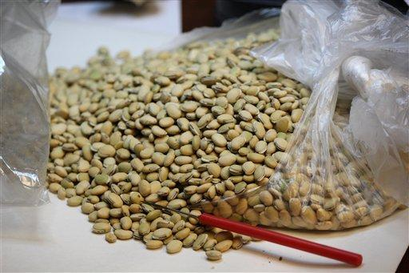
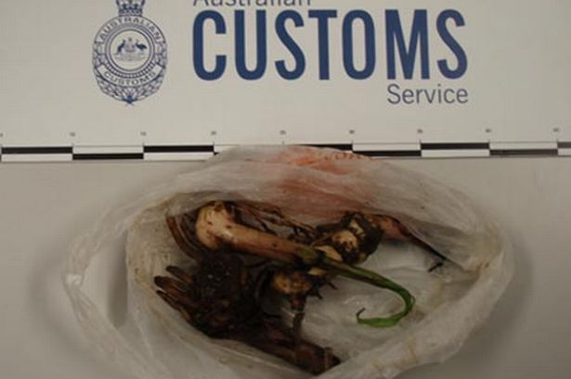
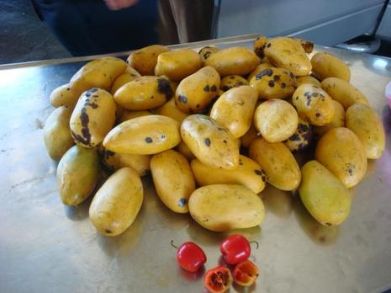
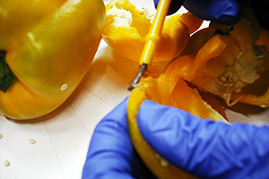

Slide 19
Other routes of entry
Inadvertent
  firewood
  ballast water
  soil, etc.
  furniture / luggage
Agricultural trade
Horticultural trade
Aquarium / pet trade

Slide 20
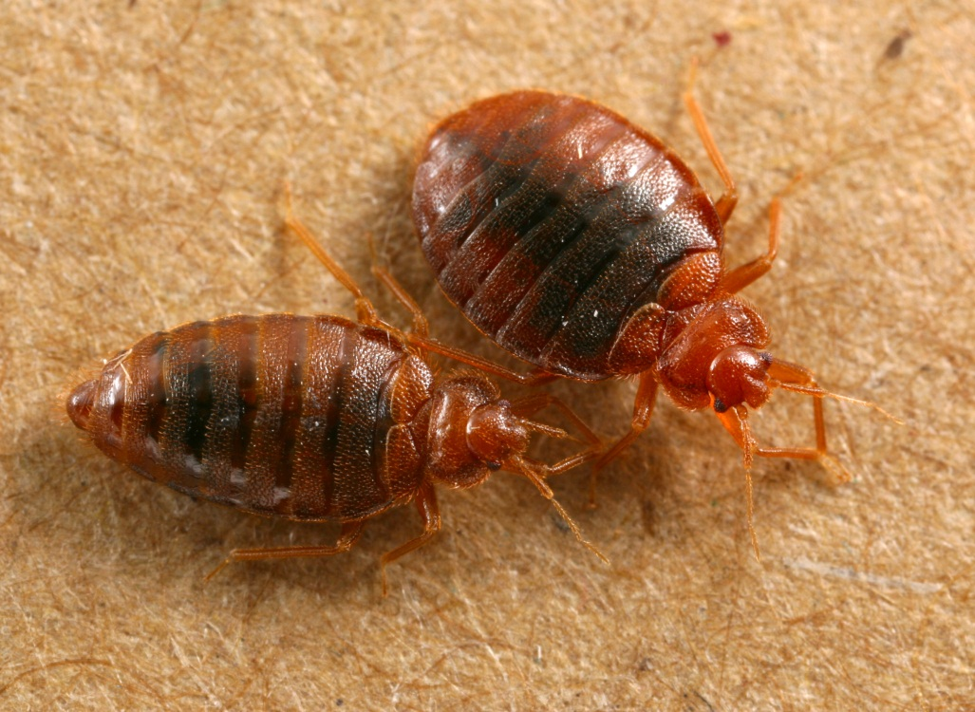
Other routes of entry
Inadvertent
  firewood
  ballast water
  soil, etc.
  furniture / luggage
Agricultural trade
Horticultural trade
Aquarium / pet trade

Slide 21
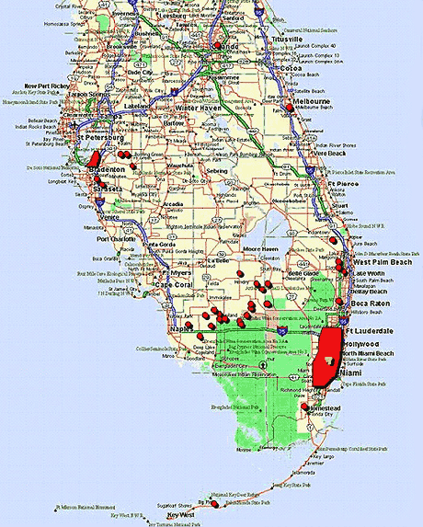
Urban ‘reservoirs’

Slide 22
Urban areas and invasion
Urban public perception ~ poor understanding of…
  Invasion ecology
  Pathways to introduction
  Agricultural / horticultural value to CA
  Pest management tactics

Slide 23
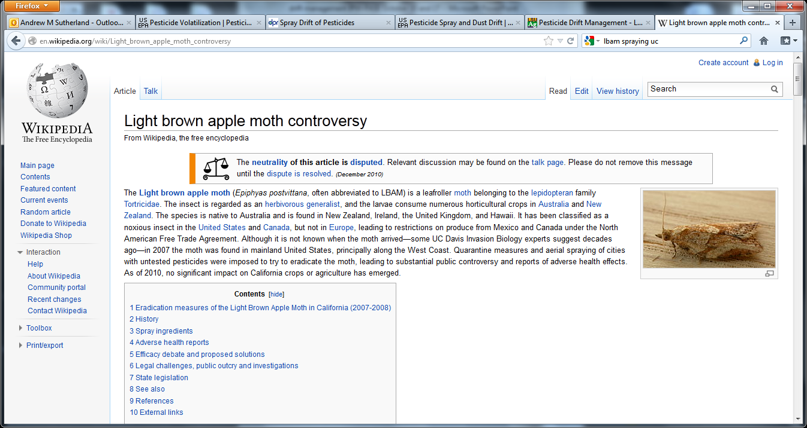
Over 600 complaints of adverse health effects reported in response to CDFA’s aerial applications of LBAM sex pheromone (2007, Santa Cruz, Monterey counties)

Slide 24
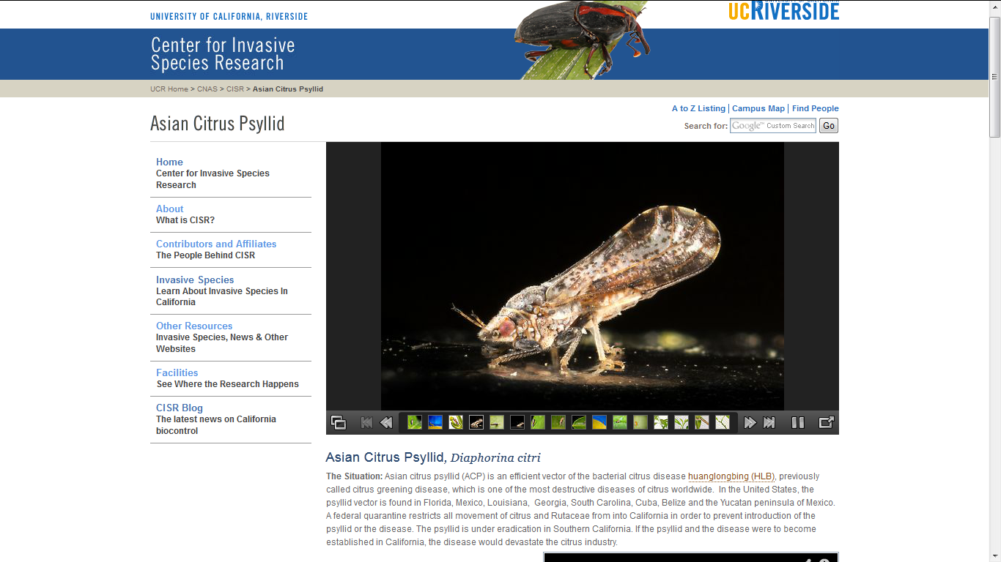

Slide 25
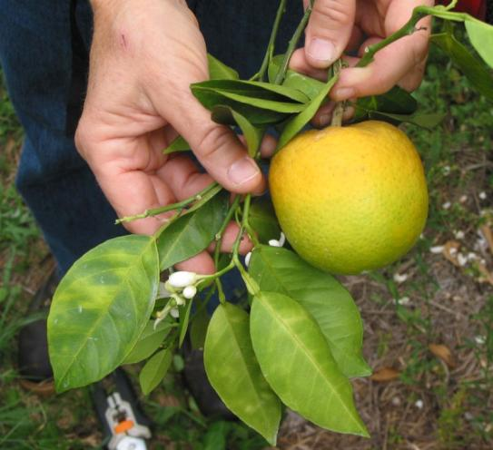
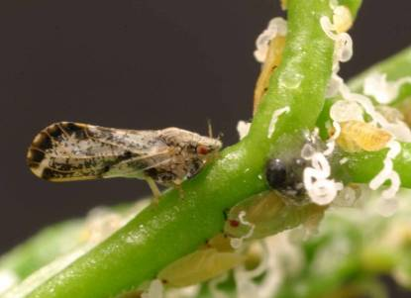
Asian citrus psyllid / huanglongbing: education
ACP: invasive insect now established in southern CA, vectors HLB
HLB: devastating, incurable citrus disease (bacterium / phytoplasma) threatening industry

Slide 26
Asian citrus psyllid / huanglongbing: prevention
Quarantine
Restrictions on sale and movement of citrus stock and products
Public outreach
Clientele communication
EARLY DETECTION

Slide 27
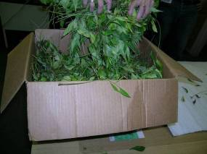
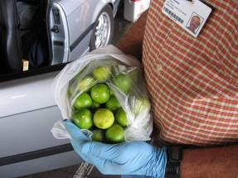
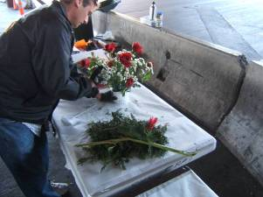
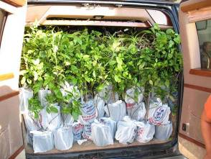
Asian citrus psyllid / huanglongbing: prevention
Psyllid-infested curry leaves shipped in boxes
Unprocessed fruit (from HLB-infected areas)
Potential routes of entry
Infested grafting material: budwood
On ornamentals in floral bouquets from Mexico
Citrus riding across
the border in vans

Slide 28
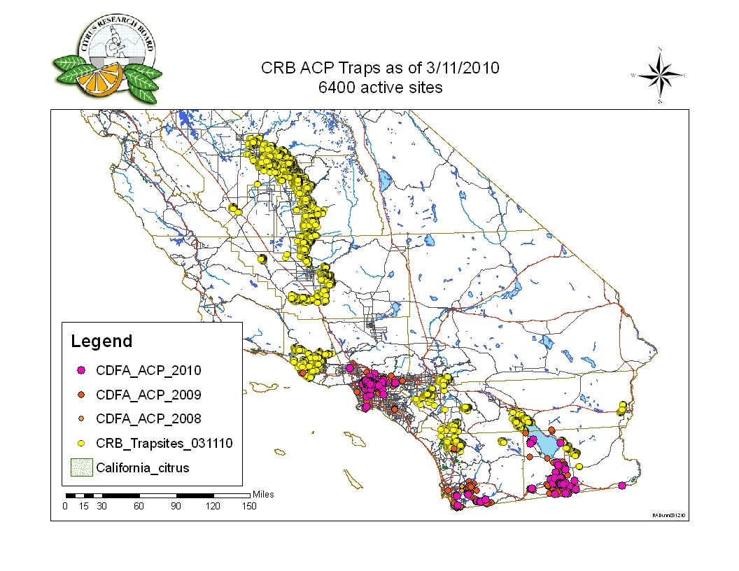
Asian citrus psyllid / huanglongbing: monitoring
Detect the insect

Slide 29
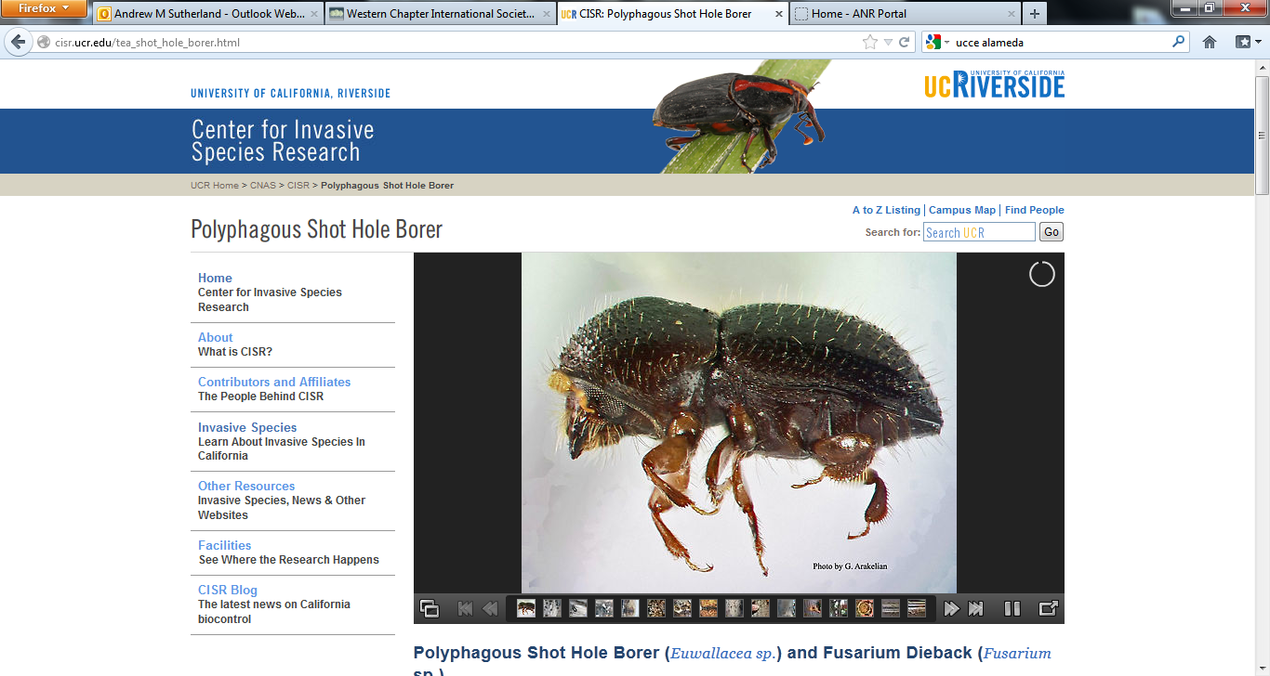

Slide 30
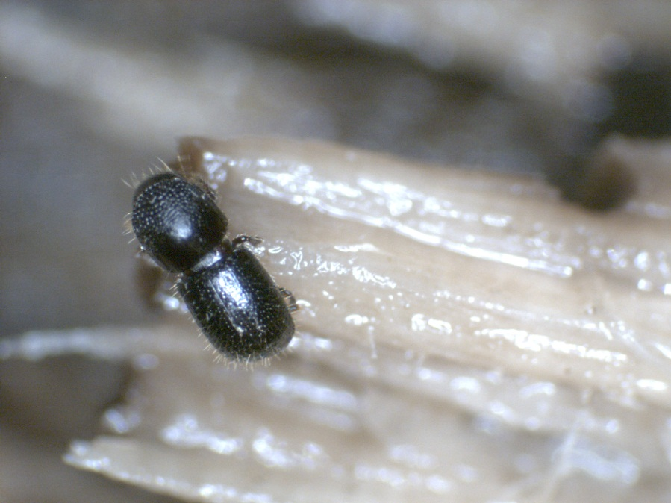
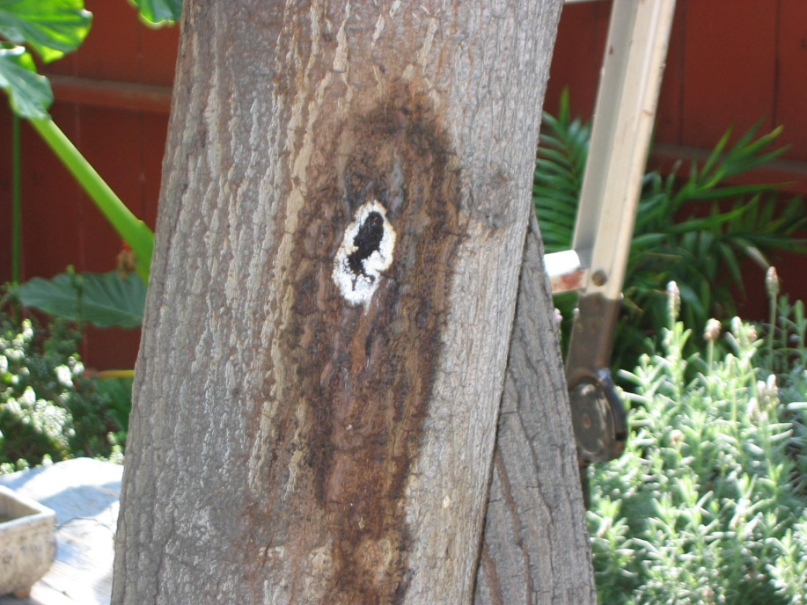
Polyphagous shot hole borer / Fusarium dieback: education
PSHB: exotic invasive bark beetle detected in southern CA 2012
FDB: fungal symbiont causing stress and dieback in suitable host trees

Slide 31


Slide 32
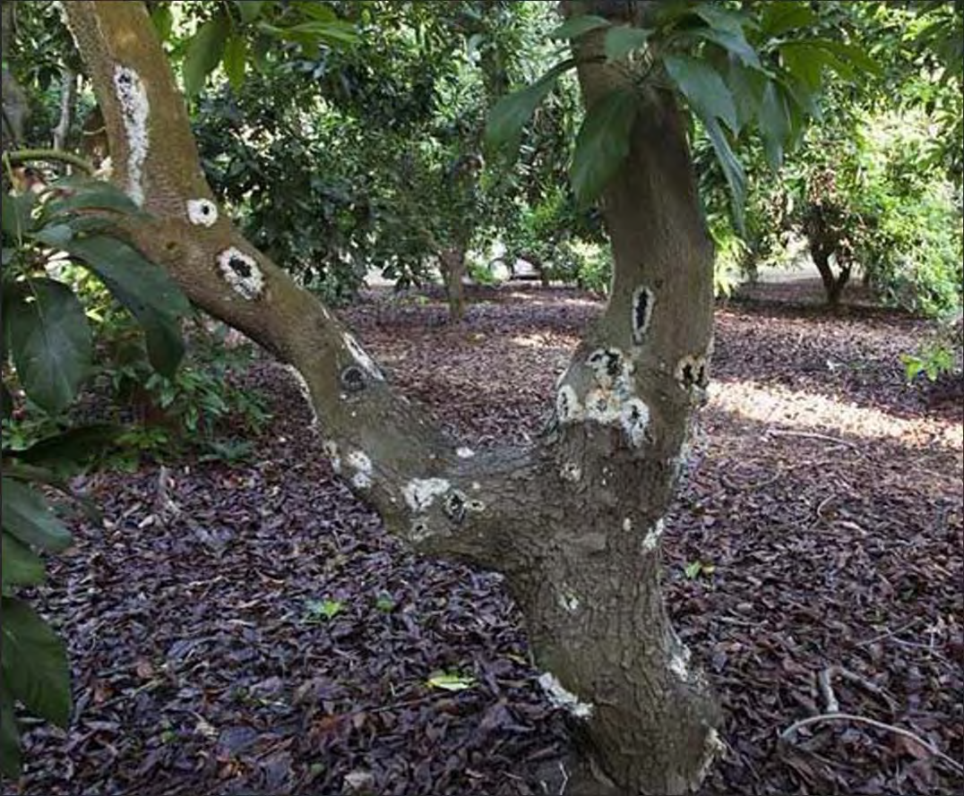

Slide 33
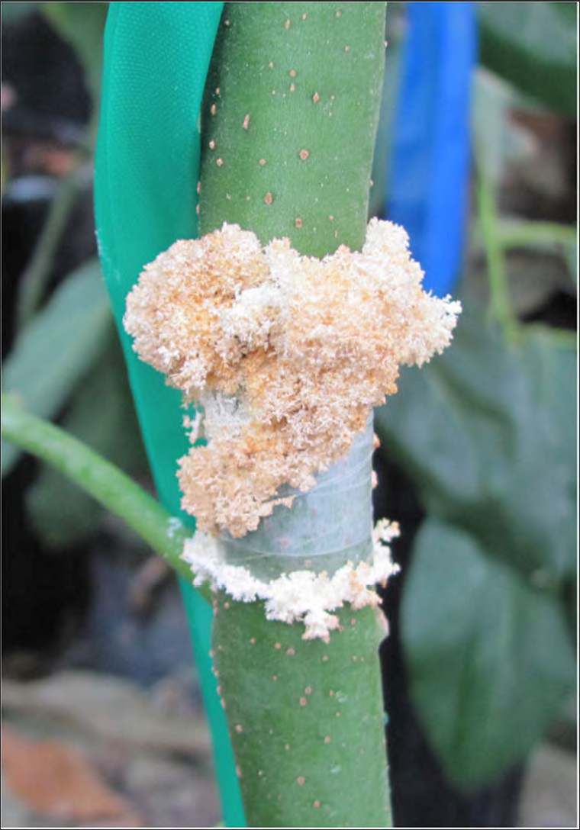

Slide 34
Pathosystem ecology
PSHB female bores into tree
Gallery infected by fungus from mouthparts
PSHB lays eggs along gallery
Fungus grows along gallery, may invade sound wood, leading to FDB symptoms
PSHB larvae eat fungus
PSHB metamophose, mate in gallery, emerge as infective adults

Slide 35
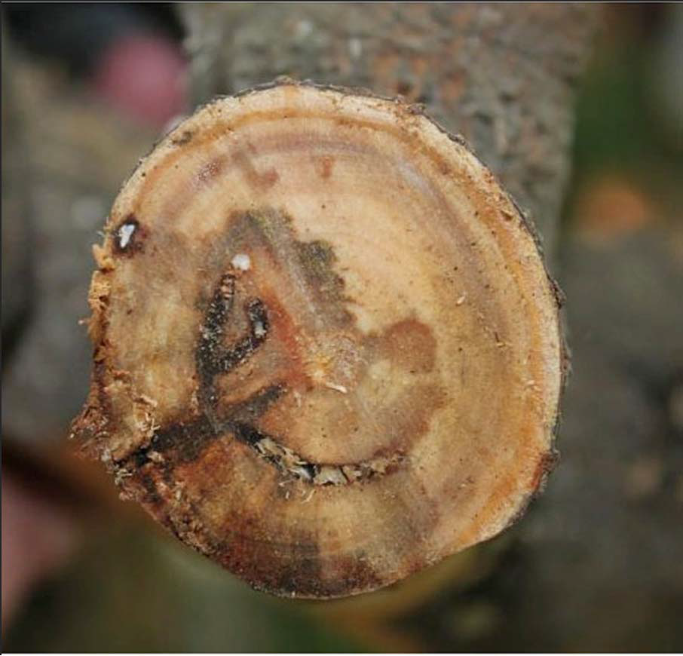

Slide 36
Partial host list
Beetle ‘tries out’ many landscape species: 52 spp. in southern CA
  Beetle is repelled, no infection: 20 spp.
  No PSHB larvae, tree infected: 29 spp.
  PSHB reproduction and tree infected:
    Avocado
    English oak
    Coast live oak
    Box elder
    Castor oil (bean) plant

Slide 37
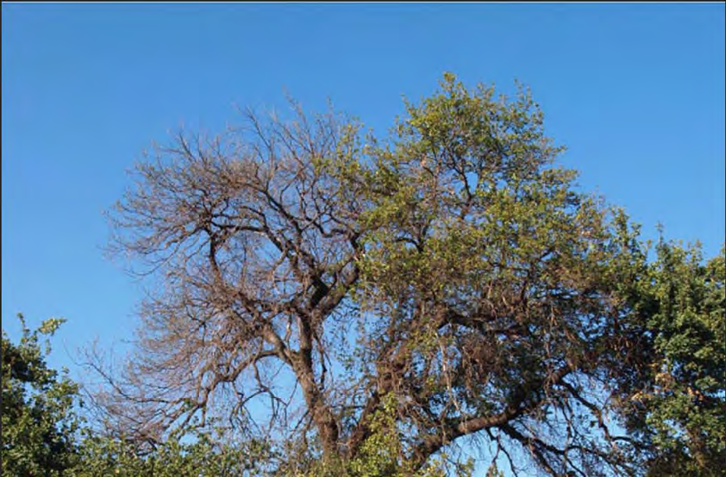
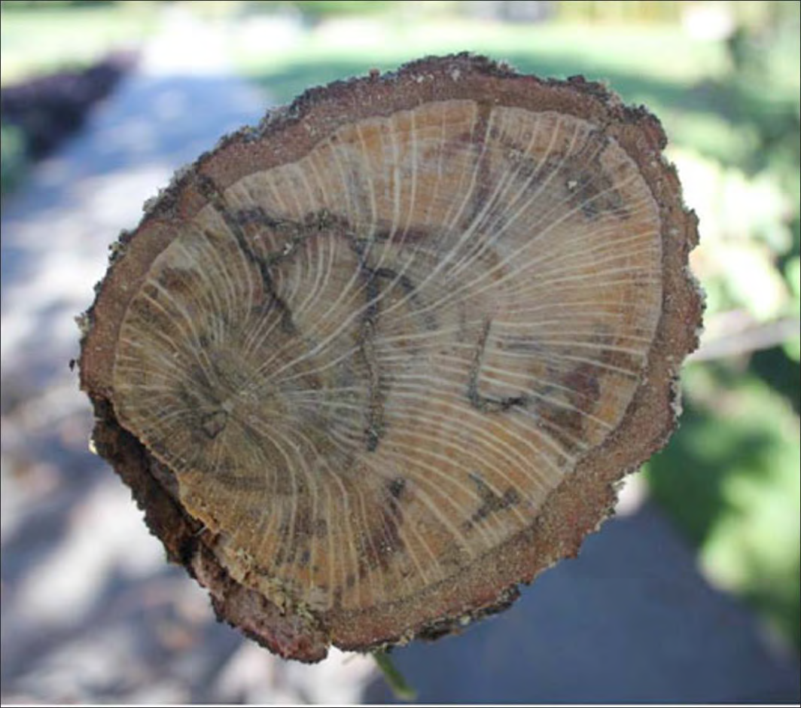
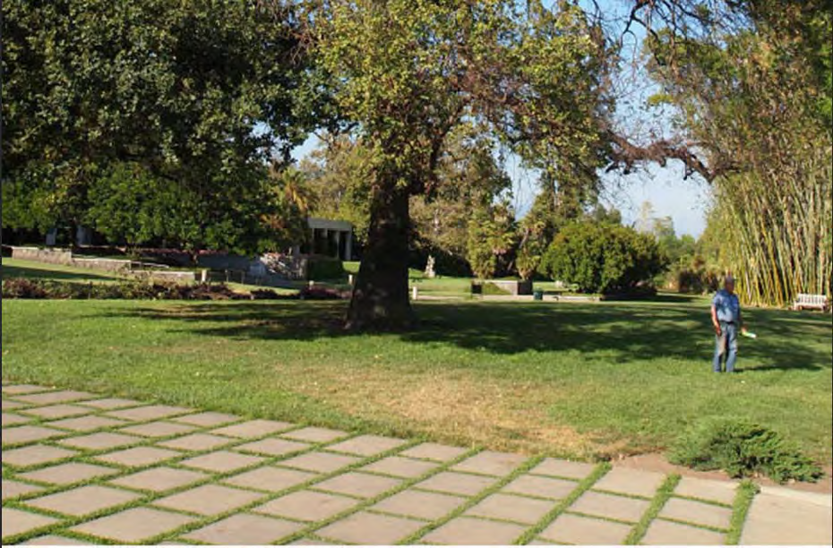
English oak; Quercus robur

Slide 38
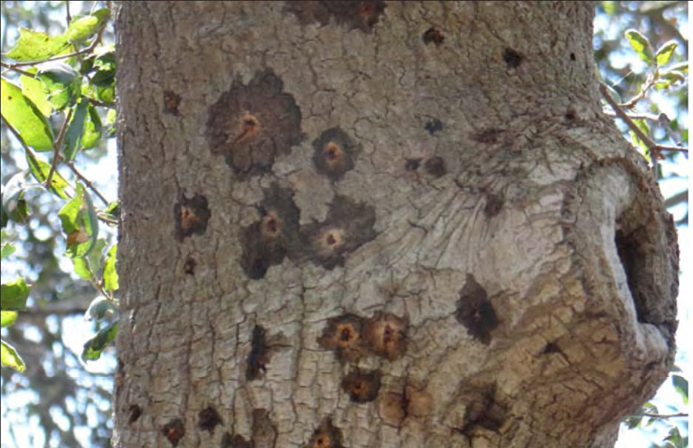
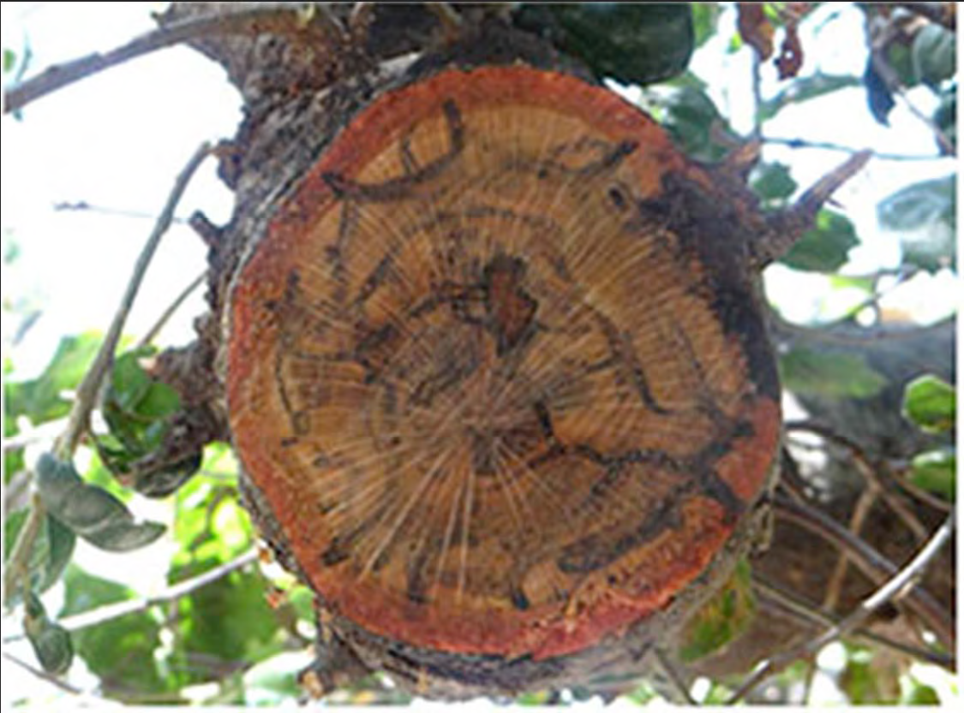
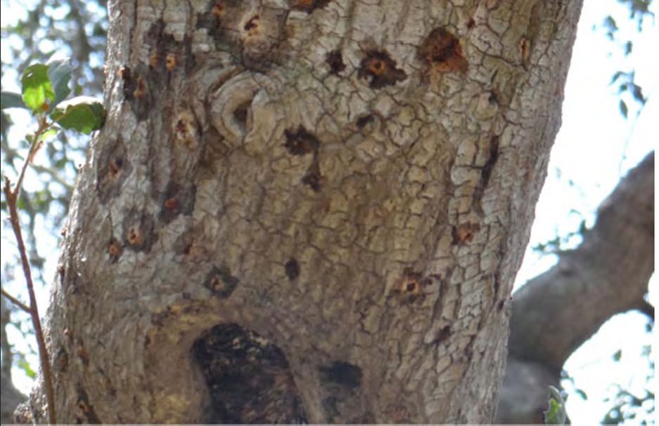
Coast live oak; Quercus agrifolia

Slide 39
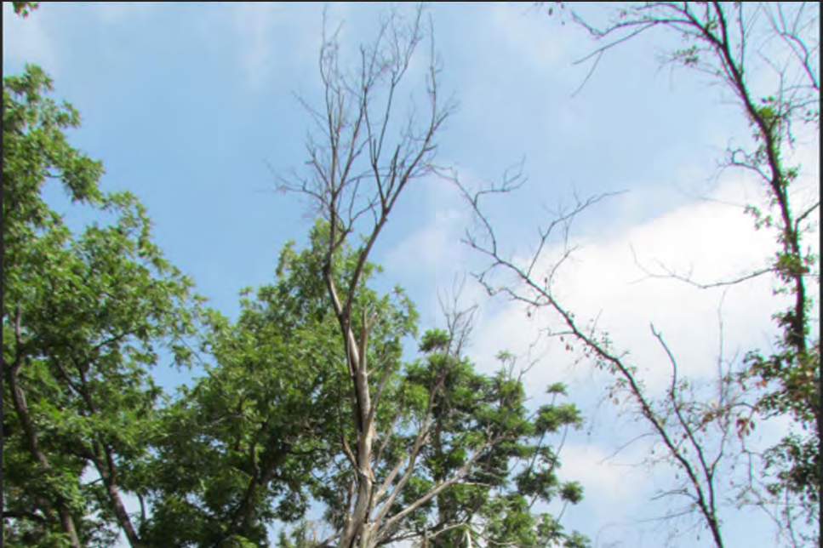


Box elder; Acer negundo

Slide 40
Other probable hosts
Big leaf maple; Acer macrophyllum
Silk tree; Albizia julibrissin
Sweetgum; Liquidambar spp.
Sycamore / plane trees; Platanus spp.
Erythrina spp.
Cercidium spp.

Slide 41

Current distribution

Slide 42

IPM for urban ants
Education
  Identification is paramount!
  Outdoor invader or indoor resident?

Slide 43


Pest ants: Hymenoptera: Formicidae

Slide 44

Red imported fire ant:
Solenopsis invicta
Report to Agricultural Commissioner

Slide 45


Ants outside
Important predators, scavengers
But…
  ‘farm’ honeydew-excreting garden pests
  Interfere with natural enemies

Slide 46


Ants interfere with biological control

Slide 47



IPM for urban ants
Education
Prevention (outdoor)
  Management of honeydew-producing insects
  Sticky barriers

Slide 48


IPM for urban ants
Education
Prevention (indoor invasion)
  Exclusion services
    Caulking, structural repairs
  Sanitation, plumbing repairs

Slide 49
IPM for urban ants
Education
Prevention
Monitoring
Thresholds
  How many ants in the landscape indicates a problem?
  How many ants in the house indicates a problem?

Slide 50
IPM for urban ants
Education
Prevention
Monitoring
Thresholds
Multiple tactics
  Physical / cultural
  chemical

Slide 51

Chemical control of urban ants
Gel baits / bait stations
  Allow for transfer of toxin: multiplies kill
  Much less likely to negatively impact human health, environment

Slide 52
Chemical control of urban ants
Gel baits / bait stations
Liquid applications
  ‘traditional’ perimeter applications

Slide 53


Slide 54
Chemical control of urban ants
Gel baits / bait stations
Liquid applications
  ‘traditional’ perimeter applications
    No longer available for pyrethroid insecticides
    Fipronil (Termidor) being considered now…
  Spot treatments (≤ 2 sq ft)
  Pin-stream applications (≤ 1” deposit)
    Construction element joints

Slide 55


IPM for white grubs
Education
  Masked chafer larvae?
  Black Ataenius larvae?
  Billbug larvae?

Slide 56
IPM for white grubs
Education
  Masked chafer larvae?
  Black Ataenius larvae?
  Billbug larvae?
Look Ma, no legs!

Slide 57


Masked chafer vs. black ataenius
Both scarab beetles (Coleoptera: Scarabeidae)
Size difference: MC: ~1”; BA: ~1/5” (5mm)
BA: multiple generations / year
MC: more common and more damaging

Slide 58


Masked chafer vs. black ataenius

Slide 59

Masked chafer biology and ecology
Adults active May – July (can be monitored via light traps)
Larvae feed on roots of all turf species in CA (damage more serious on ryegrass, bluegrass)
Overwinters as mature larva in earthen cells
Pupates in early spring

Slide 60


Damage usually becomes evident in autumn, when grubs are large…
Vertebrate predators such as skunks, raccoons may damage turf while foraging for grubs

Slide 61

IPM for white grubs
Education
Prevention
  Warm season grasses more tolerant
  Proper irrigation
  Thatch removal

Slide 62


IPM for white grubs
Education
Prevention
Monitoring
  Adult beetles attracted to lights (May-July)
  Cut / roll turf to expose grubs (June-…)
Infestations tend to reoccur in same area / region

Slide 63
IPM for white grubs
Education
Prevention
Monitoring
Thresholds
  ≥ 6 grubs / sq.ft. in most turf situations
  ≥ 1 grub / sq. ft. in golf course greens
  Vertebrate predation / turf damage?

Slide 64
IPM for white grubs
Education
Prevention
Monitoring
Thresholds
Multiple tactics
  Cultural
  Biological
  Chemical

Slide 65

Biological control for white grubs
Entomopathogenic nematodes
  Heterorhabditis bacteriophora
  Steinernema spp. not effective

Slide 66
Biological control for white grubs
Entomopathogenic nematodes
  Heterorhabditis bacteriophora
  Steinernema spp. not effective
  Can be used at any time during grub stage
  May not prevent vertebrate predation

Slide 67

Biological control for white grubs
Entomopathogenic nematodes
Tiphiid wasps
  Common naturally-occurring larval parasitoids
  May not reduce grubs below threshold

Slide 68
Biological control for white grubs
Entomopathogenic nematodes
Tiphiid wasps
Milky spore disease (Paenibacillus spp.)
  May offer natural control
  Not commercially available

Slide 69
Chemical control for white grubs
Neonicotinoids
  Imidacloprid
  Thiamethoxam
  Clothianidin
  Must be applied when grubs are small
  Most only work when applied just prior to egg hatch

Slide 70
Chemical control for white grubs
Neonicotinoids
Carbaryl (Sevin)
  Can be used against large grubs
  Disrupts soil biota
  May be prohibited / regulated in cases
  Should be considered last option

Slide 71
IPM for white grubs
Education
Prevention
Monitoring
Thresholds
Multiple tactics
Integration
  Broad spectrum insecticides may interfere with biological control agents

Slide 72

IPM for white grubs
Education
Prevention
Monitoring
Thresholds
Multiple tactics
Integration
Evaluation
  Continue monitoring program

Slide 73

IPM for weed management
Education
Prevention
Monitoring
Thresholds
Multiple tactics
Integration
Evaluation

Slide 74


Multiple tactics: Iron HEDTA herbicides
Chelated iron
HEDTA: hydroxyethylenediaminetriacetic acid
NOT ORGANIC (OMRI) due to chelate
mode of action: iron toxicity (oxidative damage at cellular level)
Selectivity: dicots vs. monocots
Cheryl Wilen
Don Bartel
Notes:
You will learn what biological control is and why it is important to the health of your garden. You will also learn about the different types of natural enemies and how to identify common species. You will also learn how to enhance the activities of beneficials in your landscape by employing integrated pest management practices.
Photos: Beneficial mini-wasp laying its egg in a caterpillar (left); lady beetle (ladybug) eating an aphid (right)

Slide 75

Iron HEDTA products registered in CA

Slide 76
Efficacy trials conducted
BioResearch, November 2010: NEU1173H (Fiesta), English daisy
Sierra Consulting, May 2011: NEU1173H (Fiesta), bull thistle
Cheryl Wilen (UC IPM), January 2012: Whitney Farms (Scotts) Lawn Weed Killer RTU, broadleaf plantain, dandelion, oxalis, black medic
Cheryl Wilen, August 2012: Fiesta, oxalis, prostrate spurge

Slide 77




BioResearch trial results
5 gal / 1000 ft²
10 gal / 1000 ft²
1 DAA
14 DAA

Slide 78

Sierra Consulting trial results

Slide 79
UC IPM RTU trial observations
Broadleaf plantain: death after one week
Dandelion: injury in 1 day, death in 3 days
Oxalis: injury in 1 day, death in 3 days
Black medic: foliar damage only
No sidewalk staining
Effective in shade and sun
No turf injury

Slide 80
UCCE / UC IPM resources for commercial landscape IPM
UC IPM Pest Notes
  http://www.ipm.ucdavis.edu/PMG/menu.house.html
UC IPM Green Bulletin
  http://www.ipm.ucdavis.edu/greenbulletin/
UC ANR Urban Ants website
  http://ucanr.edu/sites/UrbanAnts/
Andrew’s Urban IPM website
  http://ucanr.edu/sites/urbanIPM/Commercial_Landscape_IPM/

Slide 81


Slide 82


Slide 83


Slide 84


Slide 85
Thanks!...Questions?
Andrew Sutherland
Bay Area Urban IPM Advisor
amsutherland@ucanr.edu
http://ucanr.edu/sites/urbanIPM/
510-777-2481 office
510-499-2930 cell
1131 Harbor Bay Parkway; Alameda

