Slide 1
Tabletop Group Exercise
Stormwater Illicit Discharge Inspector Training Workshop
April 24, 2013

Slide 2
Group Exercise Format
Present an illicit discharge scenario
Review Handouts for illicit discharge scenario description and prompt questions
Discuss with your group (10 minutes) possible investigation, education, enforcement, and clean up actions
Representatives from 2 groups will briefly present their approach
Present information about scenario’s actual resolution
Comments

Slide 3
Group Exercise Goals
Emphasis on information sharing
Work towards consistency within agency and within County Program
Learn from other agencies’ experiences
There is more than one way to solve a problem

Slide 4
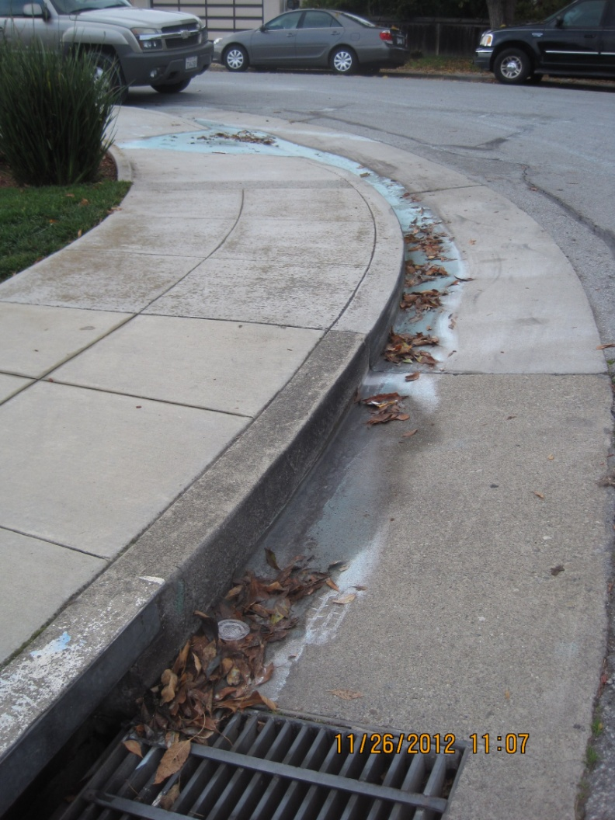
Case Scenario #1
Notes:
On November 26, 2012 you respond to the report of a green powdery substance in the street in front of a residence. What are the appropriate education and enforcement steps to take to achieve timely compliance?
You will have 10 minutes to discuss with your group. There are additional prompting questions on the handouts to start the discussion. Go ahead and start.

Slide 5
Case Scenario #1 - Resolution
6 city staff, and 4 vehicles cleaned up the site
The homeowner was held financially responsible for the use of 2 vehicles and 5.32 hours
The citation and fine ($812.43) were disputed, but paid.
The City responded explaining municipal code and NPDES permit
Notes:
Next slide is also part of resolution

Slide 6
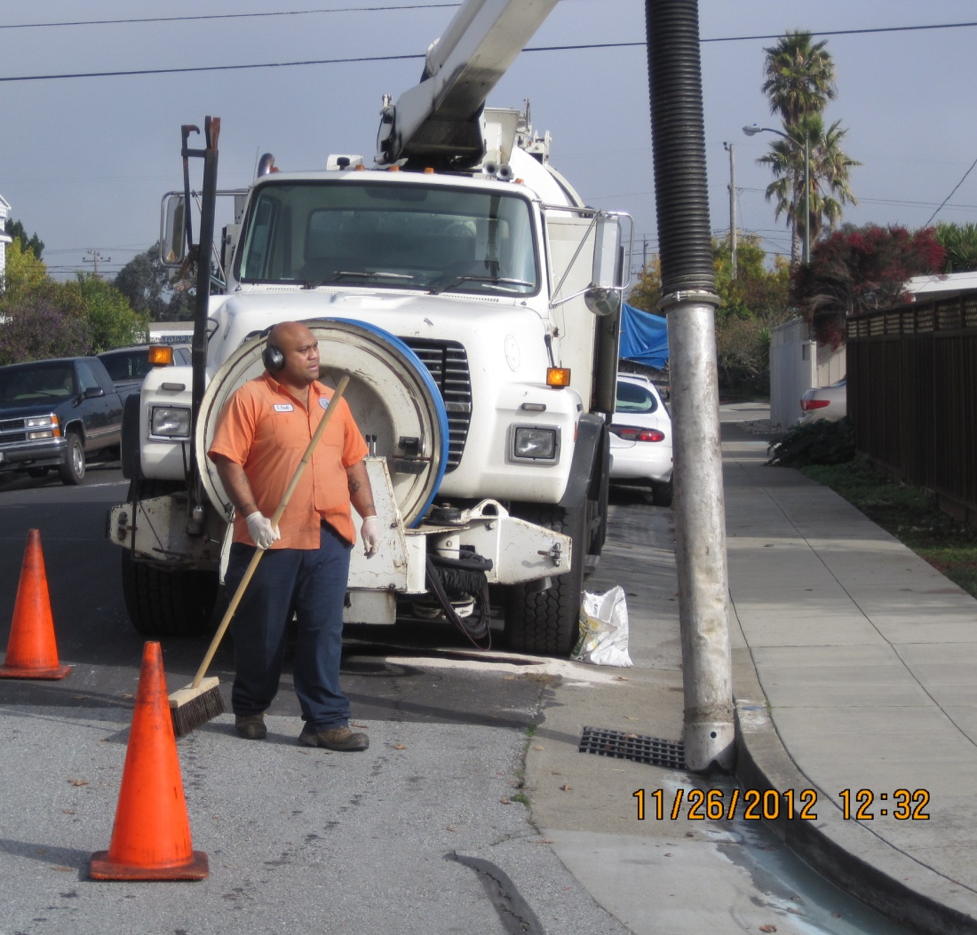
Case Scenario #1 - Resolution
Notes:
These are the clean up activities by the city.
Knowing the city’s resolution are there any other comments?

Slide 7
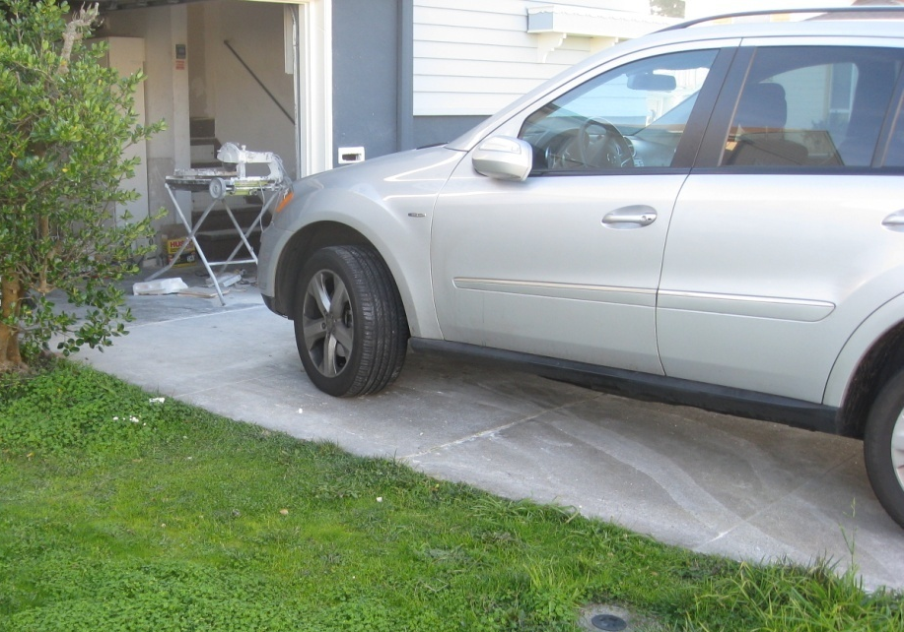
Case Scenario #2
Notes:
On January 3, 2013, you are performing a routine field investigation and observe tile cutting wash water entering the street from a resident’s garage. What are the appropriate education and enforcement steps to take to achieve timely compliance?
You have 10 minutes to discuss with your group.

Slide 8
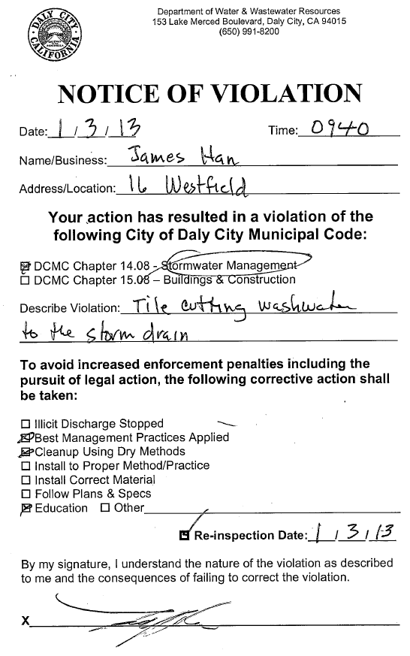
Case Scenario #2 - Resolution
Inspector described different drainage systems and went over proper BMPs
Resident cleaned driveway, sidewalk, curb and gutter using dry cleanup methods
Notes:
Next slide is also part of resolution

Slide 9
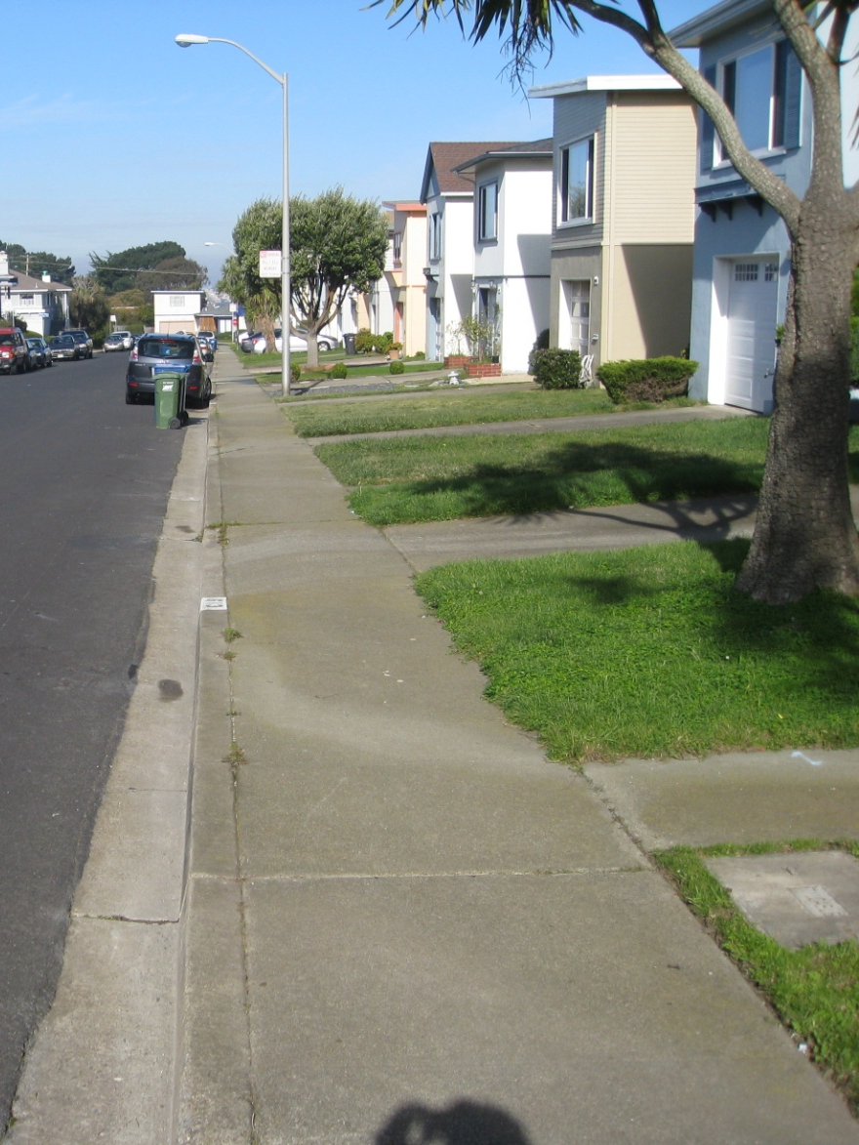
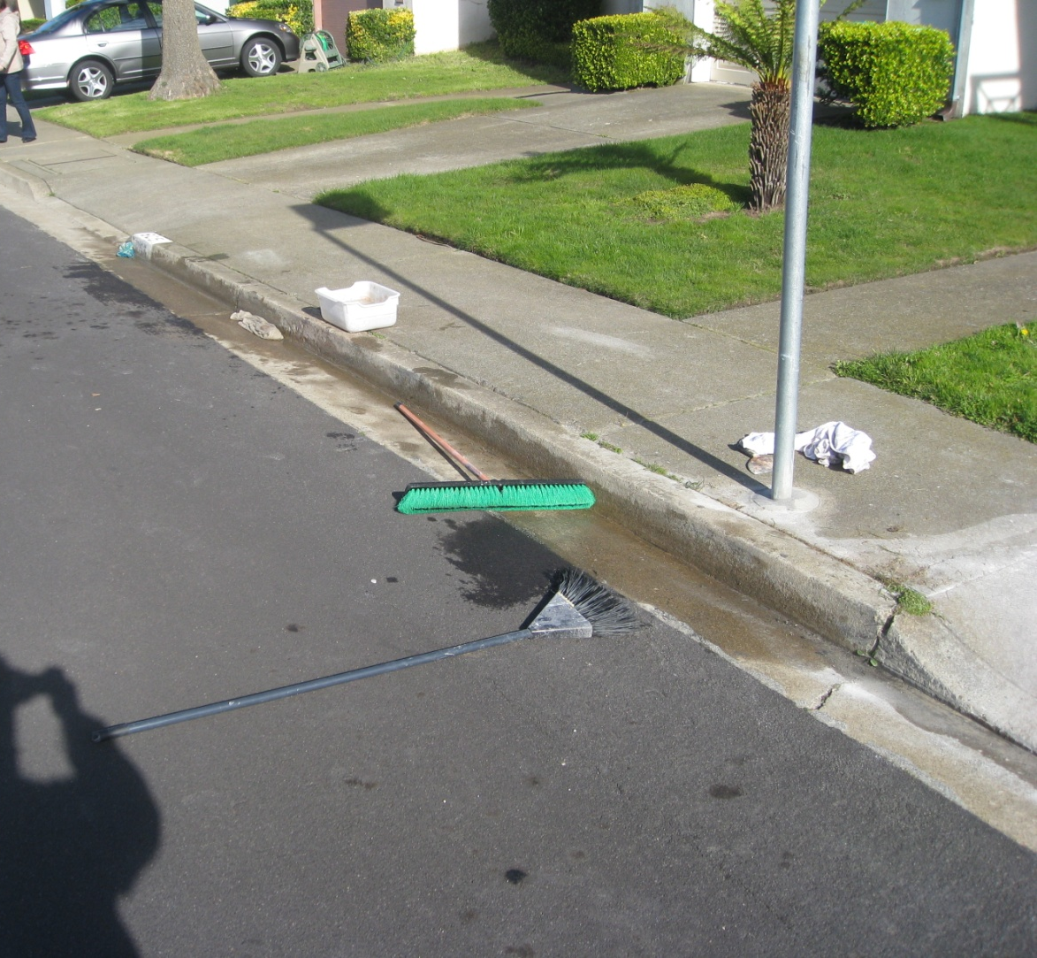
Case Scenario #2 - Resolution
Notes:
This was the clean up by the resident.
Knowing the city’s resolution are there any other comments?

Slide 10
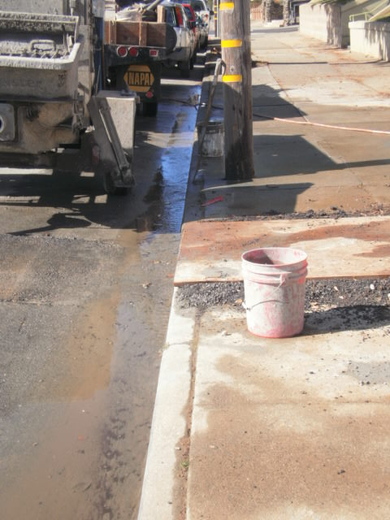
Case Scenario #3
Notes:
On a dry day, between two storms, you respond to a report of concrete sediment and wash water discharging from a small construction project to the street. Upon arrival you find out a subcontractor is responsible for the discharge and has made no attempt to stop the flow.
You have 10 minutes to discuss with your group.

Slide 11
Case Scenario #3 - Resolution
City’s Street Dept was contacted for inspection of catch basin and gutter
Site workers were unresponsive and rain was forecasted for the next day, so the City’s Street Crew mobilized two trucks that afternoon
Discharged flushed downstream toward catch basin and another pumper truck collected all the wash water after plugging the catch basin
Contractor billed for the cost of cleanup
Notes:
Knowing the city’s resolution are there any other comments?

Slide 12
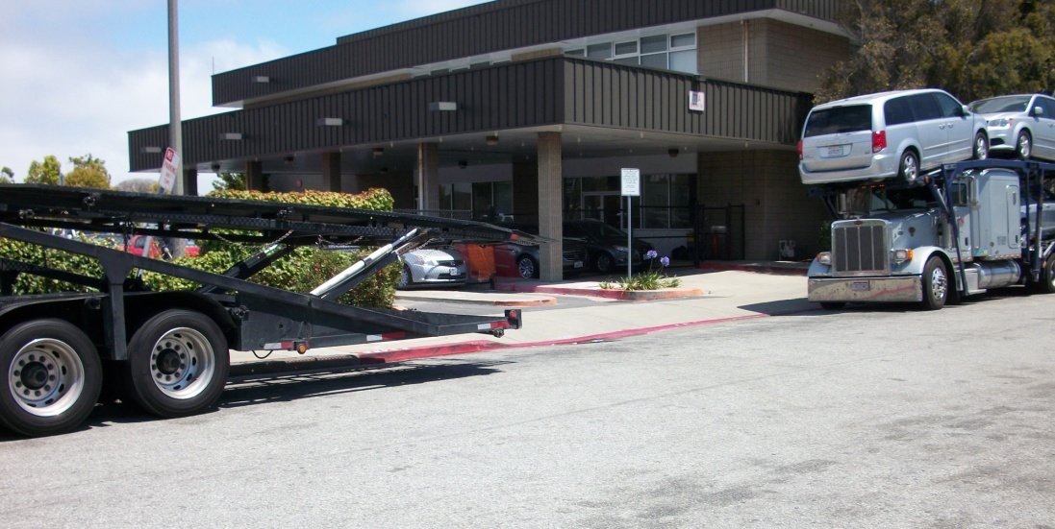
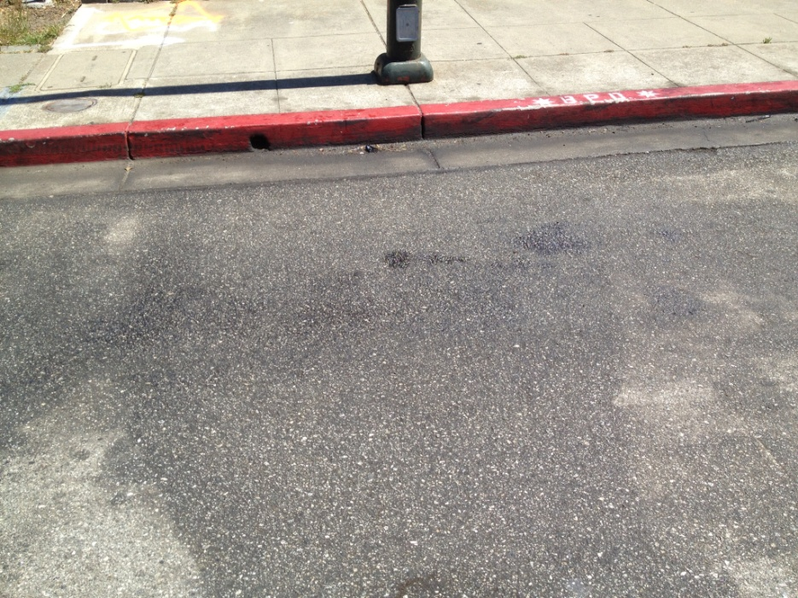
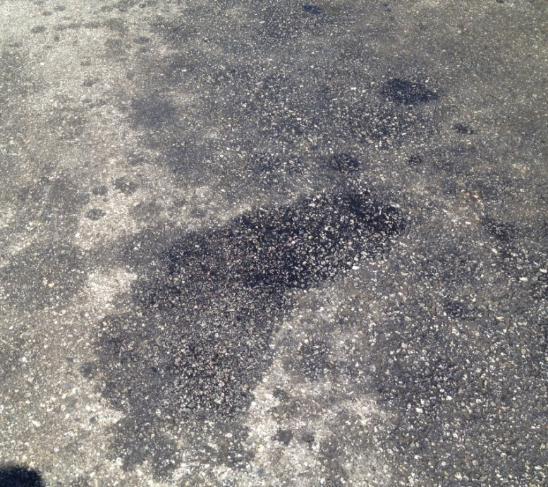
Case Scenario #4
Notes:
You are performing a routine inspection at a car rental fleet storage facility and observe visible oil stains on the street next to the storage facility. What are the appropriate education and enforcement steps to take to achieve timely compliance?
You have 10 minutes to discuss with your group.

Slide 13
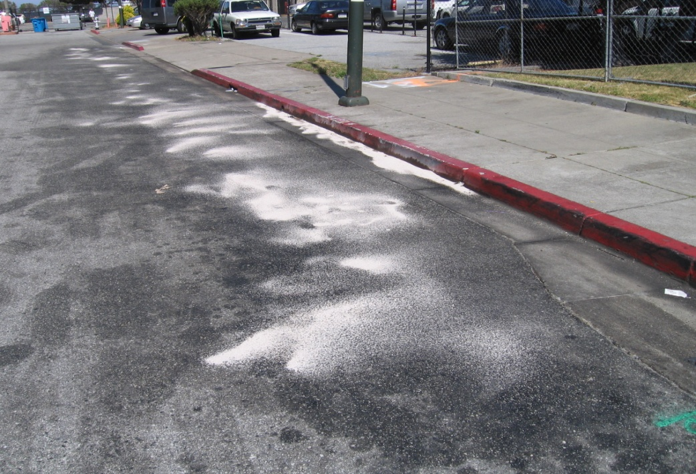
Case Scenario #4 - Resolution
Leak was caused by a truck earlier in the day
Older trucks leak, but usually drivers carry spill pans and spill kits
Facility has spill response procedures & spill kit supplies are readily available
Manager provided temporary containment & hired licensed environmental vendor to complete cleanup
Notes:
Next slide is also part of resolution

Slide 14
Case Scenario #4 - Resolution
Facility developed notification notice for security guards to distribute to drivers:
ATTENTION VEHICLE TRANSPORT DRIVERS
When delivering vehicles make sure you are capturing any fluids that may be leaking from your truck. In the event of a spill please see the security guard and they will supply you with a spill kit. In the event that you are caught leaking fluid onto the street you will be responsible for any fines or penalties levied by the City of Burlingame. The City monitors the area frequently.
Thank you for your cooperation.
Management
Notes:
Knowing the city’s resolution are there any other comments?

Slide 15
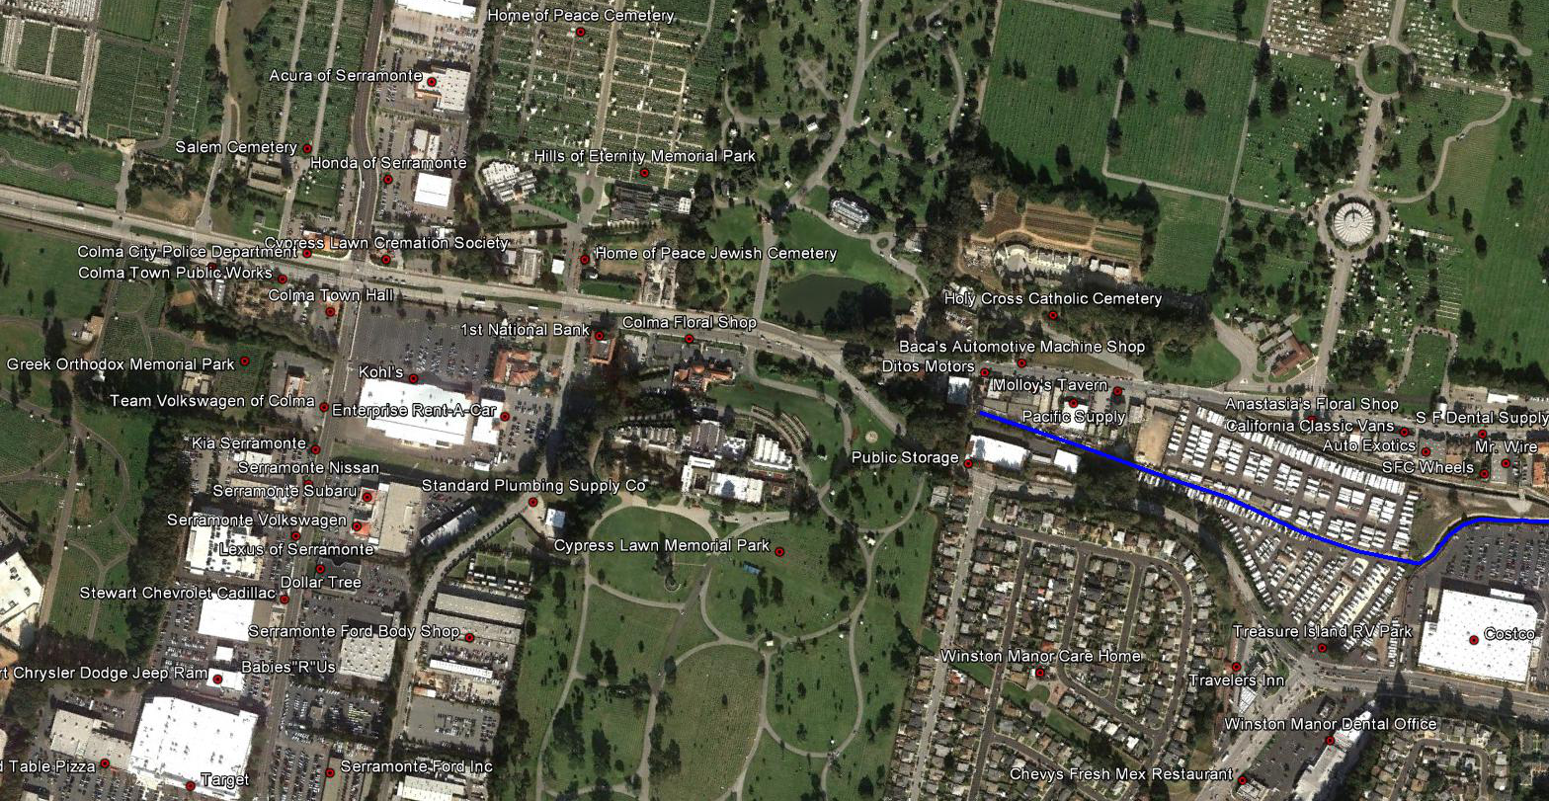
Case Scenario #5
Notes:
A white milky substance is reported in the creek near a bank. What are the appropriate investigation, education and enforcement steps to take to achieve timely compliance?
You have 10 minutes to discuss with your group.

Slide 16
Case Scenario #5 - Resolution
Staff inspected likely sources (e.g., automotive facilities, car dealerships, etc.) but found nothing
Source was a retirement home!
Painters were washing paint cans and brushes in a storm drain on the side of the building.
Notes:
Next slide is also part of resolution

Slide 17
Case Scenario #5 - Resolution
Staff educated them on proper BMPs and that the storm drain did not go to the sanitary sewer.
Staff helped them identify a janitor’s closet drain that was connected to the sanitary sewer.
Staff called an adjacent city to help pump out the storm drain and notified another adjacent city because the creek flows into their jurisdiction.
Notes:
Knowing the city’s resolution are there any other comments?

Slide 18
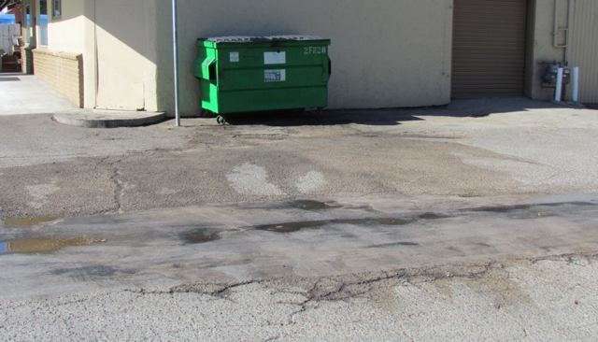
Case Scenario #6
Notes:
On a routine inspection, you observe a leaking dumpster behind a business. What are the appropriate education and enforcement steps to take to achieve timely compliance?
You have 10 minutes to discuss with your group.

Slide 19
Case Scenario #6 - Resolution
Did not require cleaning stained asphalt
Required to replace leaking dumpster

