Slide 1
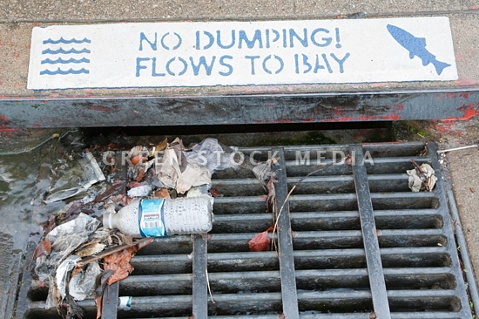
Reducing Trash in Stormwater
John Fusco
Senior Engineer
EOA, Inc.
May 23, 2013

Slide 2
Trash Capture
  Trash Load Reduction Requirements
    40 % by July 1, 2014
    70 % by July 1, 2017
    “No Impact” by July 1, 2022
MRP Minimum Full Capture Requirements
  Must treat an area equivalent to > 30% of Retail/Wholesale/Commercial Land Use
  Devices must be installed by July 1, 2014
San Francisco Estuary Partnership Grant
  Bay-area Trash Demonstration Project
  Funded by the Clean Water State Revolving Fund and the American Recovery and Reinvestment Act of 2009
  $4.27 M

Slide 3
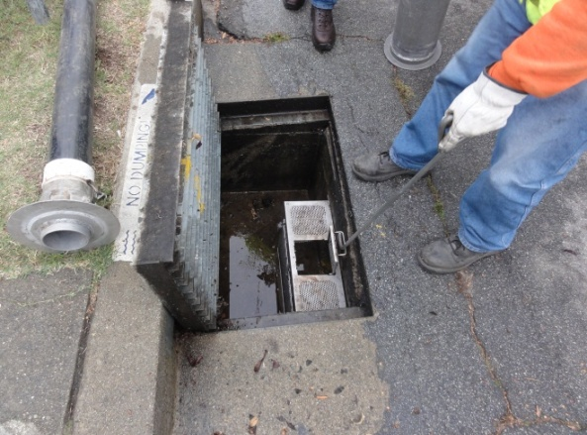
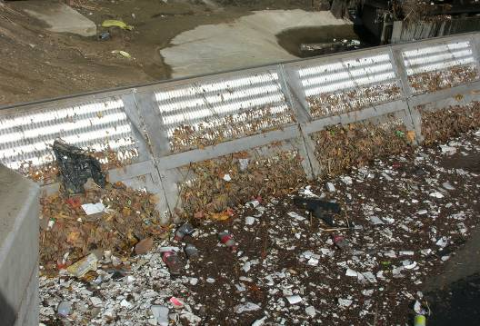
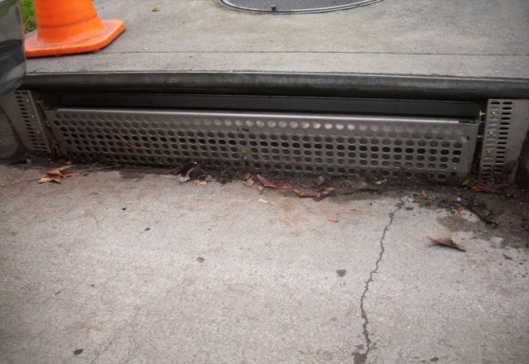
Trash Capture Devices
General Description
  Small Full Capture
  Large Full-Capture
  Partial Capture
  Small Full-Capture and Partial Capture (Combo)

Slide 4
Full-capture Devices
Full-capture Standard
  Traps all particles retained by a 5 mm (0.2 inch) mesh screen and has a design treatment capacity of not less than the peak flow resulting from a one-year, one-hour storm in the sub-drainage area
“Recognized” by SF Bay Regional Water Quality Control Board as part of SFEP/ARRA trash demonstration project
~30 recognized full-capture devices
Notes:
Traps particles retained by

Slide 5
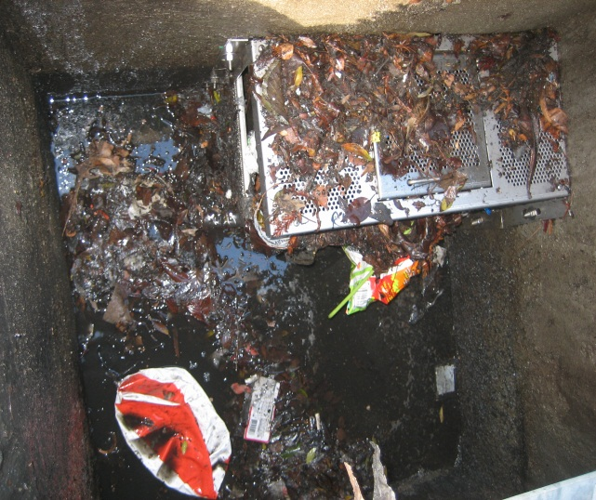
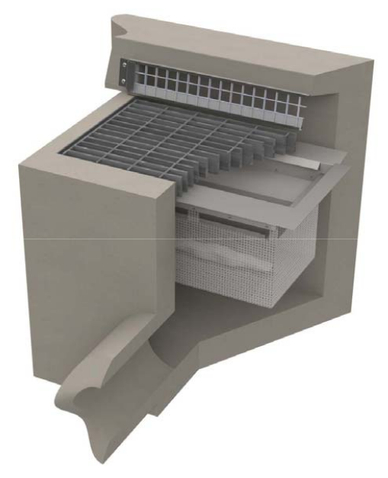
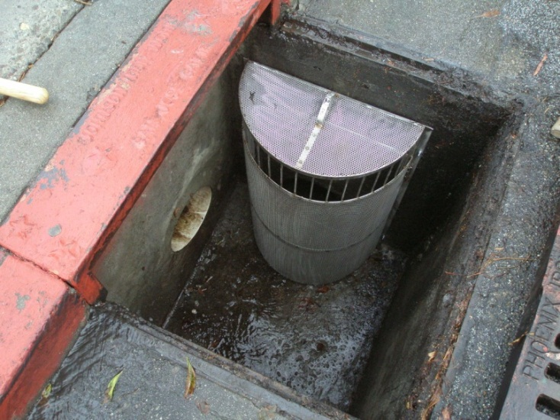
Small Full-capture Devices
Any full-capture device installed within a catch basin
Requires more frequent maintenance than large full-capture devices
~20 recognized small full-capture devices
Notes:
Traps particles retained by

Slide 6
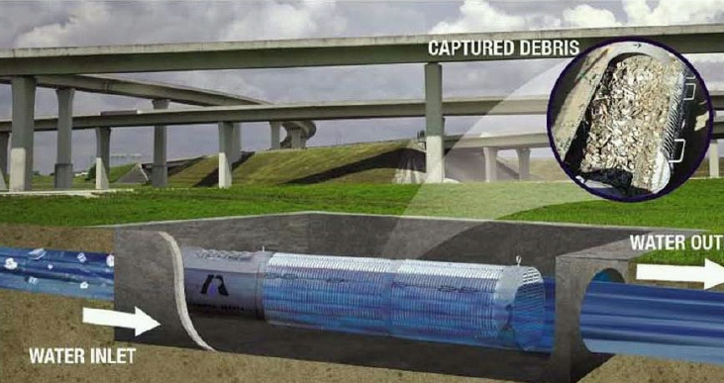
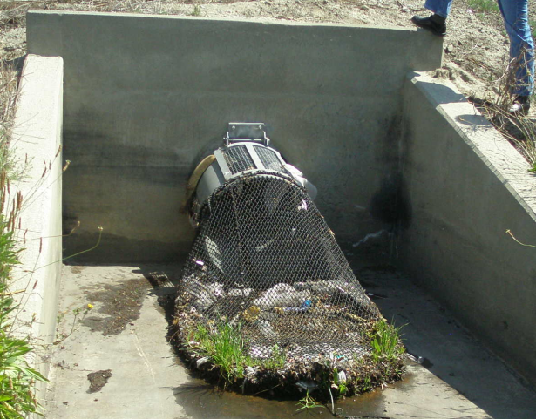
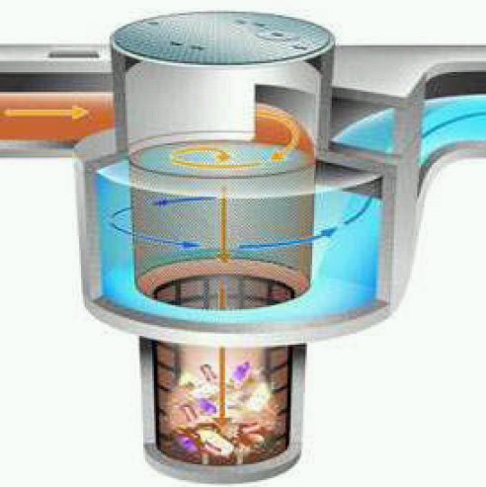
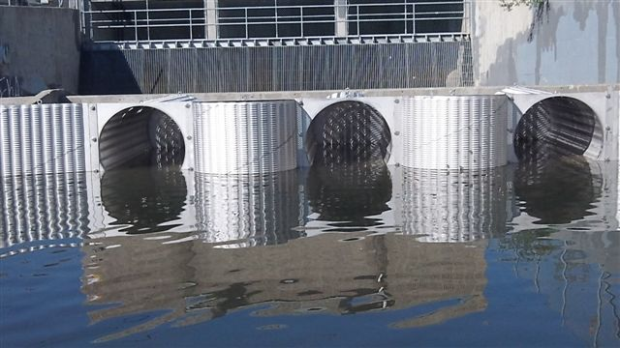
Large Full-capture Devices
Any full-capture device installed in-line or end-of-pipe
Recent installations within the fore bay of a stormwater pump station
~10 recognized large full-capture devices
Notes:
Traps particles retained by

Slide 7
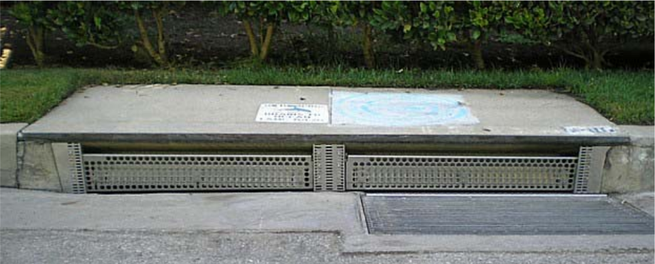
Partial Capture Devices
A trash capture device not meeting the full-capture treatment standard
Usually used in combination with small full-capture devices
  Automatic Retractable Screen
  Clean Screen

Slide 8
Installed Trash Capture Devices

Slide 9
