Slide 1
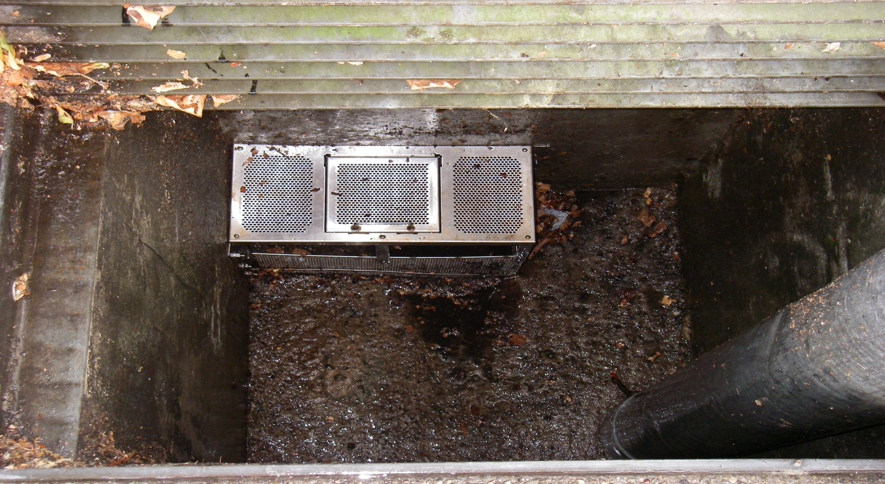
San Leandro’s Small TCD Maintenance Program (by Rick Orta, Collection System Supervisor)

Slide 2
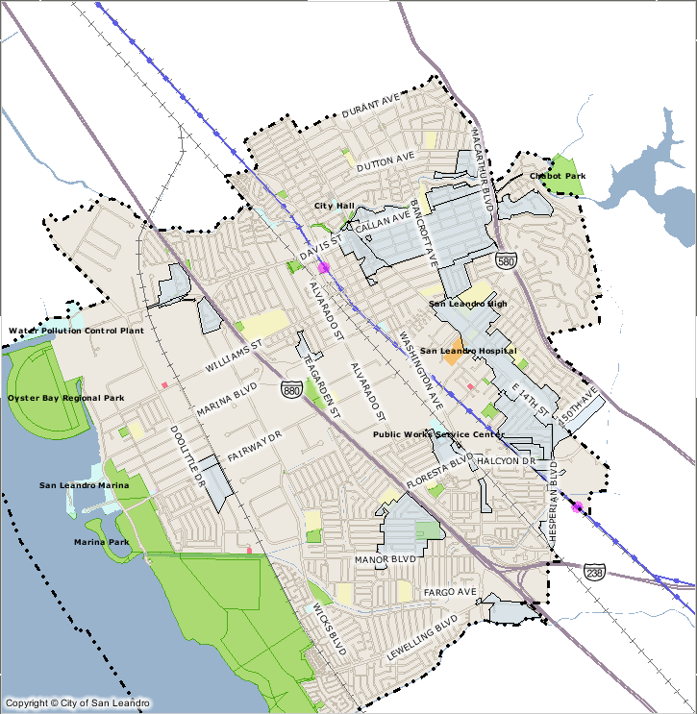
In July 2011 the City of San Leandro Installed 254 TCD’s Throughout the City

Slide 3
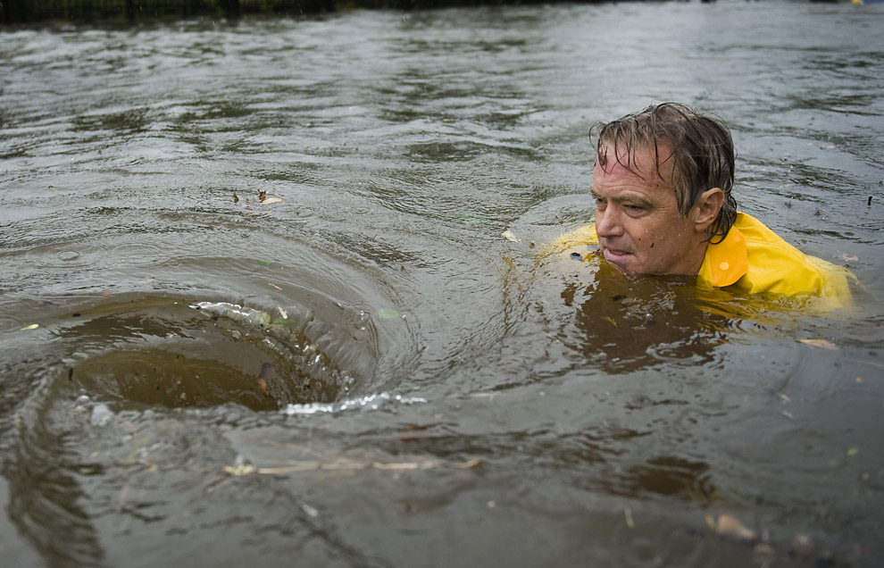
“Initial Thought”

Slide 4
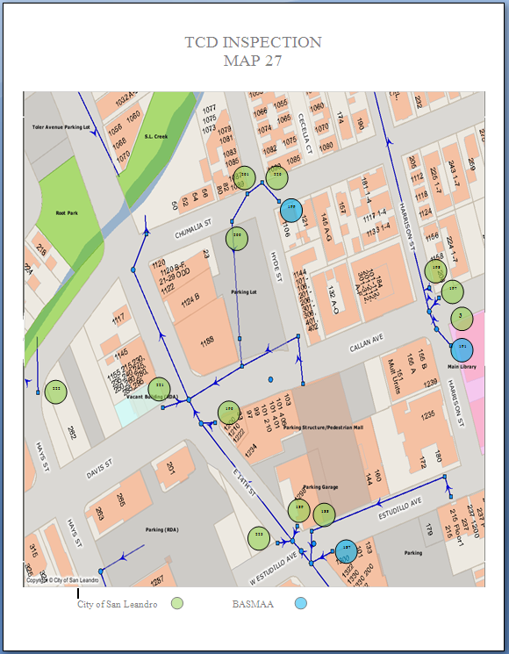
Created a Map to Generate Cleaning Routes

Slide 5
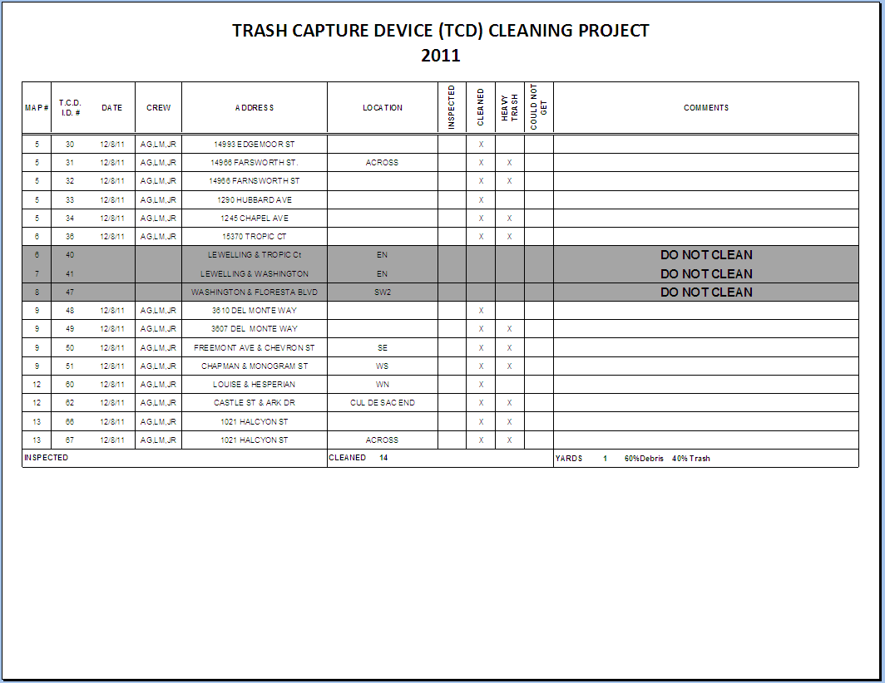

Slide 6
Cost ?

Slide 7
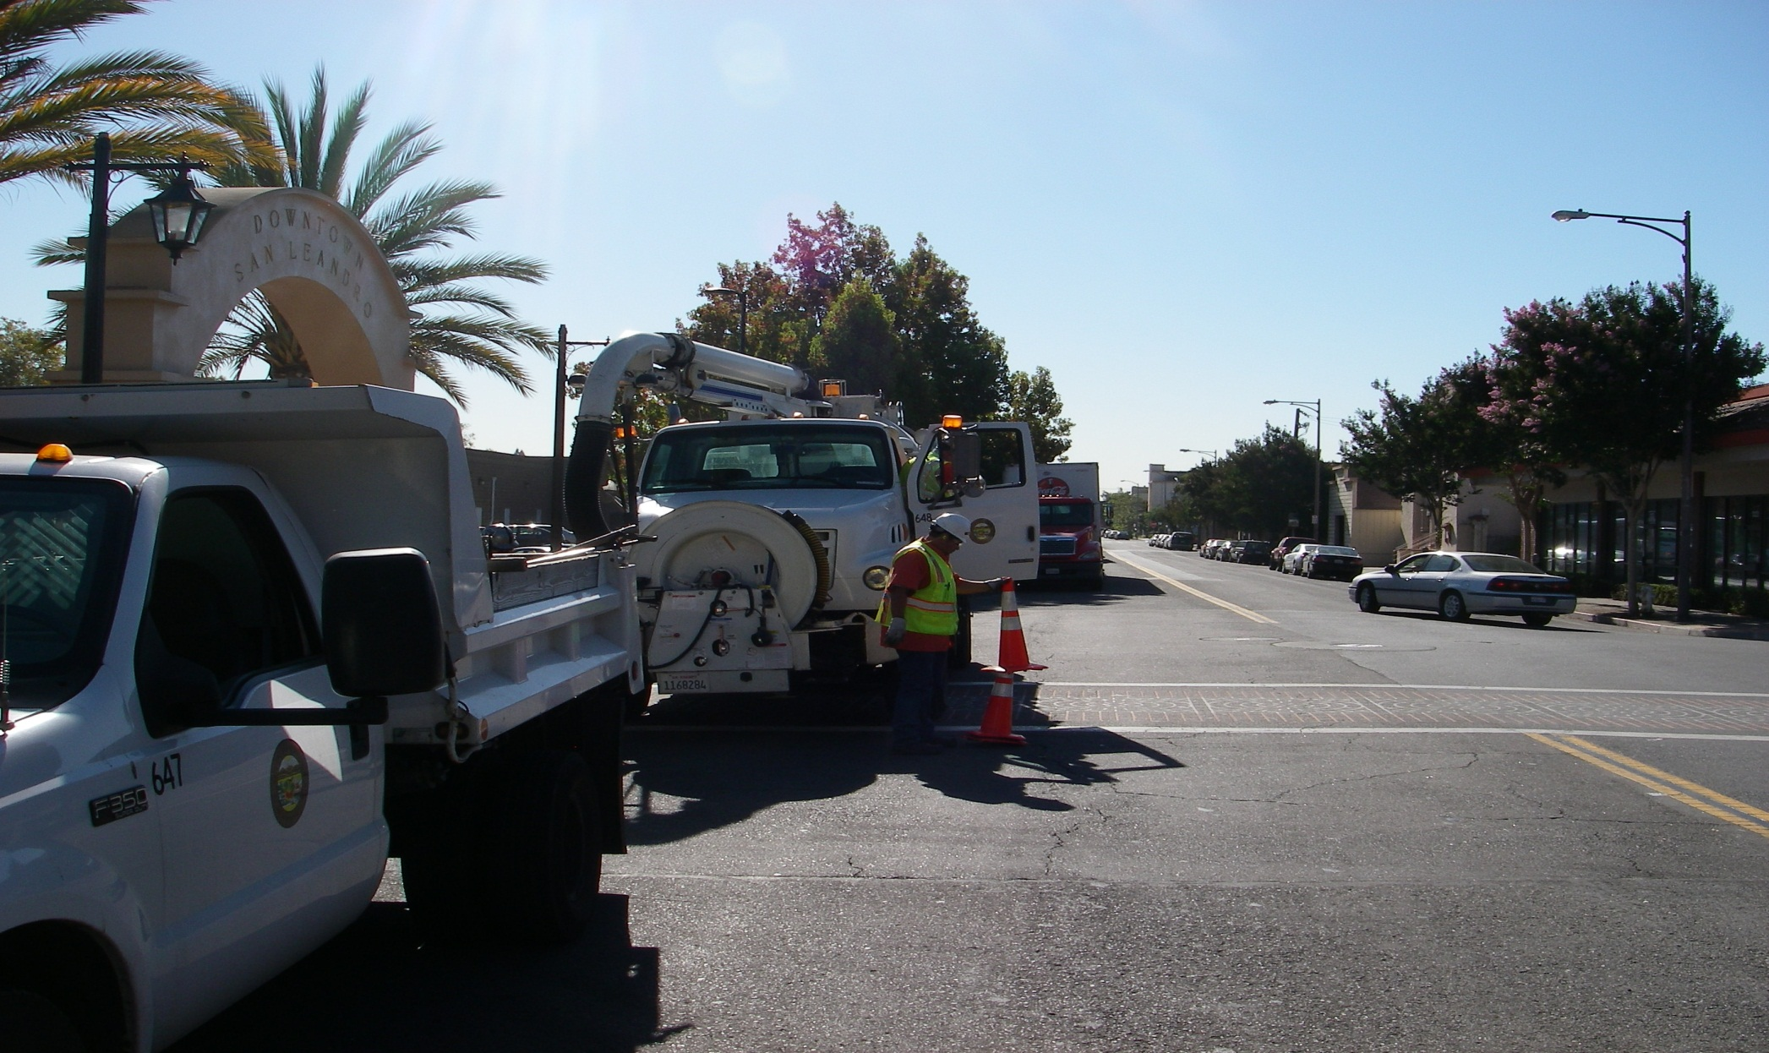
Equipment Used

Slide 8
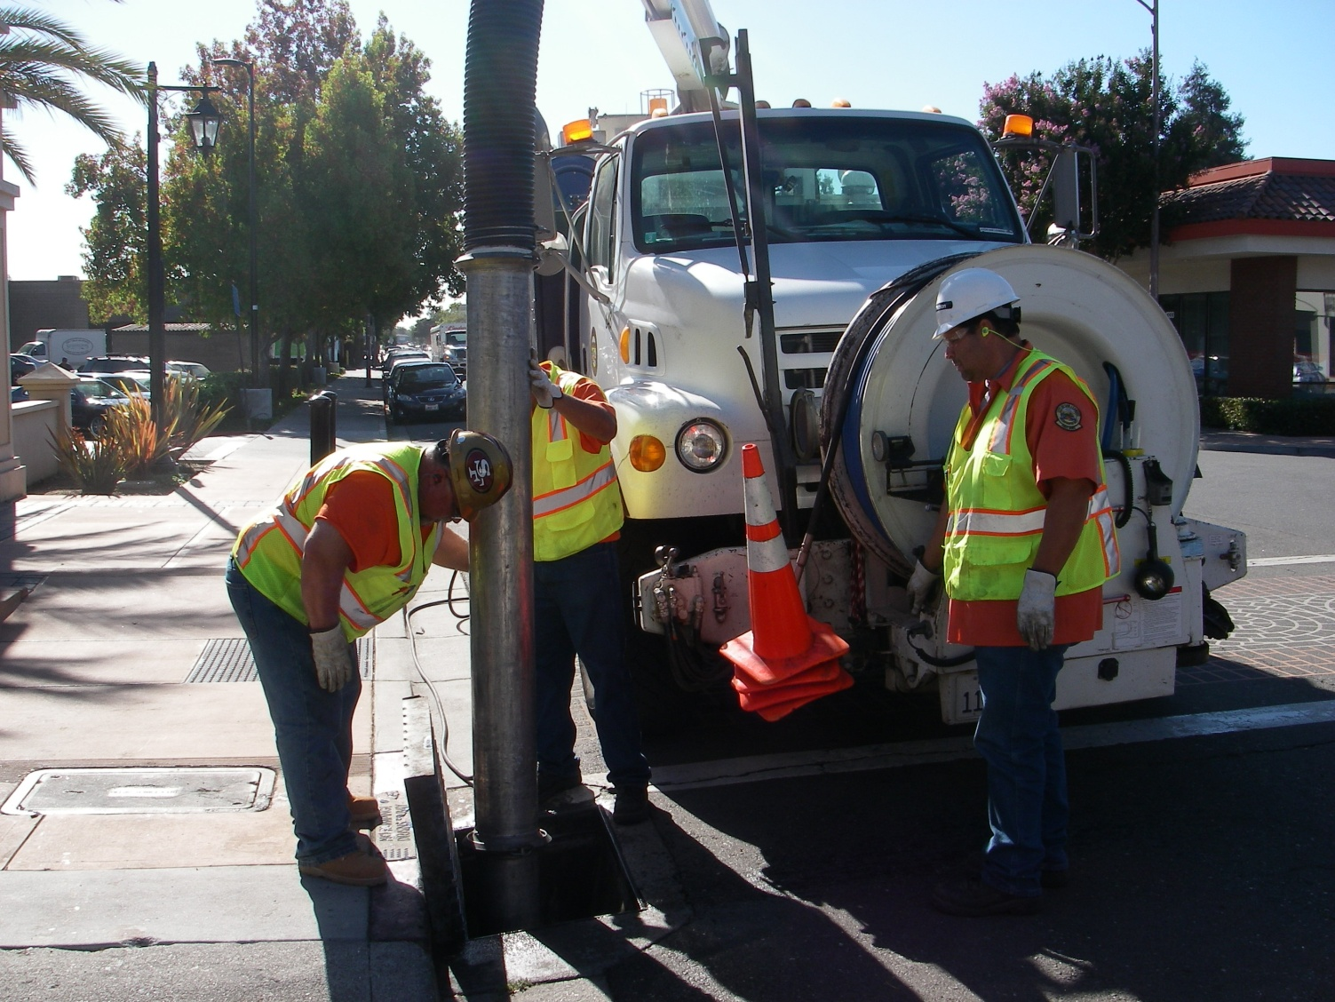
Maintenance Crew

Slide 9
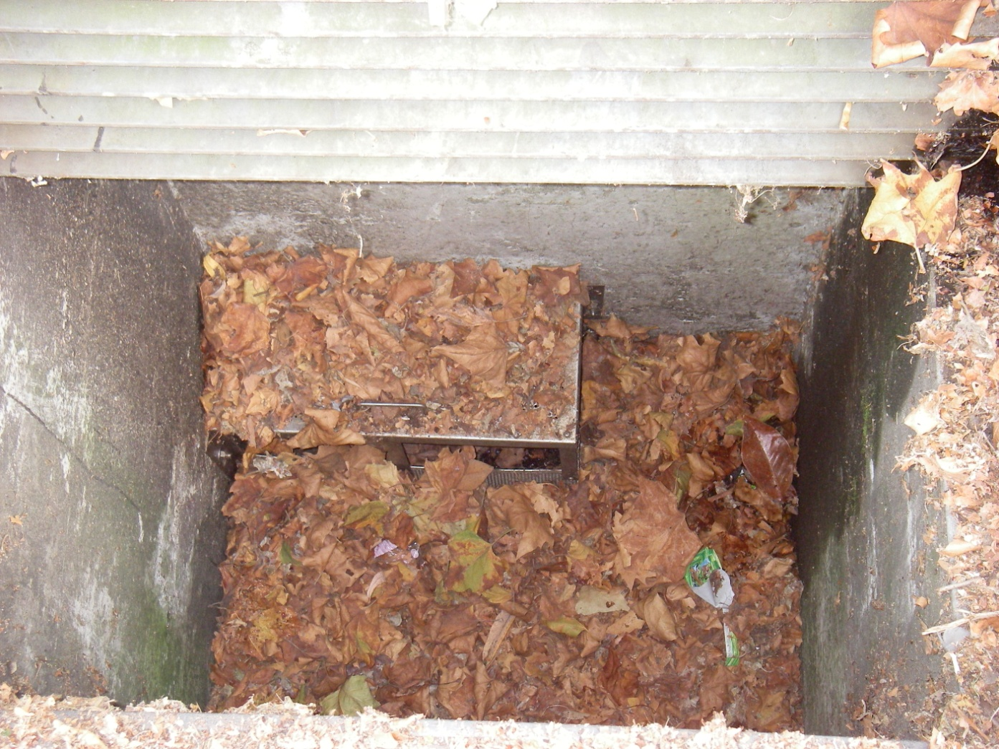
Estimate Debris / Trash

Slide 10
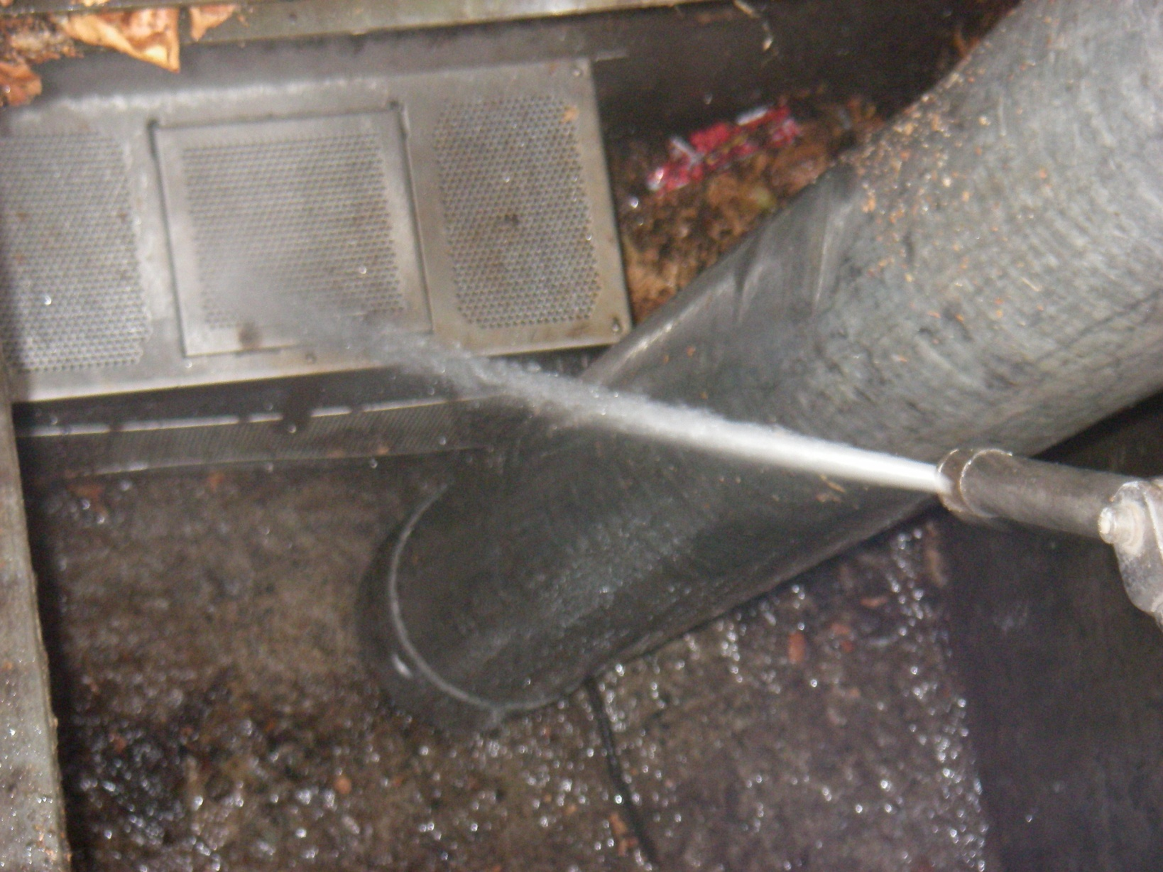
Cleaning

Slide 11
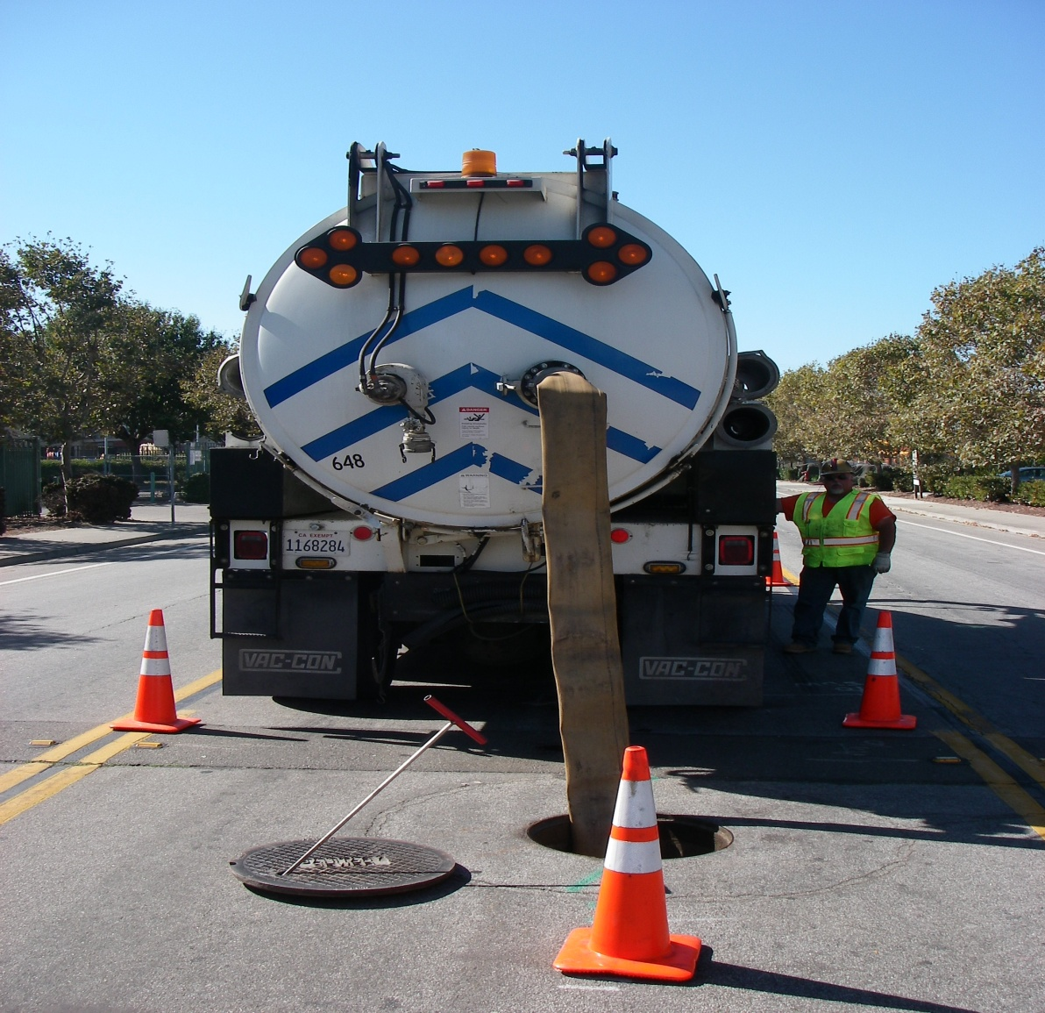
Decant Water

Slide 12
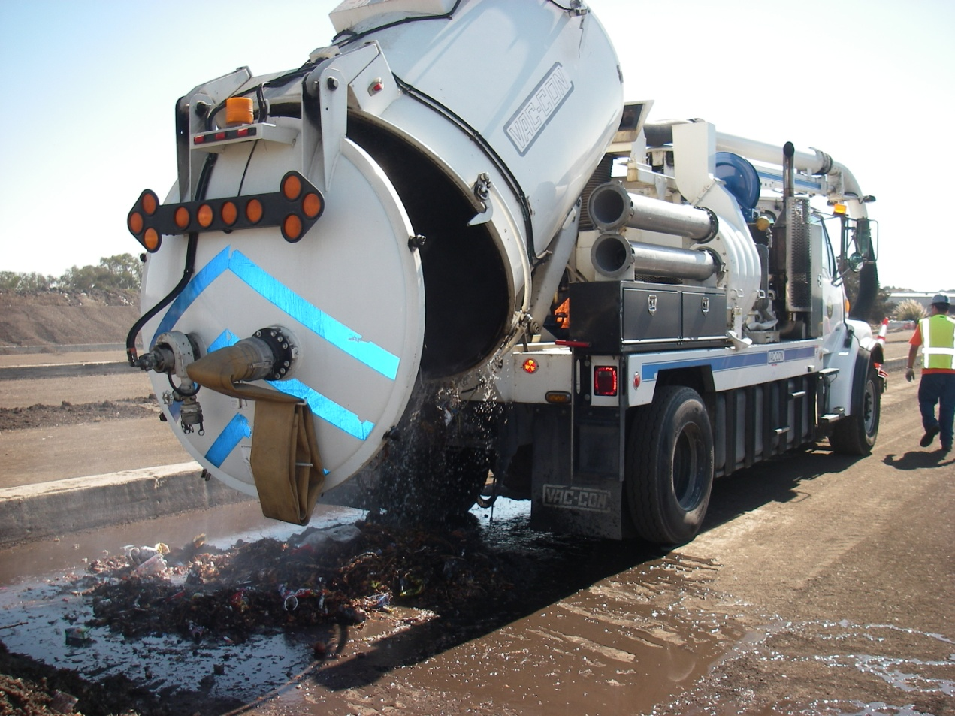
Designate a Dumpsite

Slide 13
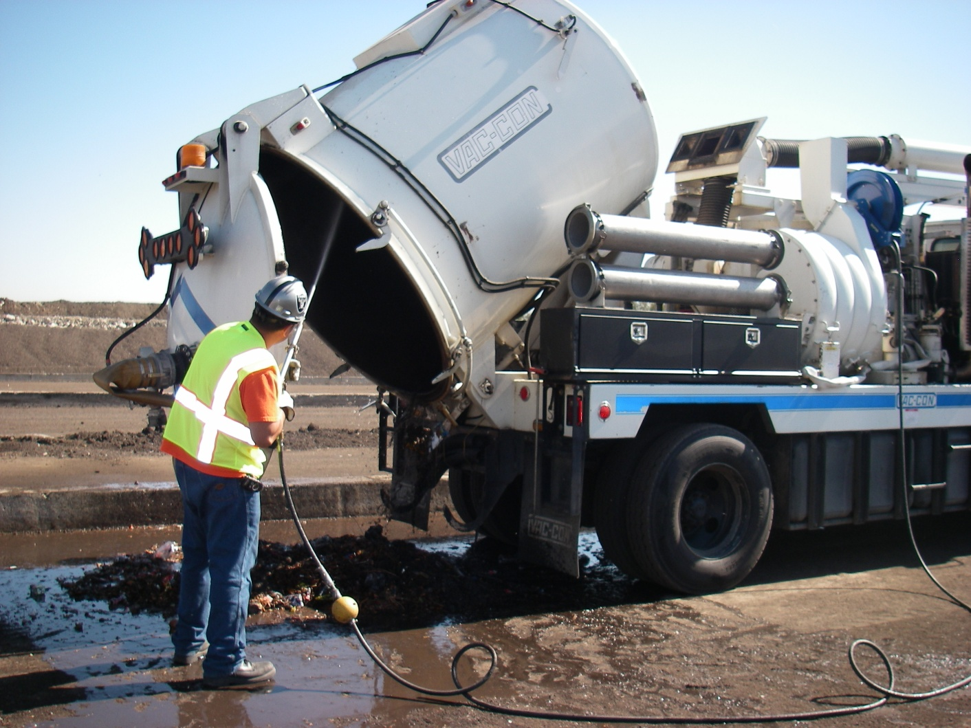

Slide 14
Estimate Total Load

Slide 15
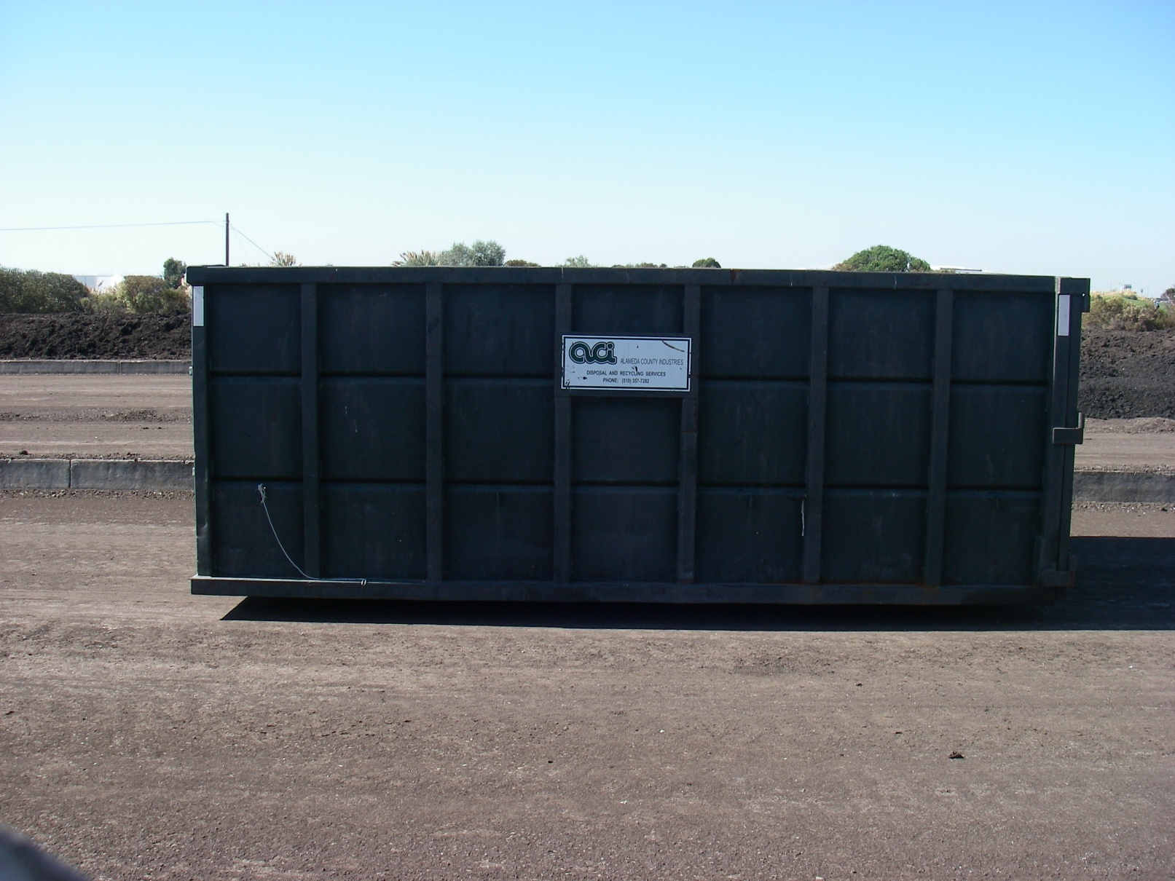
Trash Hauling

Slide 16
Lessons Learned

Slide 17
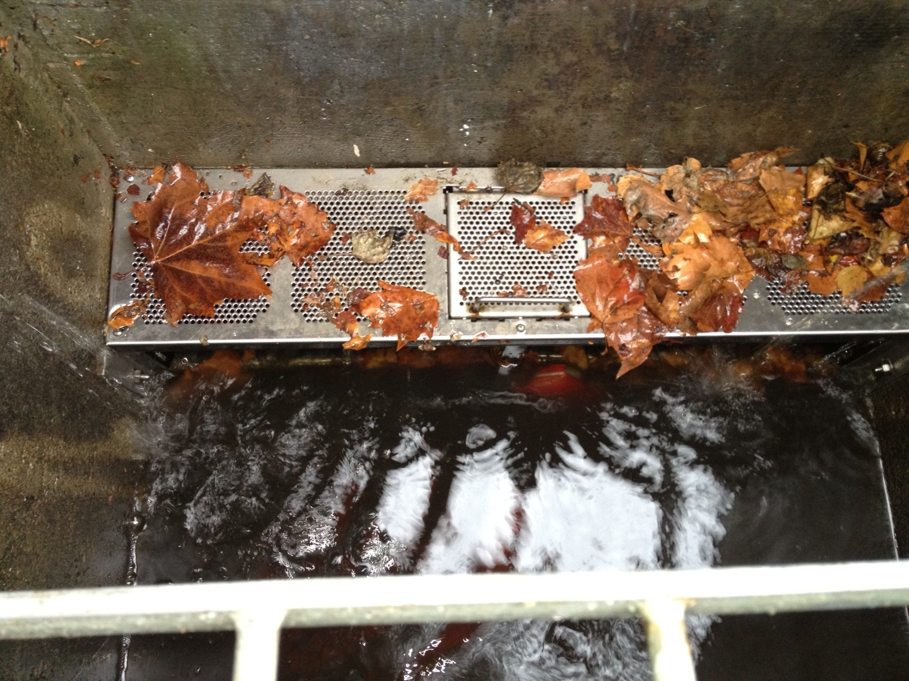
FULL TCD

Slide 18
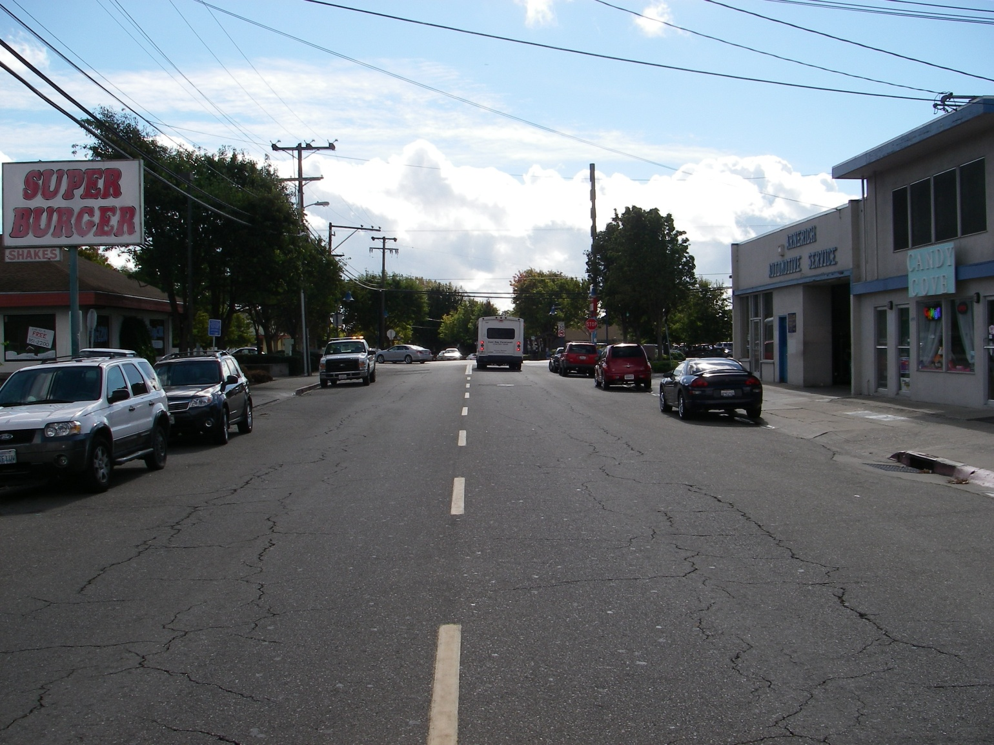

Slide 19
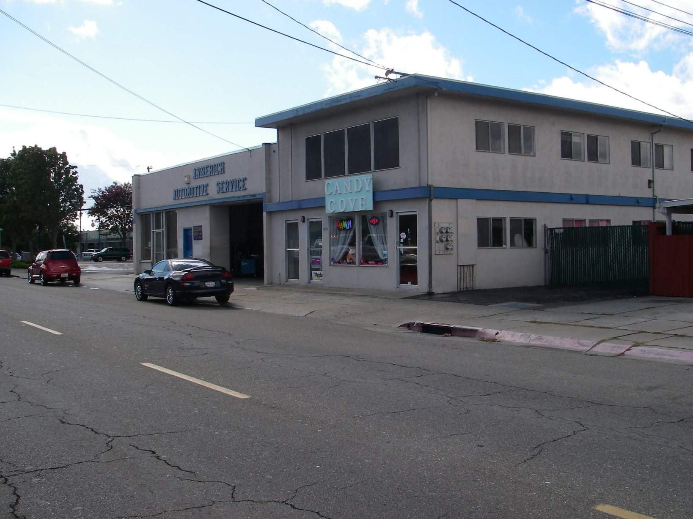

Slide 20
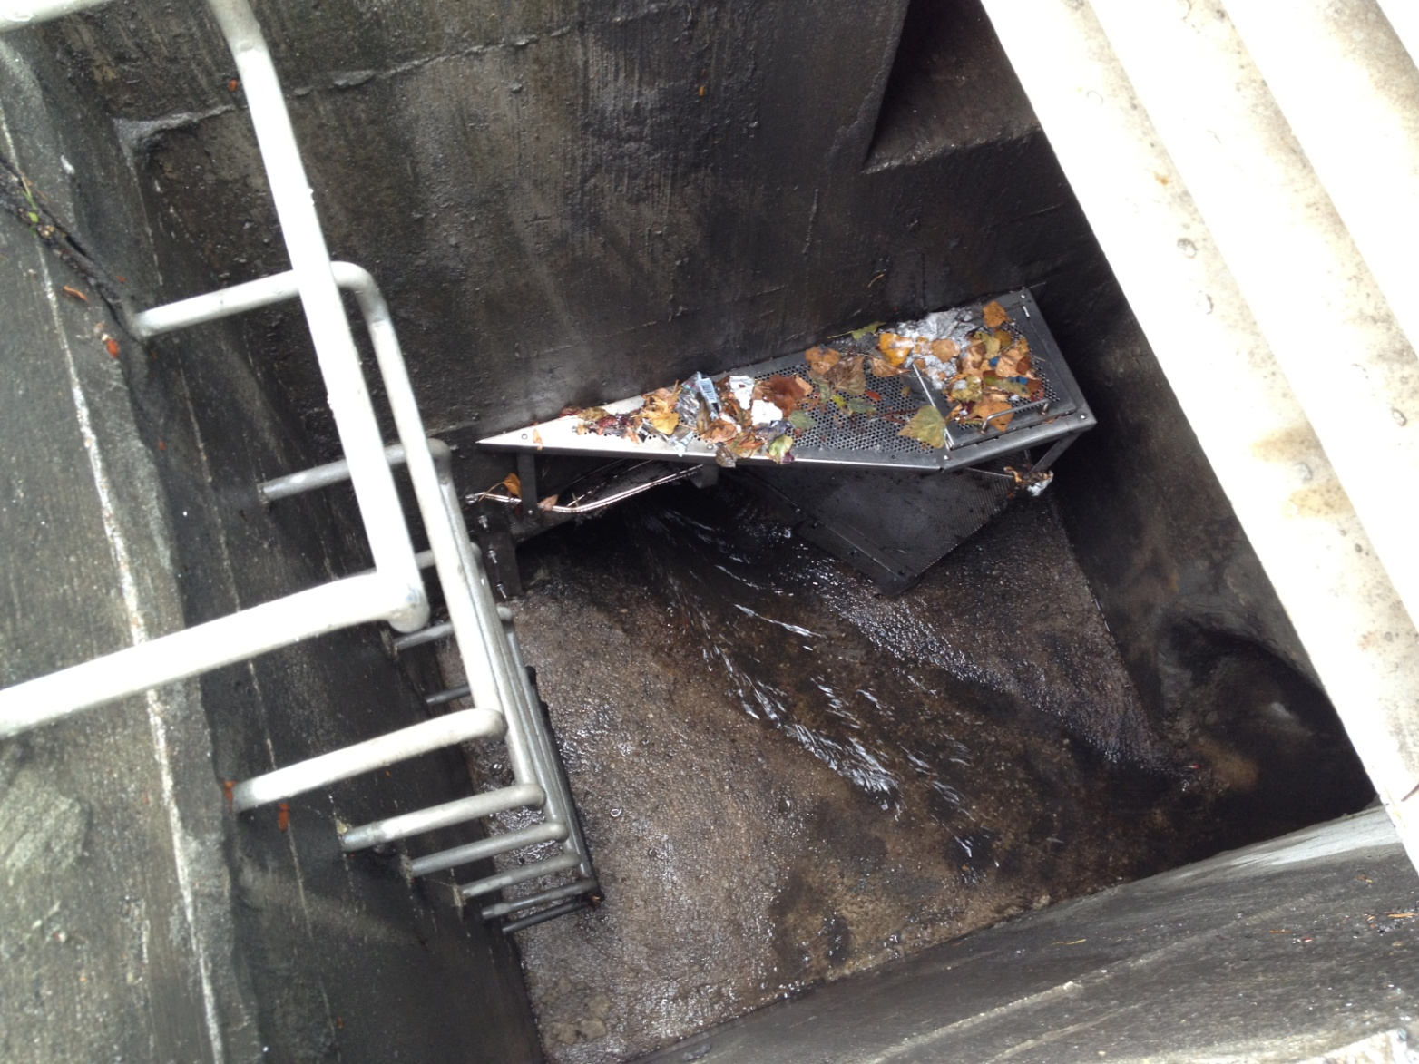
Too Much Volume

Slide 21
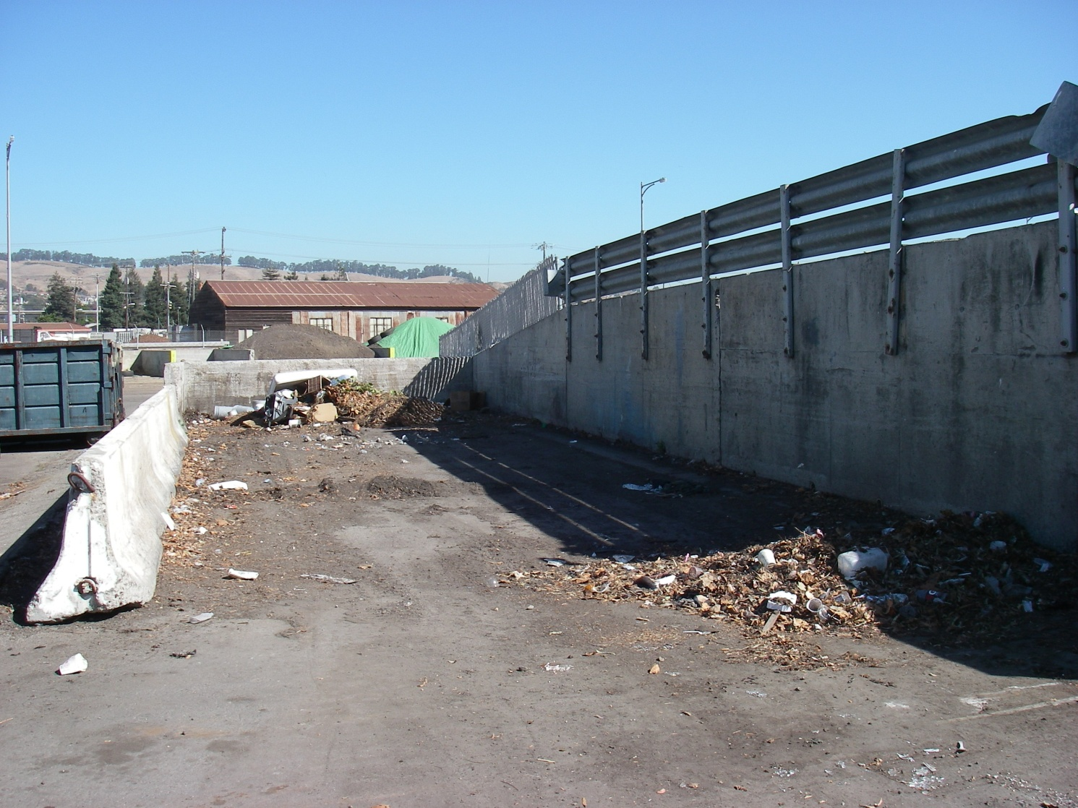
Choose The Right Dump Site

Slide 22
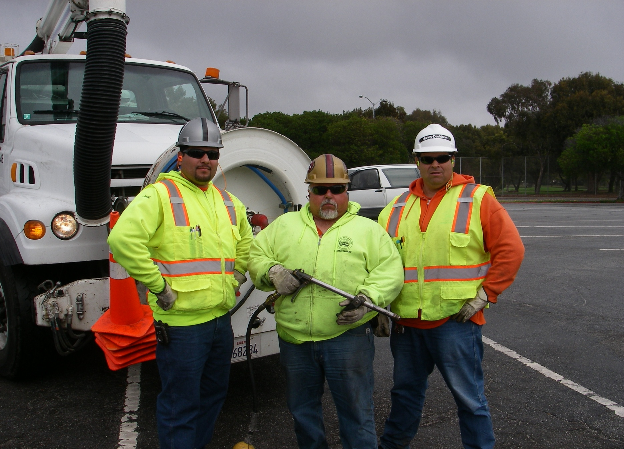
Bad Ass Crew

