Slide 1
Trash Capture Device Installations
Municipal Maintenance Stormwater Workshop
Kevin McGillicuddy, P.G.
Roscoe Moss Company

Slide 2
Topics
Large scale screen device design criteria
Installation Examples
Maintenance Practices

Slide 3
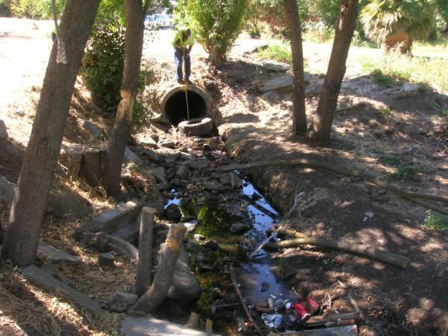
Screen Design Criteria
Site Selection
Provide adequate access for installation
and
future maintenance events

Slide 4
Screen Design Criteria
Target Flow Calculator
Peak flow (Q) determined using formula Q = C * I * A
C = runoff coefficient : 0.8
I = 1 yr-1 hr rainfall intensity : 0.5 in/hr
A = tributary drainage area : 150 acres
Q = Target Flow = : 60.1 cu.ft/sec
Bypass System Must be Designed to Transfer Flows Above Target Flow Rate

Slide 5
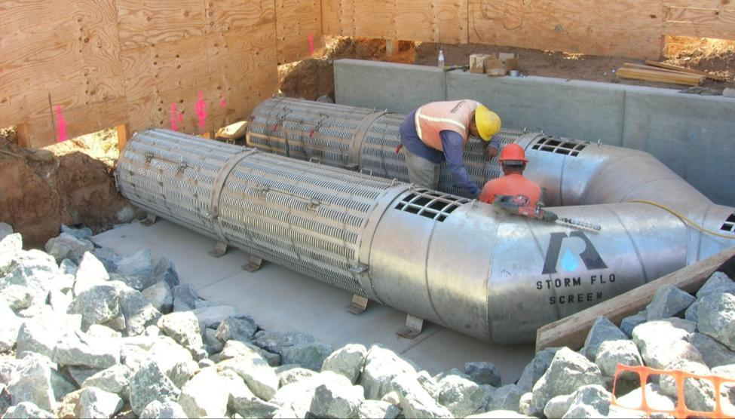
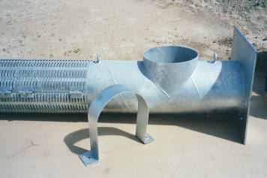
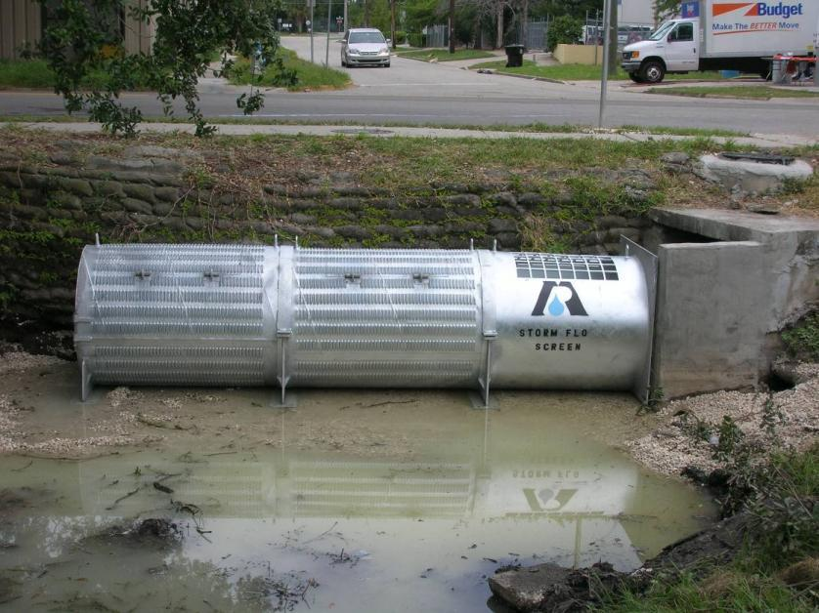
Overflow Bypass Sections

Slide 6
Screen Design Criteria
Device Size
Requires determination of diameter and length
Diameter: - match outfall dimensions
- flow line of treated storm event
Length: - as required to treat target flow with debris in place
- capacity to hold captured debris between cleaning events

Slide 7
Screen Configuration Options
Single linear configuration
Parallel multi-screen configuration

Slide 8
Screen Configuration Options
Single linear configuration
Parallel multi-screen configuration

Slide 9
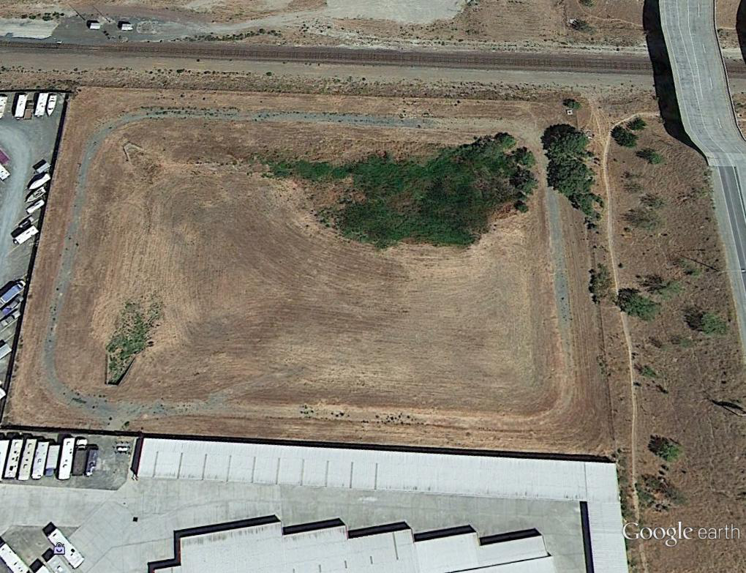
City of Antioch
Detention basin area – 6 acres
Drainage area: 200 acres
Target flow: 60 cfs

Slide 10
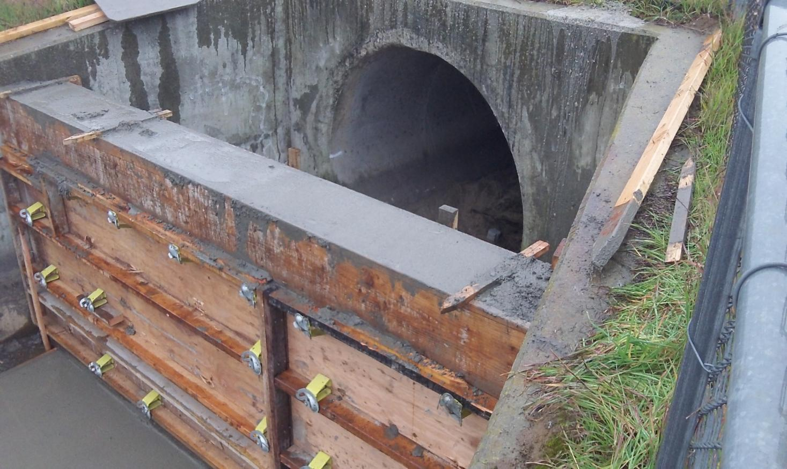

Slide 11
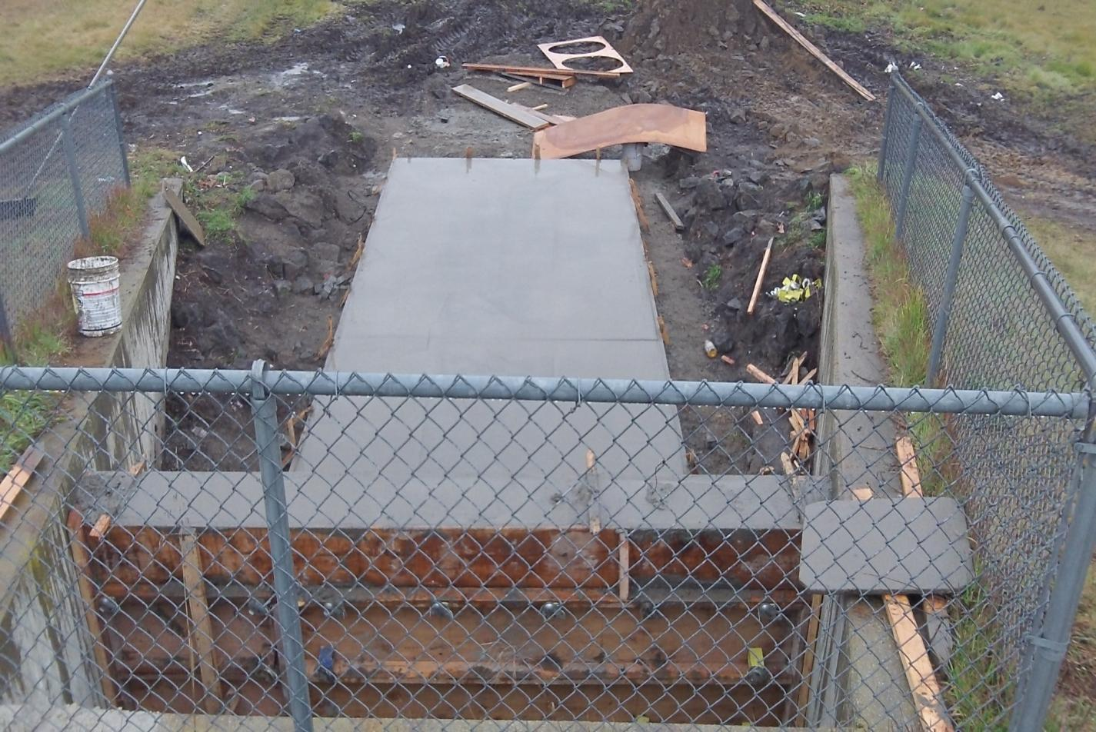

Slide 12
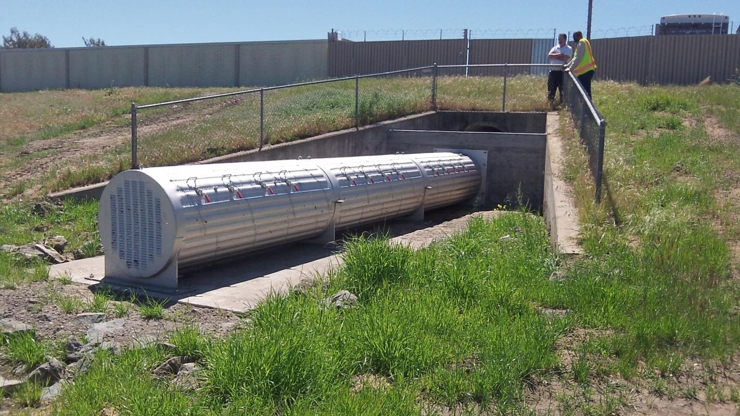
30 ft – 42 in dia screen
Treatment capacity 60 cfs up when ¼ full

Slide 13
Brentwood, CA 15 ft – 48 in screen, treatment capacity 23.4 cfs when ½ full

Slide 14
Pittsburg, CA 50 ft - 36in screen, treatment capacity 55 cfs when 1/2full

Slide 15
Milpitas, CA combination radial , semi-circular, and flat panels
30 ft – 42 in screen
Treatment capacity 60 cfs when ½ full

Slide 16
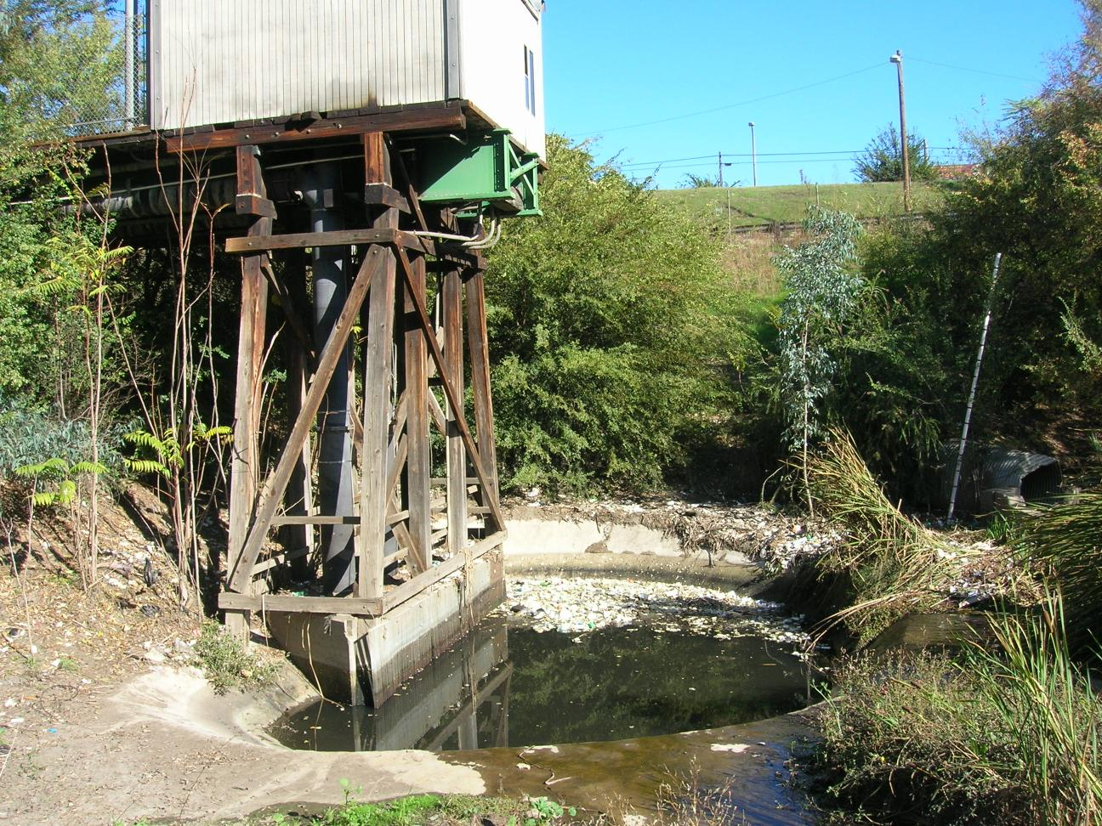

Slide 17
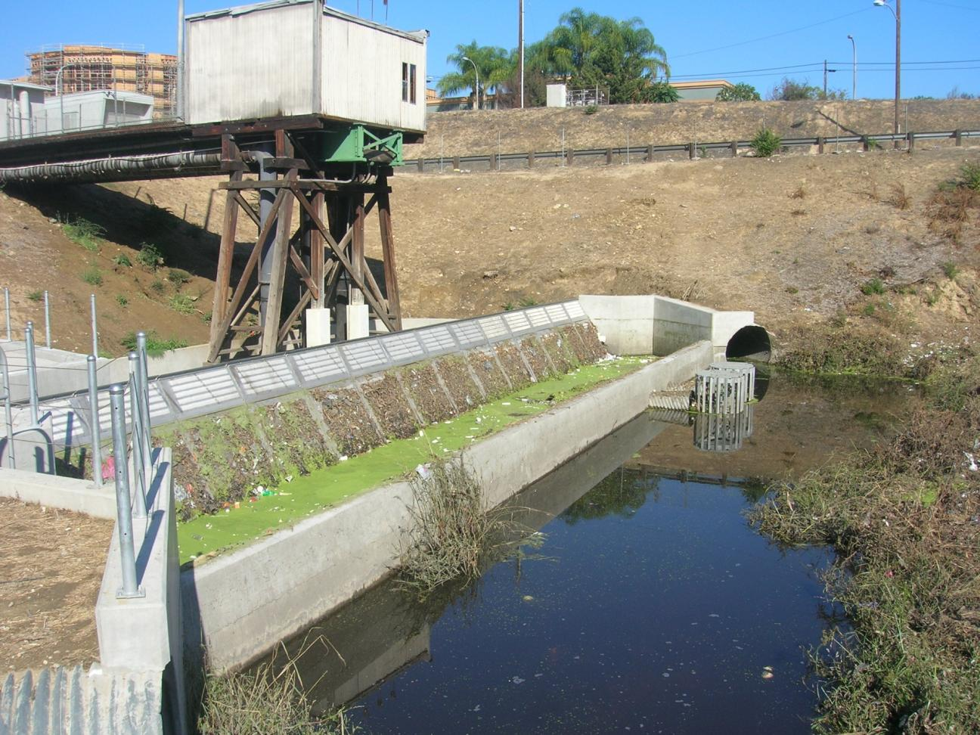

Slide 18
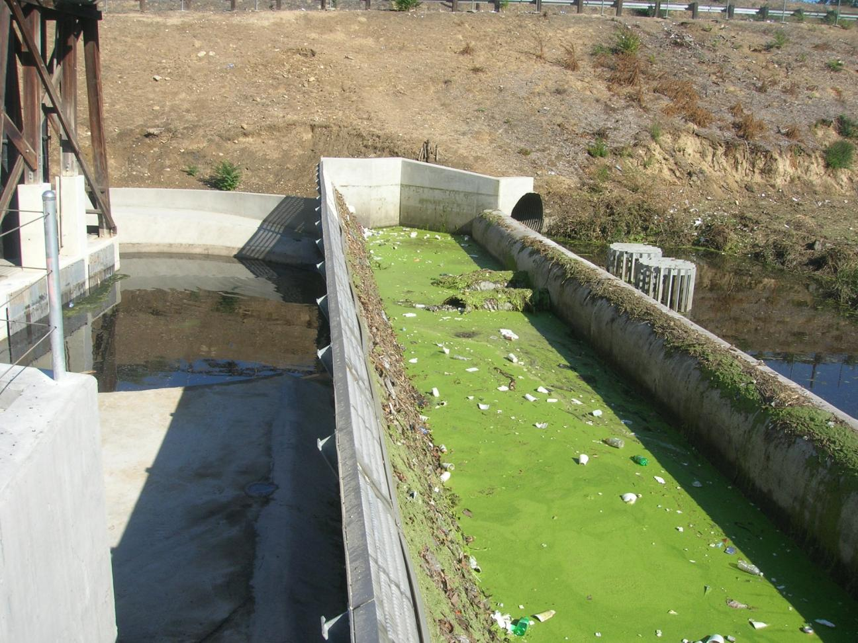

Slide 19
Maintenance Procedures

Slide 20
Video

Slide 21
Questions ?
Please Contact :
Kevin McGillicuddy
Roscoe Moss Company
4360 Worth Street
Los Angeles, CA 90063
Tel: (323) 263-4111
www.roscoemoss.com
Email:kmc@roscoemoss.com

