Slide 1

Curb Inlet Screens
Why curb inlet screens
Different styles
How they work
The Good and Bad
Burlingame's New Capture Device Marker

Slide 2
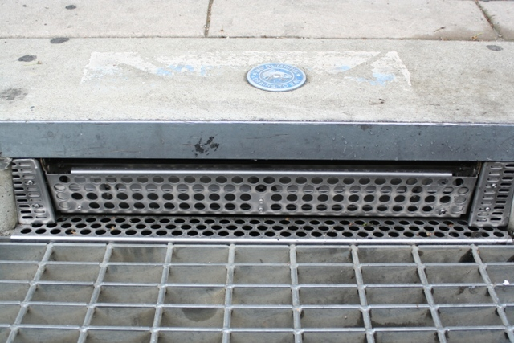
Automatic Retractable Screen

Slide 3
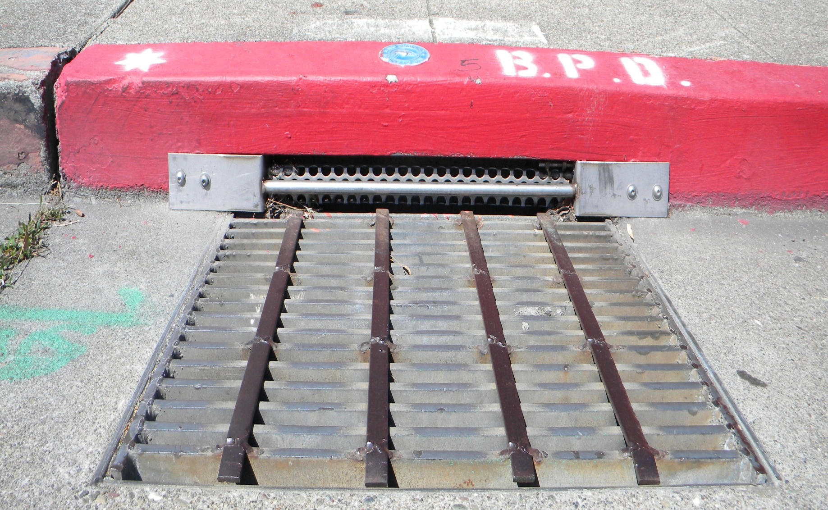
Manual Retractable Screen

Slide 4
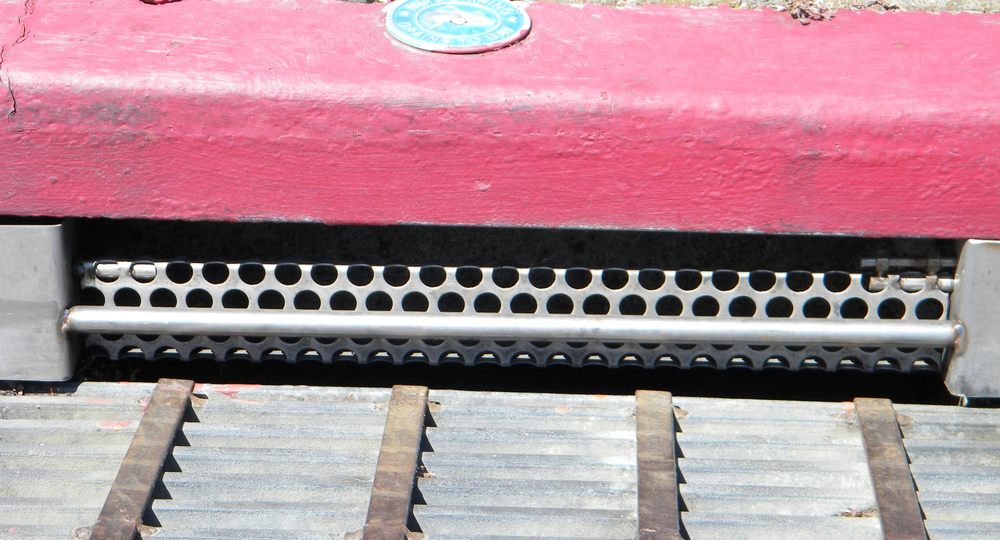
Gaps Top & Bottom of Screen

Slide 5
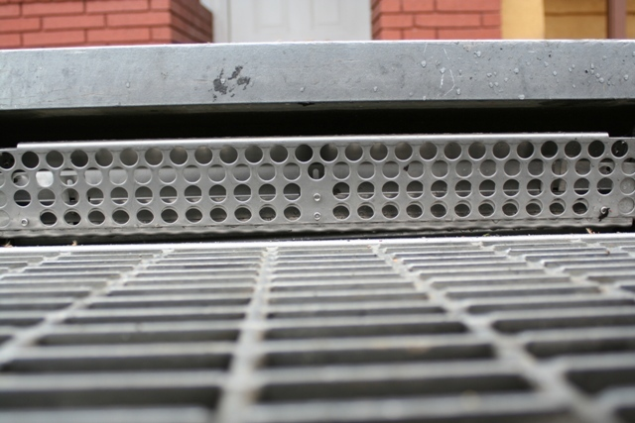
Gap only on Top of Screen

Slide 6
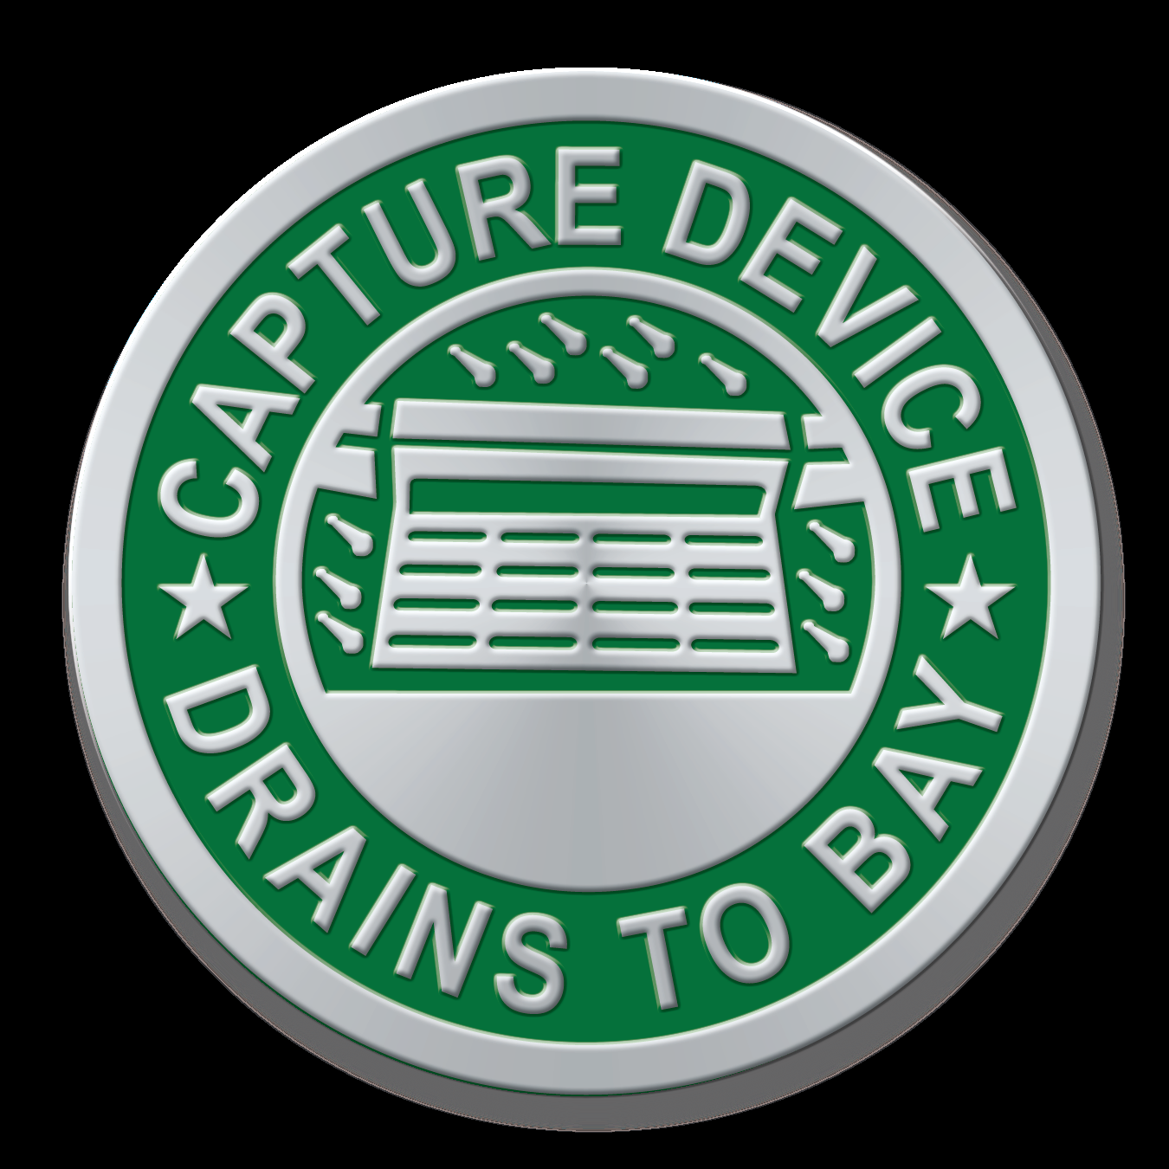

Burlingame’s New Capture Device Markers
Markers Contact Info:
Kim Redmond
Inside Sales Manager
Midwest & Western Region
Almetek Industries
PH: 908-850-9700 x 114
FX: 908-850-9618
www.almetek.com

Slide 7

Food for Thought

